Slide 1
Customizing the Occlusion Rims & Establishing Maxillomandibular Relations
Rola M. Shadid, BDS, MSc

Slide 2
Procedures Carried Out During Jaw Relation Appointment
Establishing the labial form of rims
Establishing the occlusal plane
Establishing vertical jaw relation
Establishing & recording of centric jaw relation
Facebow transfer (will be discussed in lab.)
Selection of artificial teeth

Slide 3
Record Base Stability & Retention
Required for record making and phonetic tests
Ensure that the rim is well adapted
Alternating finger pressure on both sides of each rim should not elicit rocking
Inaccurate if loose
Use denture adhesive if slightly loose
Pronounced looseness - REMAKE

Slide 4
Record Base Retention
Causes of Poor Retention
Poor adaptation of resin to cast (particularly from the posterior border and palate) during polymerization.
Over- or under-extension
Excessive block-out

Slide 5
Establishing The Labial Form Of Maxillary Occlusion Rim
Aimed at establishing the anteroposterior position of the anterior teeth & the esthetics of the lips & face
The operator uses the following guides:
1. Facial esthetics
2. Phonetic guidelines *
3. Incisive papilla guide: On average, the facial surface of the central incisors should be approximately 8-10 mm anterior to a line drawn perpendicular to the palatal midline, passing trough the distal aspect of the incisive papilla
Notes:
*The antero-posterior location of the incisal point can be determined by asking the patient to say a word containing a fricative consonant, e.g. ‘fish’. The incisal point should correspond to the posterior part of the lower lip

Slide 6
Establishing The Labial Form Of Maxillary Occlusion Rim Using “Facial Esthetics”
Facial esthetics as a guide:
Fullness of the upper lip
The philtrum
The nasolabial fold
Commissures of the mouth*
Notes:
* If there is lowering or drooping of the corners of the mouth, add more wax to labial surface.
If the corners of mouth appear stretched outward, remove wax from labial surface until features assume normal appearance

Slide 7
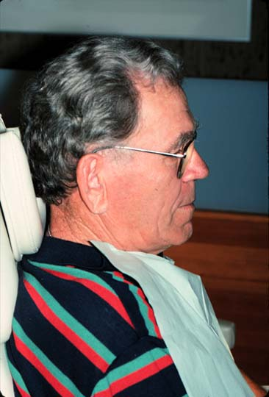
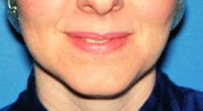
Establishing The Labial Form Of Maxillary Occlusion Rim Using “Facial Esthetics”
Lips should be unstrained
Naso-labial angle ≈ 90°
Philtrum depressed
Vermilion border * showing
Notes:
*The area of the external lips where the red mucous membrane ends and normal outside skin of the face begins is known as the vermilion border

Slide 8
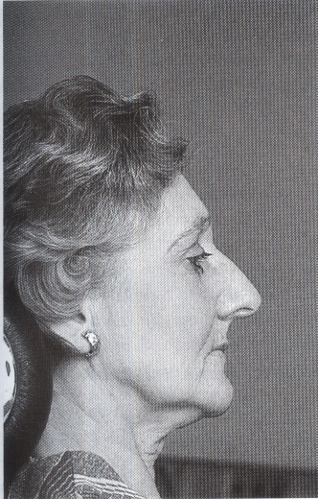
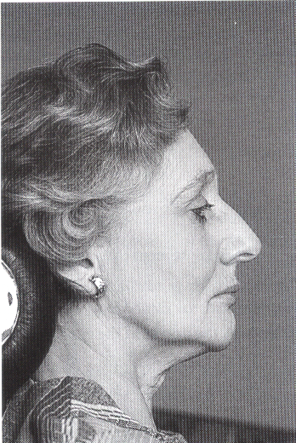

Slide 9
The Buccal Corridor *
Excessive buccal corridor results in dark space which appear unesthetic
Inadequate buccal corridor
Notes:
Buccal corridor: the space between buccal surface of posterior teeth and inner surface of cheeks. The buccolingual positioning of occlusion rim should permit an appropriate buccal corridor

Slide 10
Establishing Level & Inclination of Occlusal Plane *
Establishing occlusal plane using the maxillary occclusion rim
Establishing occlusal plane using the mandibular occclusion rim
Notes:
*Aims:
To establish the superoinferior position of teeth in relation to basal bone
To determine level & slant of occlusal plane

Slide 11
Establishing Occlusal Plane Using the Maxillary Occclusion Rim
The anterior height & inclination of the upper occlusion rim
Incisal visibility
Interpupillary line
The posterior height & inclination of the upper occlusion rim
Ala-tragus line (Camper’s line) ¤
Stensen’s duct
Notes:
¤ A line running from the inferior border of the ala of the nose to some defined point on the tragus of the
ear, usually considered to be the tip of the tragus.

Slide 12
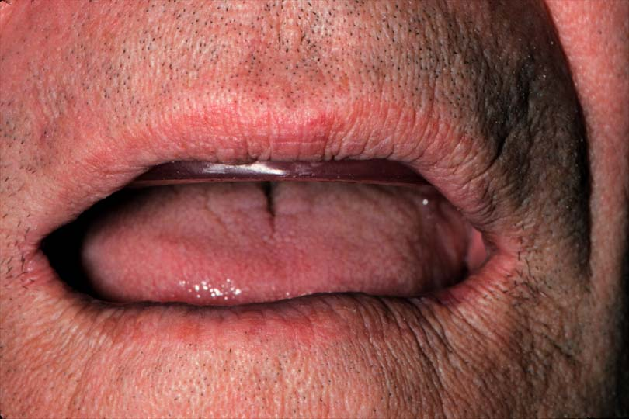
Maxillary Occlusion Rim Adjustment
Anterior height 1-2 mm below the lip at rest/when the patient slightly smiles

Slide 13
Maxillary Occlusion Rim Adjustment
Touches wet line of lower lip when ‘F’ or ‘V’ sounds
Count ‘50-60’

Slide 14
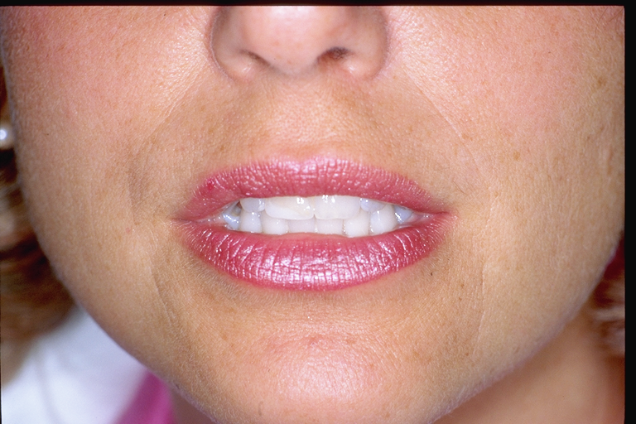
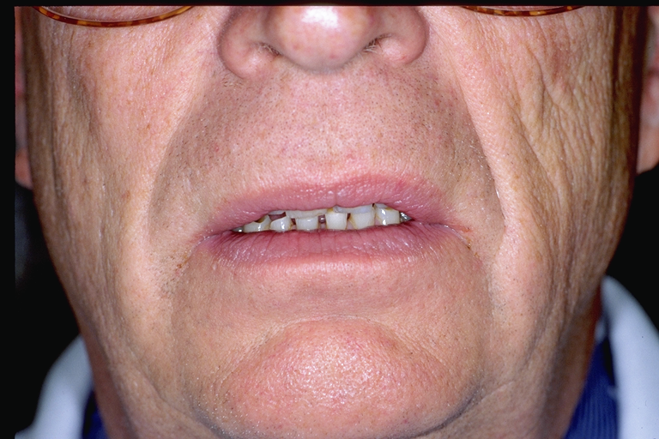
Wax rim/tooth display can be adjusted with sex, age, and lip (Journal of prosthetic dntistry 1978).
Lip Length
Incisal Display
10-20mm | 3-4mm
20-25mm | 2mm
26-30mm | 1mm
>30mm | 0
Sex & Age
Female Male
Young +2 +1
Middle +1 0
Old 0 -1

Slide 15
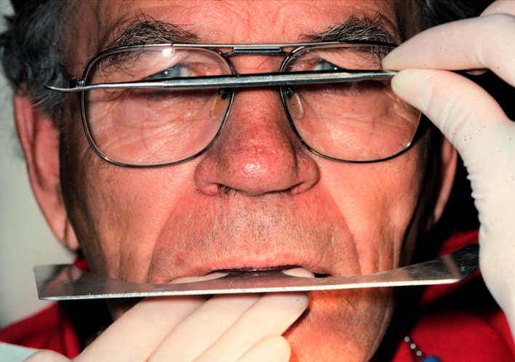
Maxillary Occlusion Rim Adjustment
Mediolaterally the anterior portion of occlusal plane * parallels the interpupillary line
Fox plane can be used
Notes:
*1: the average plane established by the incisal and occlusal surfaces of the teeth. Generally, it is not a plane but represents the planar mean of the curvature of these surfaces 2: the surface of wax occlusion rims contoured to guide in the arrangement of denture teeth

Slide 16
Maxillary Occlusion Rim Adjustment
The anterior-posterior orientation of occlusal plane parallel to the ala-tragus line (Camper’s line)

Slide 17
Maxillary Occlusion Rim Adjustment
Stensen’s duct can be used as a guide, the posterior occlusal plane is levelled at about quarter inch below Stensen’s duct

Slide 18
Once the occlusal height of one of occlusion rims is established, the vertical height of opposing rim is adjusted to provide for an interocclusal distance (ID) of 2-4 mm. Then the lower rim is leveled such that it meets the upper rim evenly

Slide 19
Establishing Occlusal Plane Using the Mandibular Occclusion Rim
Anterior height
Posterior height

Slide 20
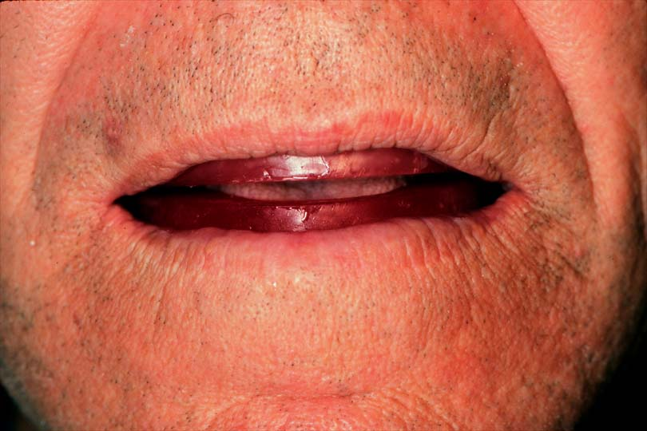
Mandibular Occlusion Rim Adjustment
Anterior height even with the corners of the mouth when jaws are at rest & the lip is slightly parted

Slide 21
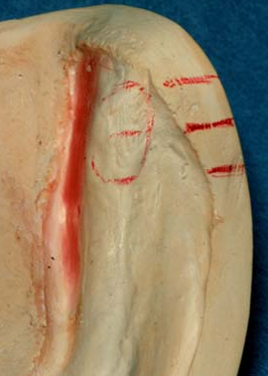
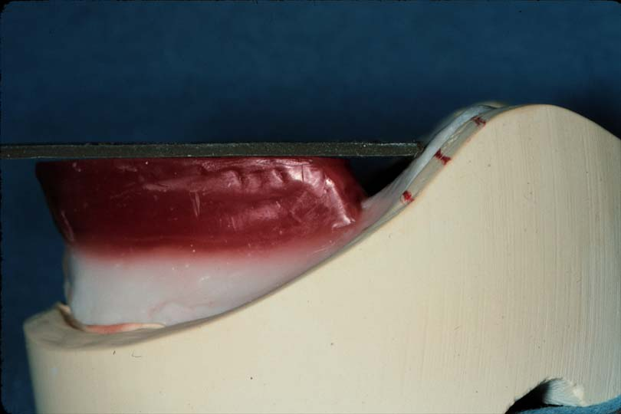
Mandibular Occlusion Rim Adjustment
Posteriorly, the occlusion rim intersects 1/2 - 2/3 up the retromolar pad *
Notes:
If occlusal plane is placed too low, this leads to tongue biting during function
If occlusal planed is placed higher than this, patient will struggle to move his tongue on occlusal surfaces of teeth to bring food bolus, this leads to fatique of tongue

Slide 22
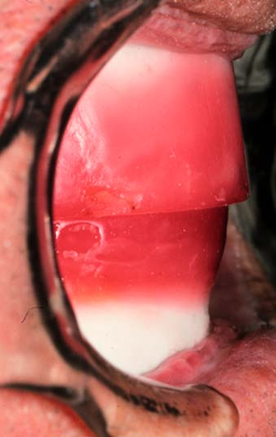
Mandibular Occlusion Rim Adjustment
1-2 mm horizontal overjet in anterior & posterior in centric position *
Notes:
* Insufficient overjet will lead to cheek biting

Slide 23
Mandibular Occlusion Rim Adjustment
Unstrained lips
Vermilion border showing

Slide 24
Once the occlusal height of one of occlusion rims is established, the vertical height of opposing rim is adjusted to provide for an interocclusal distance (ID) of 2-4 mm. Then the opposing rim is leveled such that it meets the another rim evenly

Slide 25
Establishing Jaw Relation
Vertical relation *
Horizontal relation
Notes:
* Vertical relations determine the amount of separation between the two jaws and has to be established correctly for the proper comfort, health and function of the mouth

Slide 26
Establishing Occlusal Vertical Dimension (OVD)

Slide 27
Methods* of Assessment of OVD
Measuring the physiologic rest position (PRP)
Feeling for interocclusal distance (ID) by ensuring movement of mandible
Phonetics as a guide
Esthetics as a guide
Reference to previous dentures
Preextraction records
Notes:
Many methods have been proposed but yet none are accurate. So, use more than one method to clinically establish the correct OVD. The first four methods are used at the same time to establish OVD.

Slide 28
Methods of Assessment of OVD
Measuring the PRP *
PRP = ID + OVD
Notes:
*The PRP is recorded to provide a point of reference from which the occlusal vertical dimension of the dentures can be calculated by subtracting approximately 3 mm for the freeway space.
The patient must be completely relaxed & sitting bolt upright.

Slide 29
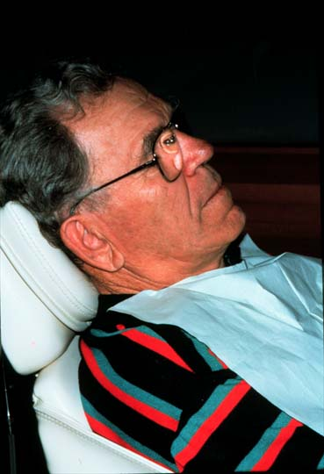
Patient sitting bolt upright
PRP affected by posture

Slide 30
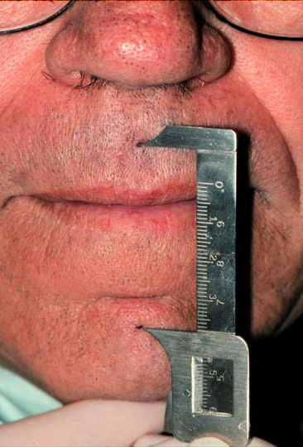
Measurements
OVD & PRP
Use external points for ease of measurement
Small dots under columella & mid-symphisis
Use Boley Gauge, not ruler

Slide 31
Measuring
Physiologic Rest Postion (PRP)
Open and close until lips barely touch - Physiologic Rest Position (PRP)
Measure distance between dots

Slide 32
Measuring
Occlusal Vertical Dimension
Open and close until rims touch
Measure distance between dots (OVD)
Measurement will be different each appointment

Slide 33
Measuring OVD
Measure the distance between dots
  At PRP
  At OVD
  Difference is ID
Measurements change each day
(position of dots)

Slide 34
Adjust the vertical height of other rim ( will be the lower if you established the vertical height of upper) to provide for an interocclusal distance (ID) of 2-4 mm. Then the lower rim is leveled such that it meets the upper rim evenly

Slide 35
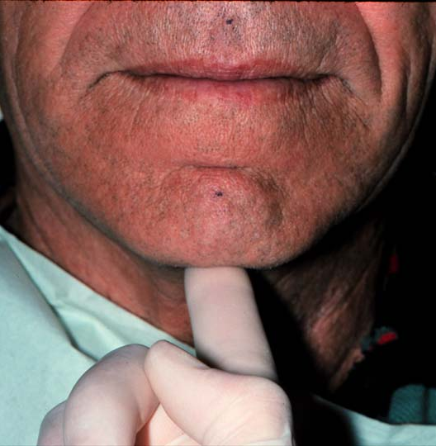
Methods of Assessment of OVD
2. Feeling for Interocclusal Distance by ensuring movement of mandible
Close until lips barely touch - PRP
Place finger on chin
Look away
Patient closes until rims touch (OVD)
Feel for movement of the mandible

Slide 36
Methods of Assessment of OVD
3. Using Phonetics As A Guide
m sound: patient repeats the letter m and the distance between two reference points are measured. The occlusion rims adjusted so that they are 2 to 4 mm short of this position when they are occluded
ch, sh, j, s, z sounds: at right vertical height there should should not be more or less than 1 to 2 mm space between upper & lower occlusion rims Closest speaking space *
Fricative sounds (f, v, ‘Fifty-Five’ , ask patient to count from 50 to 60) - upper incisal edges should JUST touch the posterior one third of the lower lip
Notes:
*The space between the anterior teeth that, according to Dr. Earl Pound, should not be more or less than 1 to 2 mm of clearance between the incisal edges of the teeth when the patient is unconsciously repeating the letter ‘‘S.’’

Slide 37
Methods of Assessment of OVD Using 4. Esthetics As A Guide
Assessment of facial proportion, expression & esthetics.
If the face appears strained, the OVD may be too much
If the corners of the mouth droop, making chin appear too close to nose, the OVD may be too less

Slide 38
Other Methods of Assessment of OVD
5. Reference to previous dentures ¶
6. Preextraction records (e.g., articulated casts £)
Notes:
¶ The former dentures can be measured between the borders of maxillary and mandibular dentures by Boley gauge
£ Measurements are made between stable landmarks with the teeth in occlusion e.g., between upper and lower freni

Slide 39
Establishing Occlusal Vertical Dimension
Check with the first four techniques to ensure acceptable OVD
No one technique 100% correct

Slide 40
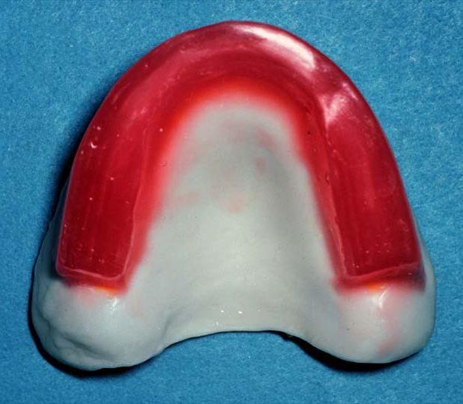
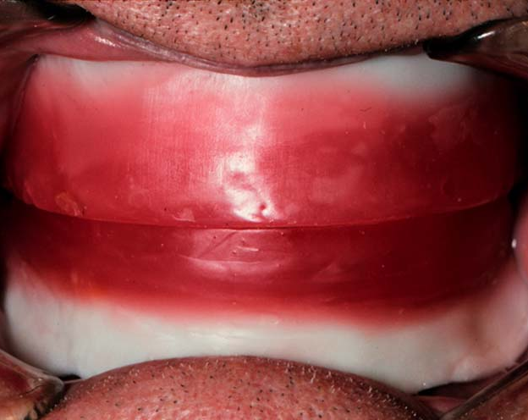
Wax Rim Adjustment at OVD
Flat even contact along entire occlusal surface
EXTREMELY CRITICAL
If uneven contact, patient may be forced into eccentric position

Slide 41
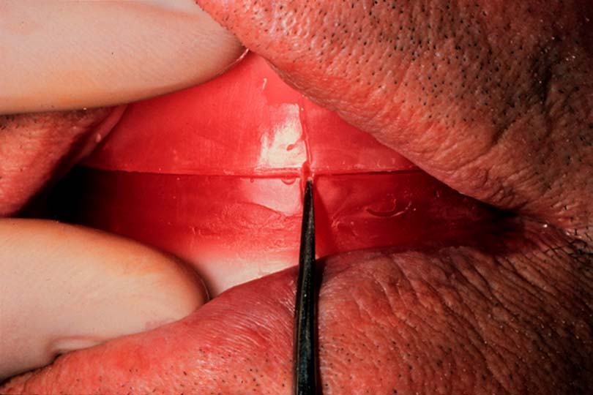
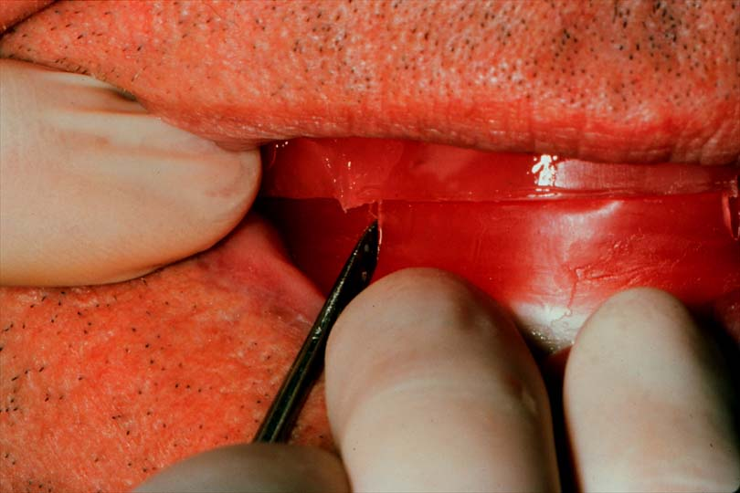
Eliminating Record Base or
Wax Rim Interferences
Patient in Centric Position
Scribe three widely separated lines between maxillary & mandibular rims

Slide 42
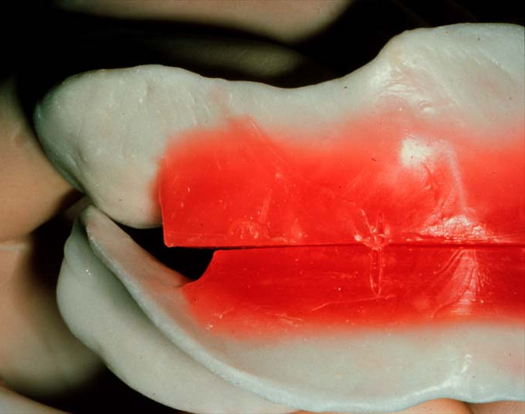
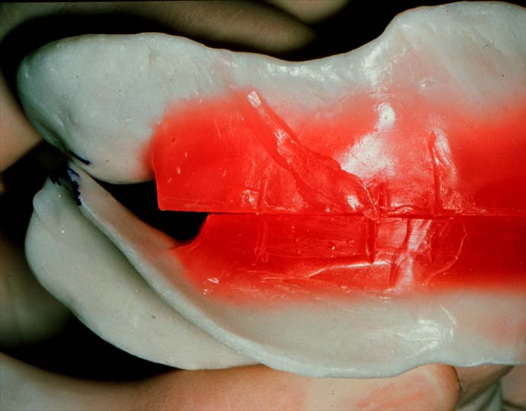
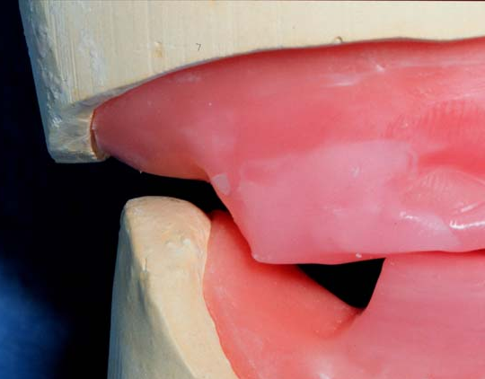
Establishing OVD
Remove, superimpose the lines
Eliminate contacts between record bases, record base/occlusion rims

Slide 43
Refer to “Occlusal Vertical Dimension” video

Slide 44
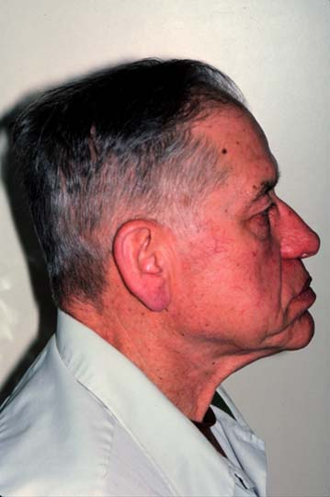
Effects Of Inadequate OVD
Decreased chewing efficiency (fatigue when chewing)
Cheek biting
Collapsed Appearance - chin too close to the nose
or protruding jaw, vermilion border reduced to a line
Angular cheilitis
TMJ pain, TMJ clicking
Costen’s syndrome due to prolonged overclosure

Slide 45

Effects Of Excessive OVD (Wax Rims Too High)
Discomfort and annoyance to patient
Trauma to underlying mucosa (sore spots)
Sore muscles
Rapid bone resorption
Dentures click during speech
Rapid wear of acrylic teeth
Strained appearance (elongated face)
Insufficient ID

Slide 46
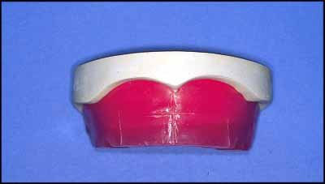
Scribing Guide Lines on Occlusion Rims *
Notes:
* Once occlusion rims are levelled to meet evenly at the correct OVD, guidelines are scribed on occlusion rims to aid in teeth selection, arrangement, and location of centric relation

Slide 47
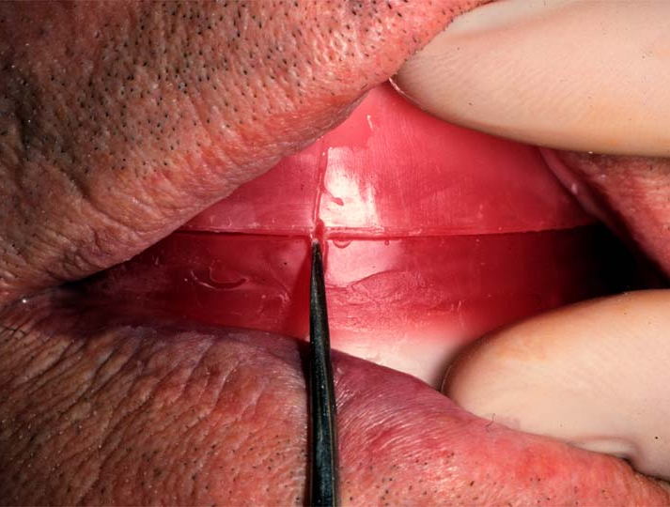
Scribing Guide Lines on Occlusion Rims (Midline)
Scribing midline: nasal septum , philtrum, or labial frenum as a guide
Ensure that these guides coincide with midline of face

Slide 48
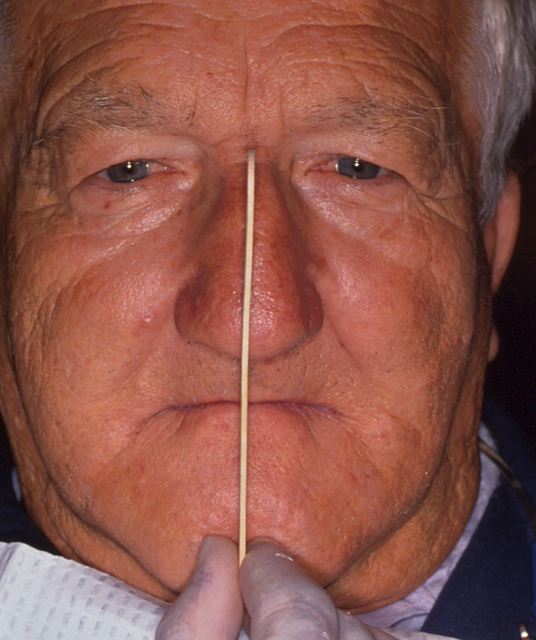
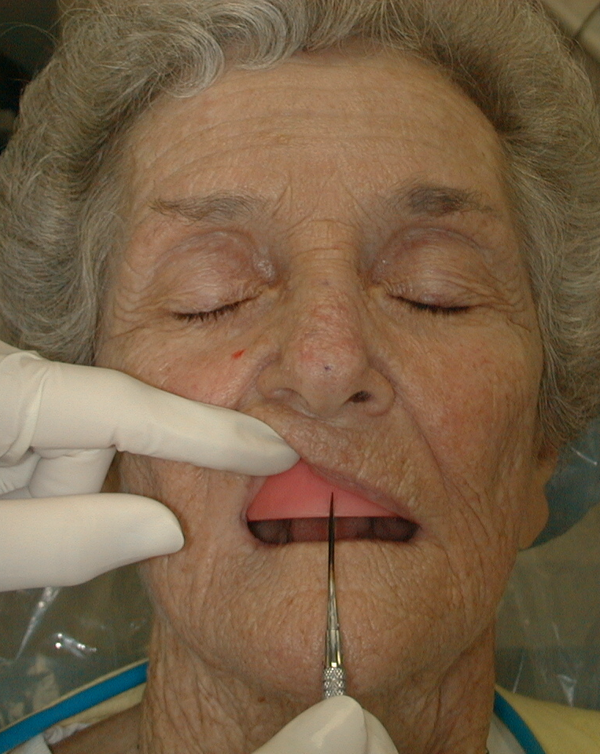
Midline of Teeth = Facial Midline
Mark midline on the wax

Slide 49
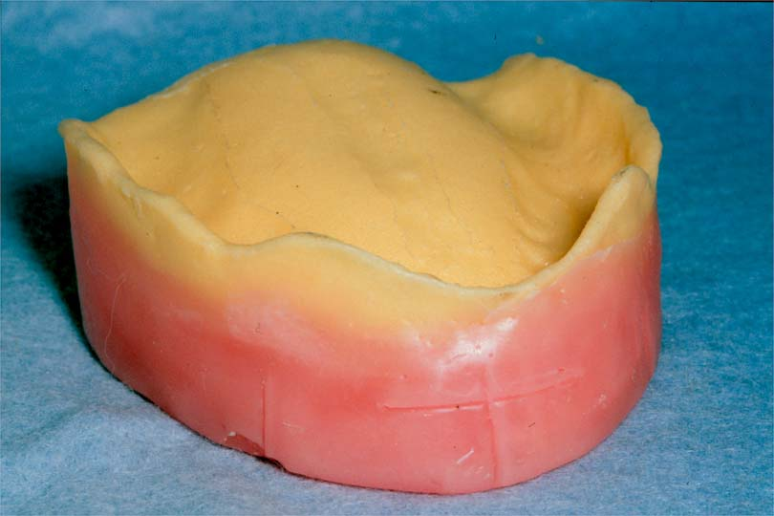
Scribing Guide Lines on Occlusion Rims (Canine Lines)
Corners of mouth at rest coincide with distal of canines
Or ala of nose coincides with canine cusp tip
To help in selection of width of anterior teeth

Slide 50
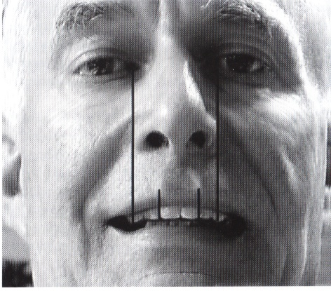
Ala of nose coincides with canine cusp tip

Slide 51
Scribing Guide Lines on Occlusion Rims (High Lip Line)
Scribing high lip line
Ask patient to smile & scribe a line horizontally marking the level of exposure of occlusion rim during smiling
Notes:
*

Slide 52
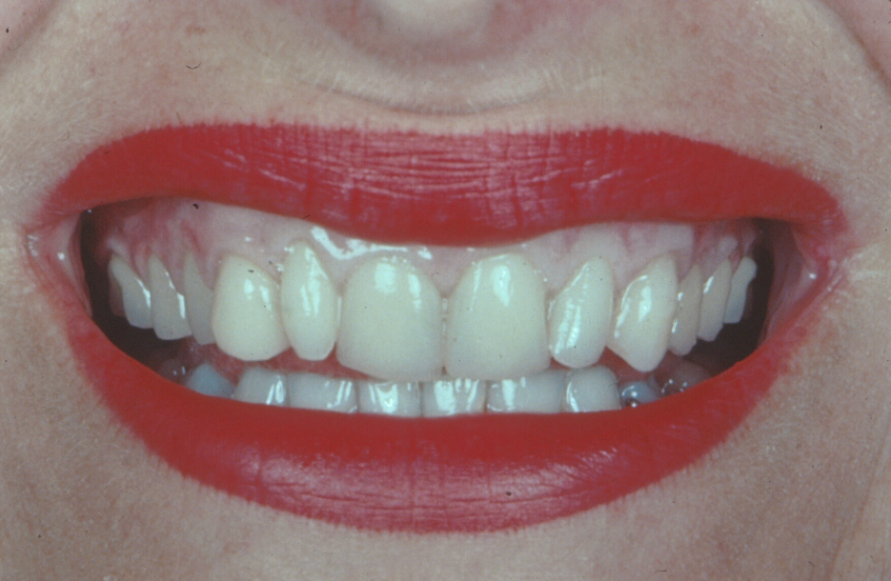
High Lip Line
Highest point of upper lip when smiling
Cervical necks lie at or above this line
If shorter teeth are selected, esthetics compromised

Slide 53
Horizontal Jaw Relation (Centric Relation Record)

Slide 54
Once OVD has been established, the clinician proceeds to establish the centric relation. It is classified as horizontal relation because variations from it occur in horizontal plane.

Slide 55
Centric Relation Record
Learned position
To obtain correct CR, you should train the patient many times before recording
Has some difficulties *
Notes:
Biologic difficulties due to lack of coordination between muscles, many edentulous patients tend to protrude the mandible, old denture wearers assume habitual eccentric positions due to wear of teeth or due to previous wrong centric record.
Mechanical difficulties, due to ill-fitting bases or due to some interferences between bases
Psychological difficulties

Slide 56
How To Obtain CR?
The Dawson method (bimanual manipulation) produces reasonably good results (the method of choice)
Giving instructions such as 'Close together slowly on your back teeth‘
Ask the patient to curl the tongue to the back of the mouth and to touch the posterior border of the upper record block while closing
Protrude and retrude the mandible repeatedly, while patient hold a finger lightly against chin
Swallow and close, disadvantage patient can swallow to slight eccentric positions also.

Slide 57
The Dawson Method (Bimanual Manipulation)
1. The patient should be placed in a slightly supine position
2. Put your index fingers on flanges of lower record block to aid in stabilizing the record bases, and thumbs under symphysis
3. Jiggle the lower jaw – the mandible should freely arc
4. Allow the patient to close the last portion
5. DO NOT PUSH THE MANDIBLE or dislodge the record base
6. The registration media must be dead soft , when the patient close into it

Slide 58
Procedure for Recording the CR (watch the video)
1. Place two sharp ‘V’-shaped notches in the wax in the premolar and molar areas of the maxillary and mandibular rims (1-2 mm deep). Make sure there are no undercuts in the rims or the ‘V’-shaped notches

Slide 59
2. Place the record blocks intraorally and guide patient into CR (by bimanual manipulation) without recording media. Train the patient several times before taking the record
3. Place a thin layer of elastomeric registration material over the entire arch of the mandibular rim.

Slide 60
4. Stabilize the mandibular record base using index fingers on the flange and the thumbs under the symphysis
5. Ask the patient to open, relax, and slowly close into CR

Slide 61
You should be able to gently arc the mandible in a hinge like motion - without translation of the mandible, without much splinting
The patient slowly closes, and the operator uses tactile input to ensure the mandible does not move suddenly forwards or to the side

Slide 62
6. The patient should close until the occlusion rims are almost touching (minimal closing pressure)
Ask the patient to stop as soon as this position has been reached, or as soon as they feel they are just barely touching the rims together.

Slide 63
7. Never instruct the patient to bite firmly - this can cause translation/ inaccuracy in the record.

Slide 64
8. Stabilize the patient’s mandible while the material sets (never make a record without keeping your hands in place - if you feel movement during setting, redo the record).

Slide 65
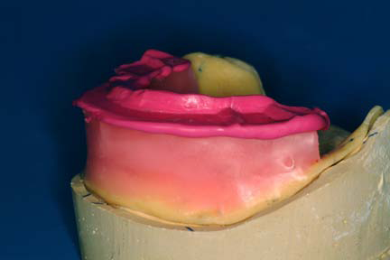
10. Reseat and ensure the record is repeatable. Make sure the record does not capture the sides of the occlusion rims. *
Notes:
*If it does, it will be difficult to confirm whether the record was taken at the CR position, because the portion of the registration capturing the sides of the rim will guide the patient into the same closure whenever they close – it will look repeatable only because the patient cannot close in any other position.

Slide 66
11. Do NOT mount the casts unless you can get full seating into the registration.
12. Place wax rims together, and lute them together with sticky wax - 4 spots between the wax rims
13. Immobilize your casts during mounting. If you mount your casts without immobilizing them, you can introduce occlusal discrepancy

Slide 67
14. Mix mounting plaster to creamy consistency - place on cast and ring - close articulator
15. Smooth the mounting plaster
16. The occlusal rims should be touching evenly, over the entire occlusal surface with no contact of the maxillary and mandibular casts or record bases. Only the occlusion rims should be contacting.

Slide 68
What Type of Registration Media to Use? *
Suitable materials include elastomeric bite registration material , zinc oxide-eugenol occlusal registration paste, quick setting plaster, or bite registration wax.
Elastomeric materials produce more accurate interocclusal records than wax.
Record the entire occlusal surface for stability
Notes:
*To locate the rims it is advisable to use a recording medium which initially is of low viscosity, thus offering little resistance to closure of the jaws but which subsequently hardens sufficiently, not to be distorted when the casts are mounted on the articulator (dimensionally stable) and has short setting time.

Slide 69
References
1. Dalhousie Continual education
2. Complete Denture Prosthodontics, 1st Edition, 2006 by John Joy Manappallil, Chapter 9

