Slide 1
Anatomy of Mandibular Denture Bearing Area
Rola M. Shadid, BDS, MSc

Slide 3
Anatomy of Supporting Structures
Crest of residual ridge
The mucous membrane covering the crest of residual ridge is similar to that of maxillary ridge, underlying bone is cancellous in nature, so considered as secondary stress-bearing area

Slide 4
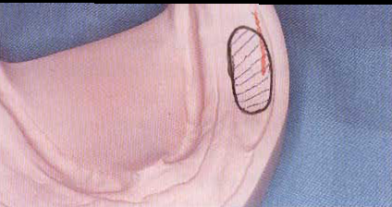
Buccal Shelf Area
The mucous membrane covering the buccal shelf area is loosely attached, less keratinized & contains thick submucosal layer.
Considered as a primary stress-bearing area because it is covered by a layer of cortical bone, & it lies at right angles to vertical occlusal forces

Slide 5
Buccal Shelf Area

Slide 6
Anatomical Features That Influence Shape of Supporting Structure
Mylohyoid ridge
Lingual tuberosity
Mental foramen
Genial tubercles
Torus mandibularis

Slide 7
Mylohyoid Ridge
The mylohyoid line is an irregular rough bony crest extending from 3rd molar to lower border of mandible in region of chin.
The lingual flange of mandibular denture should extend inferior but not lateral to mylohyoid line.
Notes:
If mylohyoid ridge is so prominent and sharp it becomes as fulcrum point, surgical intervention is indicated. Also, mucosa in this region is poorly keratinized and prone to trauma; so denture requires relief in this area.

Slide 8
Lingual tuberosity
The lingual tuberosity is an irregular area of bony prominance at the distal termination of the mylohyoid line.
Notes:
When this area is excessively prominent or rough, it may present an undesirable undercut area so sugically removed or rounded.

Slide 9
Mental Foramen
Located on lateral surface of mandible most commonly betw. 1st & 2nd bicuspid
If the loss of residual ridge is extensive, foramen occupies superior position and denture base should be relieved over the area to avoid numbness or paresthesia of lower lip.

Slide 10
Genial Tubercles
The genial tubercles or mental spines are situated on the lingual aspect of the mandibular body in the midline.
Notes:
When the loss of residual ridge is extensive, the spines are sometimes superior in position than the crest of ridge; so relief or surgical procedure is implicated.

Slide 11
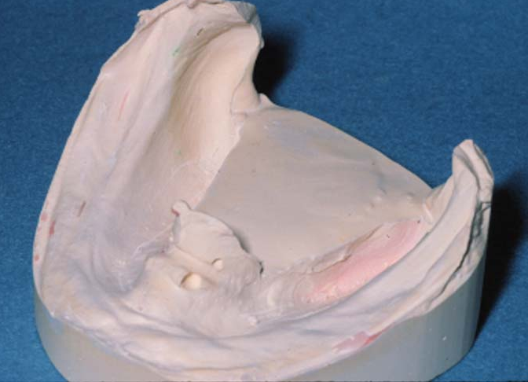
Genial Tubercles

Slide 12
Genial Tubercles
Correct
Incorrect

Slide 13
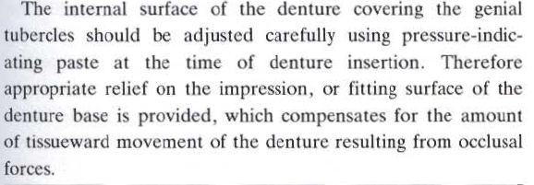

Slide 14
Torus Mandibularis

Slide 15
Anatomy of Limiting Structures
Labial vestibule
Buccal vestibule
Lingual border
Retromylohyoid fossa
Sublingual gland region
Alveololingual sulcus

Slide 16
Mandibular Anatomic Landmarks
A: mandibular labial notch
B: labial flange
C : mandibular buccal notch
D: buccal flange
E: area influenced by masseter
F: Retromolar pad area
G: lingual notch
H: premylohyoid eminence
I: retromylohyoid fossa

Slide 17
Labial Vestibule
Runs from labial f. to buccal f.
The labial f. helps attach the orbicularis oris muscle .
The mentalis attaches close to the crest of the ridge .
Mandibular dentures will always be narrowest in the anterior labial region
Notes:
When the patient opens wide, the orbicularis oris muscle becomes stretched narrowing the sulcus, so if the denture flange in this area is unnecessarily thick, displacemnt of denture will occur.

Slide 18
Buccal Vestibule
Extends from the buccal f. to the outside back corner of the retromolar pad
The buccal flange swings wide into the cheek & is nearly at right angles to the biting forces (widest in this region)
Its extent is influenced by the buccinator muscle

Slide 19
Buccal Vestibule
The denture should cover completely the buccal shelf & the fibers of buccinator attached to it.

Slide 20
Buccal Vestibule

Slide 21
Buccal Vestibule
The distobuccal border must converge rapidly to avoid displacement by the contracting masseter muscle (7)
The tension of masseter muscle will make a concavity in the distobuccal outline of the impression

Slide 22
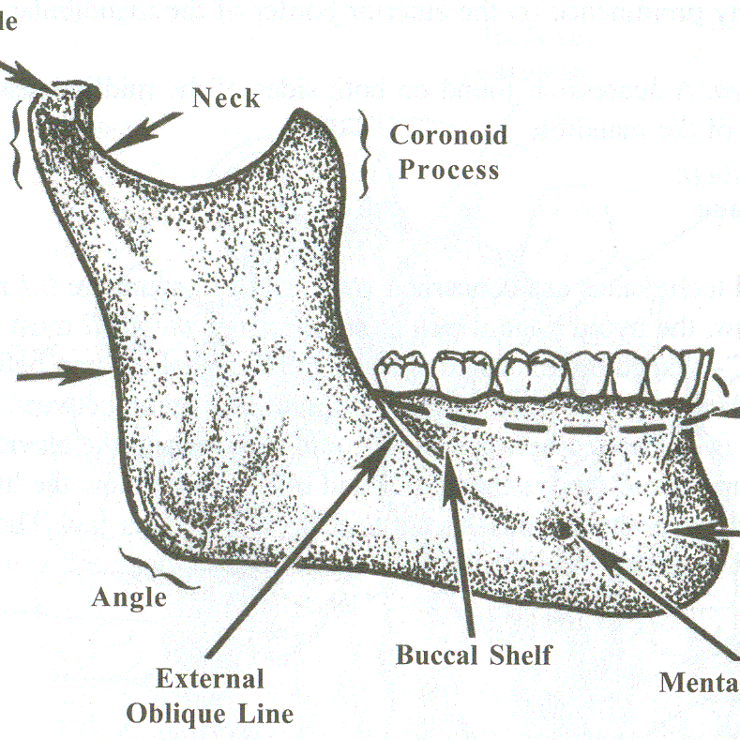
Buccal Vestibule
The external oblique ridge does not govern the extension of the buccal flange
The denture border can be extended 1-2 mm beyond this ridge
In the impression, the external oblique ridge shows a groove

Slide 23
Buccal Vestibule

Slide 24
Distal Extension
Limited by ramus of the mandible, by buccinator, by superior constrictor, & by sharpness of lateral bony boundaries of retromolar fossa *
The denture base should extend one half to two thirds over the retromolar pad (not more because….)
Notes:
* Retromolar fossa is formed by a continuation of the internal and external oblique ridges ascending the ramus . If the impression or denture extends onto the ramus, the buccinator & adjacent tissues will be compressed between the denture and the sharp oblique ridges leadind to soreness and limits the function of buccinator.

Slide 25
Distal Extension-Retromolar Pad
Retromolar pad
Terminal border of the denture base
Compressible soft tissue
Comfort
Peripheral seal
Must be captured in impression
Notes:
The mucosa is thin and non keratinized in retromolar pad
The submucosa has loose alveolar tissue, glandular tissue, fibers of buccinator and superior constrictor, pteryomandibular raphe, and tendon of temporalis; so denture should extend only one half to two thirds over the retromolar pad

Slide 26
Lingual Border
Mylohyoid muscle has an indirect effect on anterior lingual border up to second premolar & direct effect on posterior lingual border in molar region .
Notes:
Mylohyoid elevates the floor of the mouth in the first stage of deglutition.
It may also elevate the hyoid bone or depress the mandible.

Slide 27
Lingual Border
Sublingual Gland Region
Molar Region of Lingual Flange
Retromylohyoid Region

Slide 28
Sublingual Gland Region
In the premolar region, when the floor of the mouth is raised , the gland comes close to the crest of the ridge & reduces the vertical space available for the extension of the flange in this region.

Slide 29
Sublingual Gland Region
The mylohyoid muscle lies deep to the sublingual gland & other structures so does not affect the border of the denture in this region except indirectly
Lingual frenum: should be registered in function because it often comes quite close to the crest of ridge

Slide 30
Sublingual Gland Region

Slide 31
Molar Region of Lingual Flange
The flange must be made parallel to mylohyoid muscle when it is contracted
The lingual flange goes beyond the mylohyoid muscle’s attachment to the mandible to reach the mucolingual fold; so lingual flange in molar region moves away from the body of the mandible & slopes toward the tongue .

Slide 32
Molar Region of Lingual Flange
An extension of lingual flange well beyond palpable position of mylohyoid ridge but not into undercut & its sloping toward the tongue has many advantages:
good border seal
no direct pressure on ridge
provides space for the floor of mouth to be raised without displacing lower denture
guides tongue to rest on top of flange

Slide 33
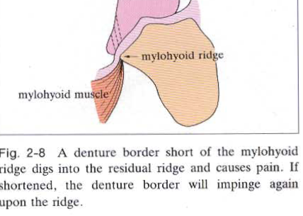
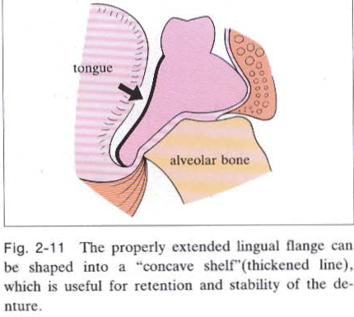

Slide 34
Retromylohyoid Fossa
Posterior to mylohyoid muscle.
The muscle has no effect here so the flange can move back toward the body of the mandible.
Bounded by retromylohyoid curtain.
The denture should extend posteriorly to contact the curtain when the tongue is protruded.

Slide 35
Retromylohyoid curtain (RMC)
The posterolateral portion of RMC overlies the superior constrictor (SC)
The posteromedial portion covers palatoglossus and lateral surface of tongue
The inferior wall overlies the submandibular gland
RM: ramus; B: buccinator; PR: pterygomandibular raphe; MP:medial pterygoid; M:masseter

Slide 36
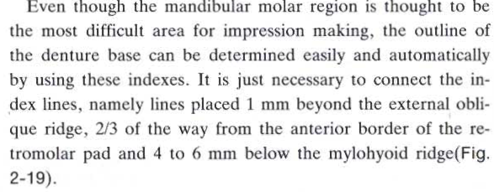

Slide 37
Alveololingual Sulcus
Space between the residual ridge & tongue .
Extends from lingual frenum to retromylohyoid curtain .
3 regions (anterior, middle & posterior)
The anterior region extends from the lingual f. back to where mylohyoid muscle curves above the level of the sulcus (premylohyoid fossa) .
Notes:
The sublingual gland, the mylohyoid muscle and the geniohyoid muscle are anatomical structures which lie in alveololingual sulcus.
The superior constrictor, mylohyoid, palatoglossus, and genioglossus muscles mold the lingual flange of denture.

Slide 38
Alveololingual Sulcus
The middle region extends from premylohyoid fossa to the distal end of the mylohyoid ridge, curving medially from the body of the mandible. This curvature is caused by the prominance of mylohyoid ridge & the action of mylohyoid muscle.
The posterior region: here the flange passes into the retromylohyoid fossa & completes the typical S form of the correctly shaped lingual flange.

Slide 39
An “S” shaped lingual flange commonly results in posterior lingual area

Slide 40
References
Boucher's Prosthodontics Treatment for Edentulous Patients. Twelfth Edition. Chapter s 13 & 14.

