Slide 1
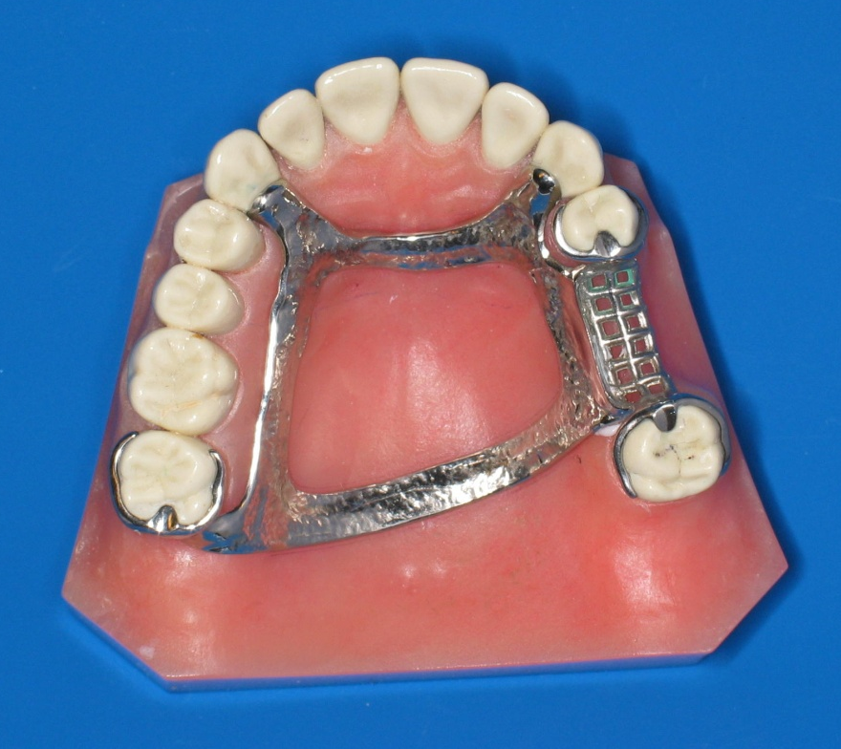
Principles of RPD Design
Dr. Rola Shadid

Slide 2
Differentiation between tooth-supported and tooth-tissue supported partial denture
1. The manner in which each is supported
2. The method of impression registration and jaw record required for each
3. The need for some kind of indirect retention
4. The denture base material
5. Differences in Clasp Design

Slide 3
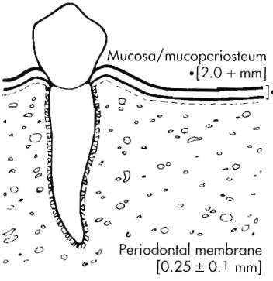
Distortion of tissues over edentulous ridge will be approximately 500 microm under 4 newtons of force, whereas abutment teeth will demonstrate approximately 20 microm of intrusion under the same load.

Slide 4
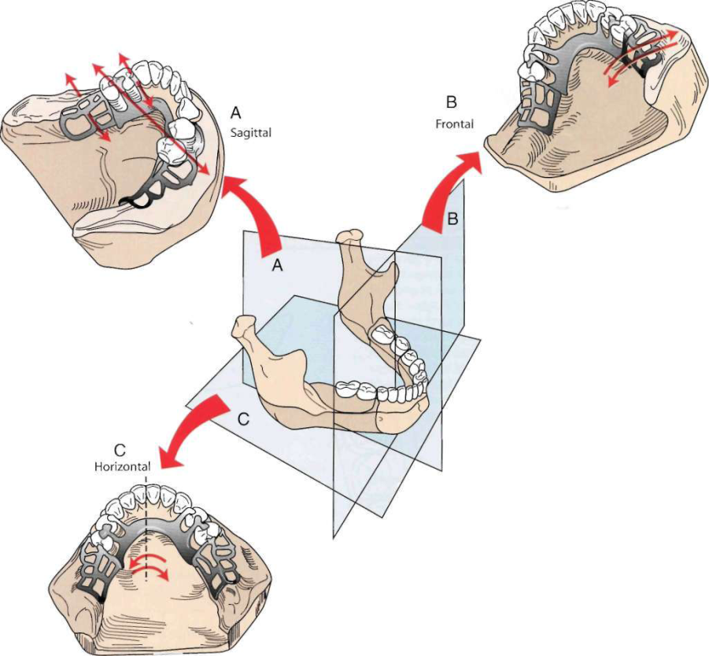

Slide 5
Components of Partial Denture Design
Tooth support & ridge support
Major & minor connectors
Direct retainers
Stabilizing components
Guiding planes
Indirect retainers

Slide 6
Guiding Plane
the body of an extracoronal direct retainer,
the stabilizing arm of a direct retainer
the minor connector portion of an indirect retainer
or by a minor connector specifically designed to contact the guiding plane surface.

Slide 7
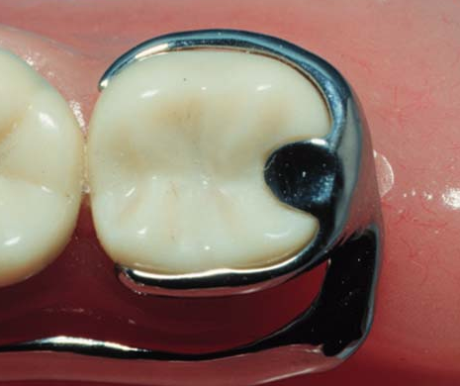

Slide 9
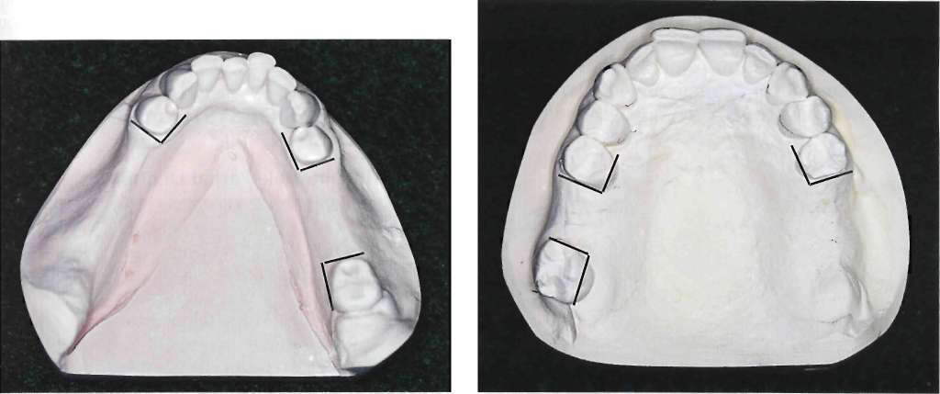
Guiding Plane

Slide 10
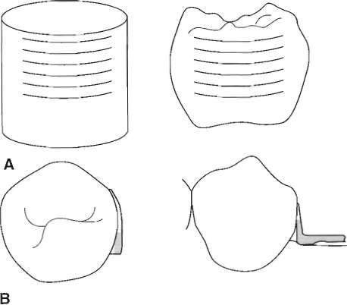
Guiding Plane

Slide 11
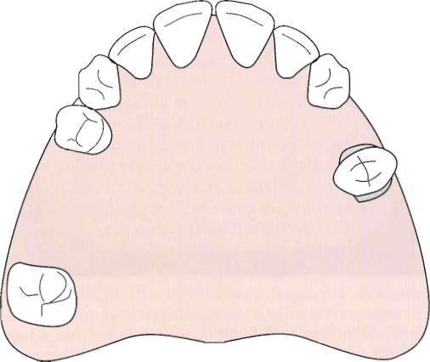
Guiding Plane

Slide 12
Direct Retainer Selection
Class I & II (Tooth & Tissue-Borne)
  Stress releasing direct retainers
Class III & IV (Tooth-Borne)
  Non-stress releasing direct retainers

Slide 13
Rest Placement: Tooth-Borne RPD’s
Adjacent Edentulous Space
  Most effective placement of support
  Ease of preparation
  Reduces minor connectors
  Very rare exceptions

Slide 14
Retainer Selection: Tooth-Borne RPD’s
Minimal rotation
Stress release usually unnecessary
Choose non-stress releasing retainers:
  Cast Circumferential *
  Ring Clasp
  Embrasure Clasp (Double Akers)
  Reverse Action (‘C’) Clasp

Slide 15
Tooth-Borne Direct Retainers
Cast suprabulge clasps
Exceptions
  Use stress-releasing clasps when:
  Esthetics
    use infrabulge or w.w.
  Poor prognosis for posterior abutment

Slide 16
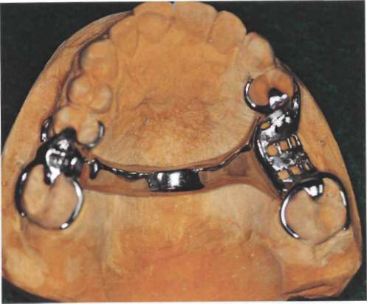
Class III Removable Partial Denture

Slide 17
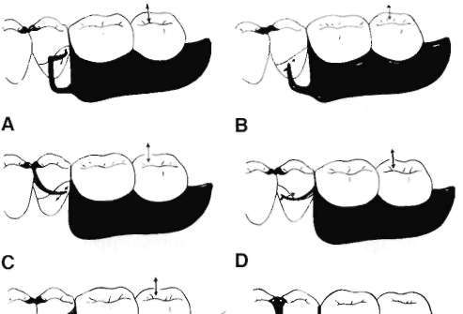

Slide 18
Tooth- Tissue Borne Cases

Slide 19
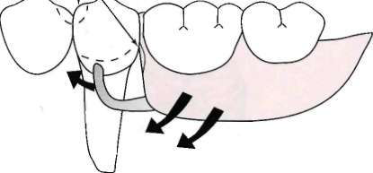
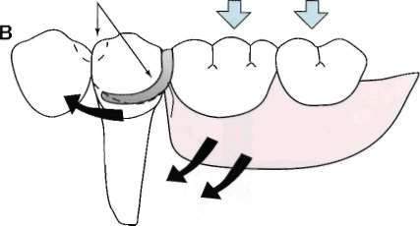
Stress-Releasing Direct Retainers
2 strategies are adopted to either
1. change the fulcrum location and subsequently the "resistance arm" engaging effect (mesial rest concept)
2. use of flexible arm (wrought-wire retentive arm).

Slide 20
Stress-Releasing Direct Retainers
Mesial Rest Concept
  Rotation: retentive tip, proximal plate
  Move mostly down (and forward)
  Into more undercut (release of tooth)

Slide 21
Non-Stress-Releasing Direct Retainers
Distal Rest
  Rotation: retentive tip, proximal plate
  Move mostly forward (tip rotates up)
  Toward height of contour (activate or bind)

Slide 22
Distal Rest Concept
Long Guiding Planes
  Binding, torque
  Not advisable
Short Guiding Planes
  proximal plate moves into space, escape of rest
  Acceptable, if mesial rest not possible

Slide 23
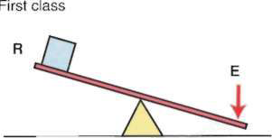
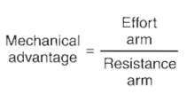
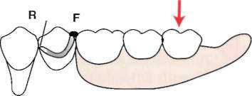
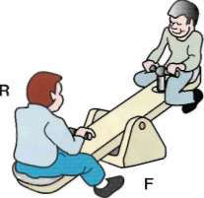
Notes:
Design often seen for distal extension removable partial denture. Cast circumferential direct retainer engages mesiobuccal undercut and is supported by distocclusal rest. If
rigidly attached to the abutment tooth, this could be considered a cantilever design, and it may impart detrimental first-class lever force to abutment if tissue support under extension base allows excessive vertical movement toward the residual ridge.

Slide 24
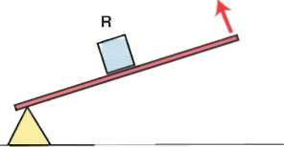
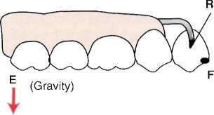
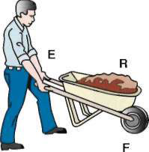

Slide 25
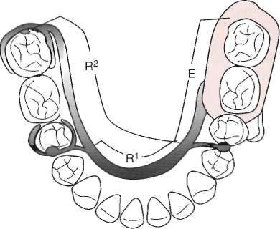
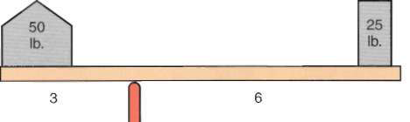
Notes:
Length of lever from fulcrum (F) to resistance (R) is called resistance arm. That
portion of lever from fulcrum to point of application of force (E) is called effort arm. Whenever effort arm is longer than resistance arm, mechanical advantage is in favor of effort arm, proportional to difference in length of the two arms. In other words, when effort arm is twice the length of the resistance arm, a 25-lb weight on effort arm will balance a 50-lb weight at end of resistance arm. The opposite is also true and helps illustrate cross-arch stabilization. When the resistance arm is lengthened (cross-arch clasp assembly placed on a second molar versus a second premolar) the effort arm is more efficiently counteracted.

Slide 26
Retainer Selection: Tooth-Tissue Borne RPD’s
Stress-releasing Clasps
  RPI Clasp *
  RPA Clasp
  Combination Clasp

Slide 27
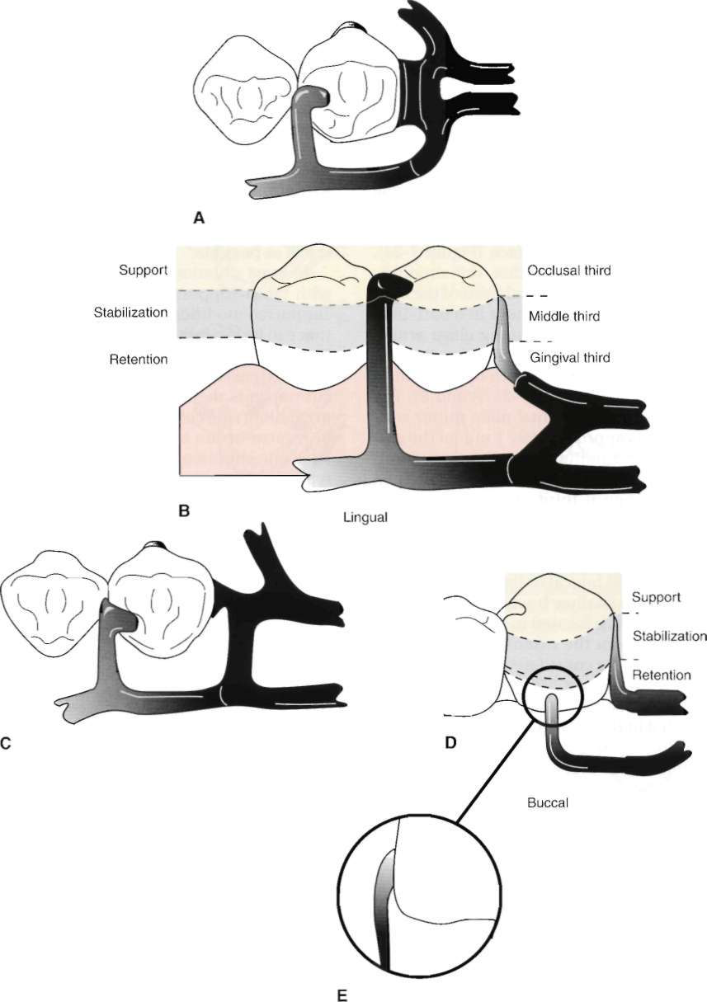
RPI Clasp
"R" Rest (always mesial)
"P" Proximal Plate (distal)
"I" I - Bar (buccal) *
Notes:
I - bar most common
S - bar used to avoid large soft tissue undercut
"Y", "T", "L", and "U" less useful

Slide 28
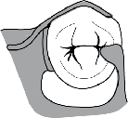
RPA Clasp
"R" Rest (always mesial)
"P" Proximal Plate (distal)
"A" Aker's retentive arm (always wrought wire)

Slide 29
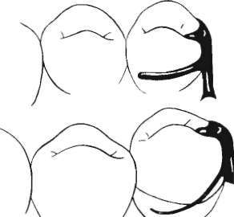
Combination Clasp
Wrought-wire retentive clasp arm & cast reciprocal clasp arm
Bracing and retentive arms originate from distal rest
Guiding plane must not run entire occluso-gingival height

Slide 30
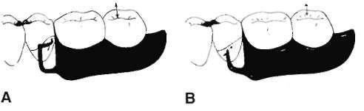
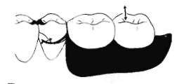
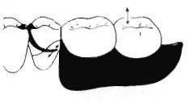

C
E
D

Slide 31
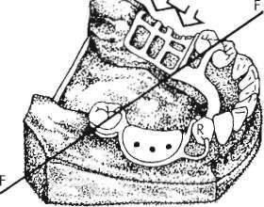
Kennedy Class II, modification 1
Notes:
the potential for first-class lever action can also exist in Class II, modification 1 designs
for removable partial denture frameworks. If cast circumferential direct retainer with a mesiobuccal undercut on right first premolar were used, force placed on denture base could
impart upward and posteriorly moving force on premolar, resulting in loss of contact between premolar and canine.
Tissue support from extension base area is most important to minimize lever action of clasp. Retainer design could help accommodate more of an anteriorly directed force during
rotation of the denture base in an attempt to maintain tooth contact. Other alternatives to first premolar design of direct retainer would be tapered wrought-wire retentive arm that uses mesiobuccal undercut.

Slide 32
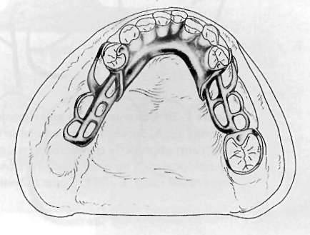
Kennedy Class II, modification 1
Notes:
Bar retainer is used on anterior abutment of modification space, and its terminus engages distobuccal undercut. Denture is designed to rotate around terminal abutments when force is directed toward basal seat on left. Such rotation would impart force on right premolar directed superiorly and anteriorly. However, this direction of force is resisted
in great part by mesial contact with canine. Direct retainer on right premolar engaging mesiobuccal undercut would tend to force tooth superiorly and posteriorly.

Slide 33
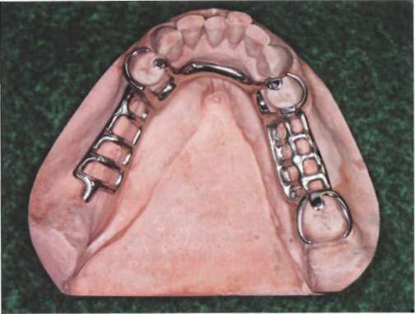
Kennedy Class II, modification I

Slide 34
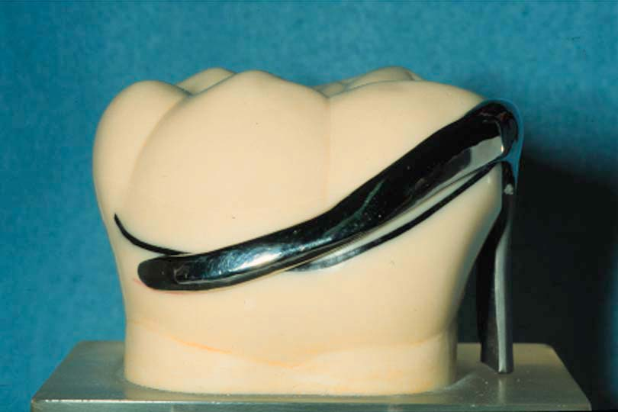
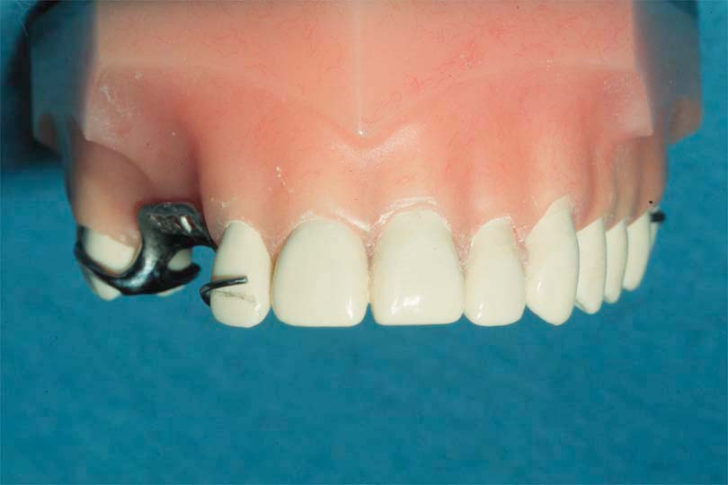
Other Alterations of Axial Contours
Lowering Heights of Contour
  In order not to interfere with opposing occlusion
  Not to increase occlusal table
  Improve esthetics
  Decrease tipping forces
Notes:
Clasps placed closer to the occlusal/incisal surface have a greater likelihood of imparting tipping forces to abutments.

Slide 35
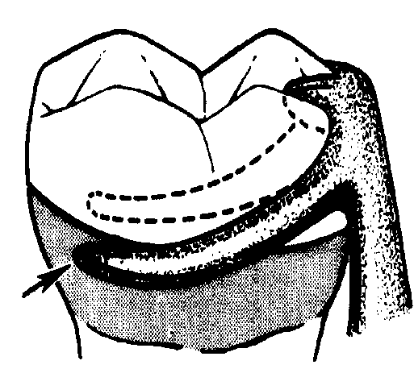
Lowering Heights of Contour
Post Is More Readily Removed by Application of Force Near Its Top Than by Applying Same Force Nearer Ground Level

Slide 36
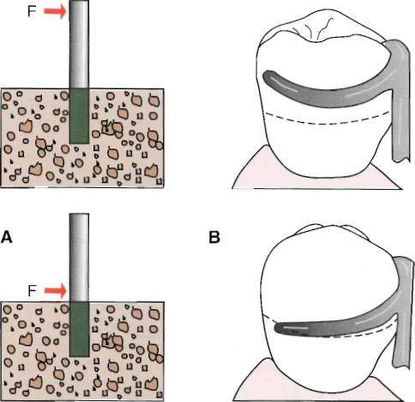
Notes:
Fence post is more efficiently removed by applying force (F) farther from the support. Force placed closer to the support reduces the effort arm. B, Clasps placed closer to the occlusal/incisal surface have a greater likelihood of imparting tipping forces to abutments. This represents similar effect of force application shown in A, top image.

Slide 37
Other Alterations of Axial Contours
Raising Heights of Contour
  Insufficient retention in gingival 1/3 (at least 1mm from gingiva)
  Prepare undercut
  Add resin above to create undercut

Slide 38
Preparing Retention
Axial surface must be close to parallel the path of insertion

Slide 39
Retentive Preparation Shape
Follows the path of designed retentive tip

Slide 40
Creating Undercuts with Bonded Resins
Axial surface must be close to parallel the path of insertion

Slide 41
Summary of Abutment Modifications
After RPD Designed
  Guideplanes
  Lower heights of contour to eliminate interferences & improve esthetics
  Create undercuts if absolutely necessary (raising heights of contour)
  Rest seat preparation

Slide 42
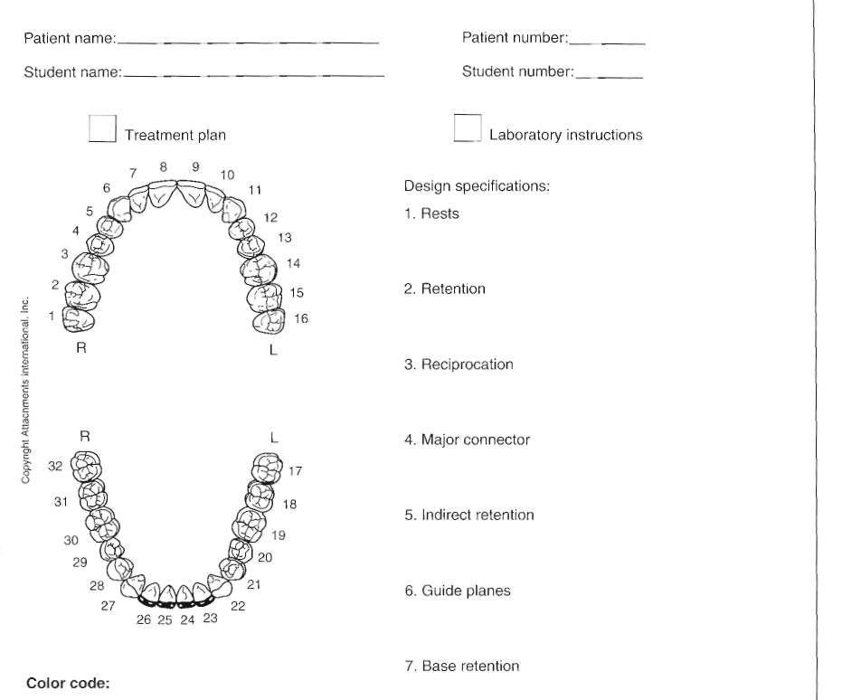

Slide 43
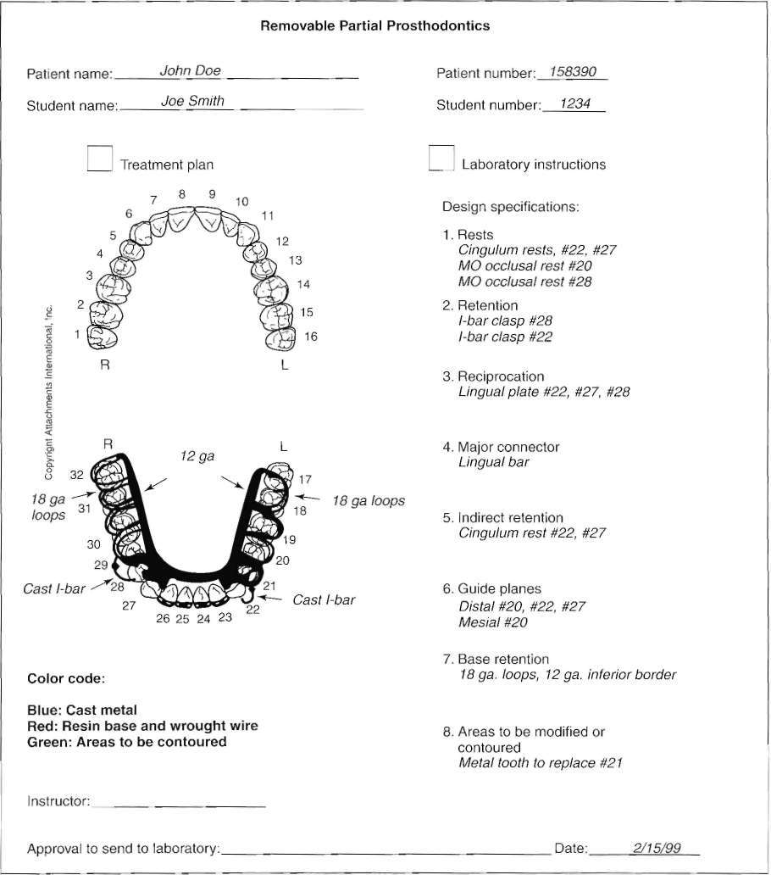

Slide 44
McCracken’s Removable Prosthodontics, 11th Edition 2005 by McGivney GP, Carr AB. Chapter 10
Dalhousie continual education

