Slide 1
Preliminary Edentulous Impressions & Custom Tray Fabrication
Rola M. Shadid, BDS, MSc

Slide 2
What Is An Impression?
A negative likeness or copy in reverse of the surface of an object

Slide 3
Principles & objectives of impression making
To provide support, retention & stability for the denture
Act as a foundation for improved appearance of lips & cheeks
Maintain the health of oral tissues.

Slide 4
Making impressions
Examination
Selection of impression material
Selection of tray
Seating of the patient
Preliminary impression
Primary cast
Custom tray
Border molding
Final impression

Slide 5
Seating of the patient
Maxillary impression
Patient in upright position*
The operator stands behind and to the right side of patient (for right handed operator)
Mandibular impression
Patient in upright position
The operator stands facing the patient to the front and to the right side
Notes:
If reclining position is used, there is a danger of gagging
Start with lower before upper impression because………..?

Slide 6
Preliminary Edentulous Impressions

Slide 7
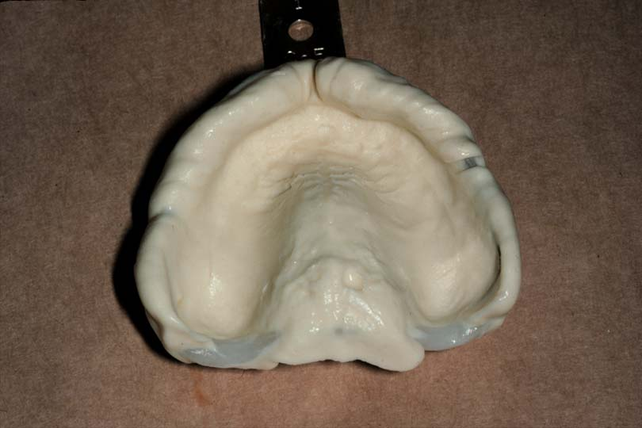
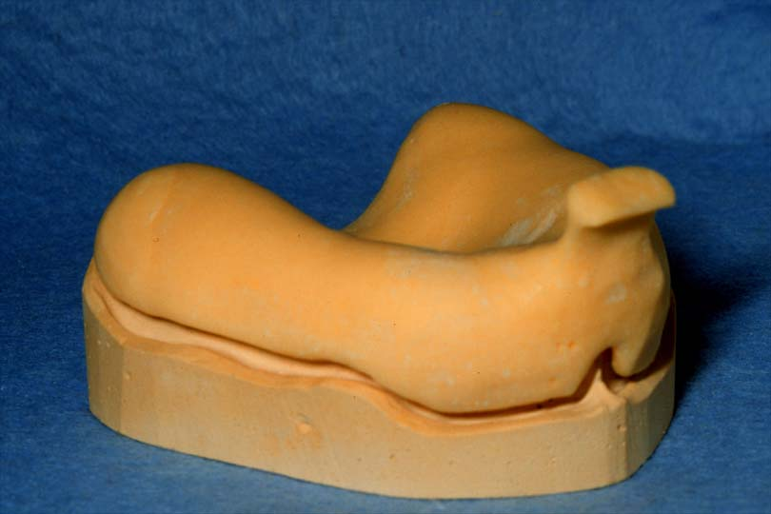
Preliminary Edentulous Impressions
Preliminary impressions (slightly overextended) needed for diagnostic casts for making custom trays

Slide 8
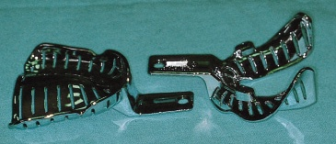
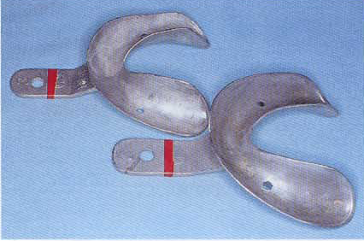
Tray Selection
Stock tray
Perforated vs nonperforated *
Dentulous, edentulous, and combination tray
Notes:
For alginate, a perforated tray is preferred to retain impression. Nonperforated tray may be used for alginate but only in conjunction with adhesive

Slide 9
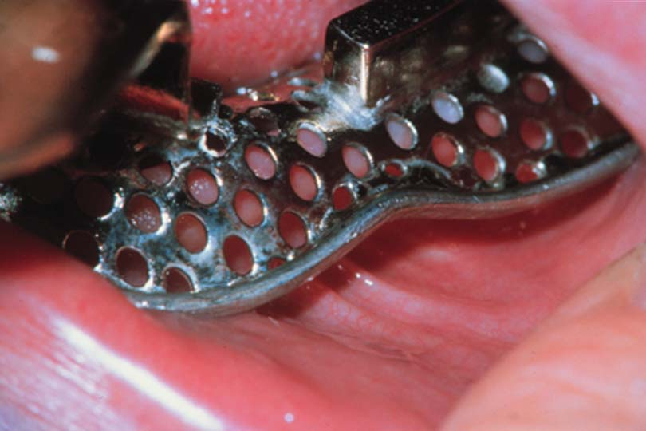
Tray Selection for Alginate (irreversible hydrocolloid) Preliminary Impression
5 mm of clearance with soft tissues
Extends to reflection of mucosa
Hydrocolloid requires bulk for accuracy, strength and stability

Slide 10
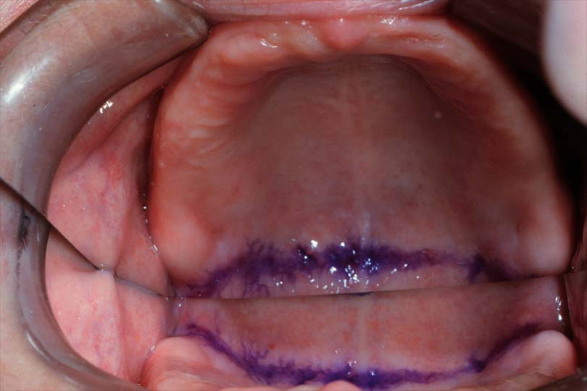
Tray Selection
Maxillary trays should extend slightly beyond vibrating line
Mandibular trays should cover the retromolar pads

Slide 11
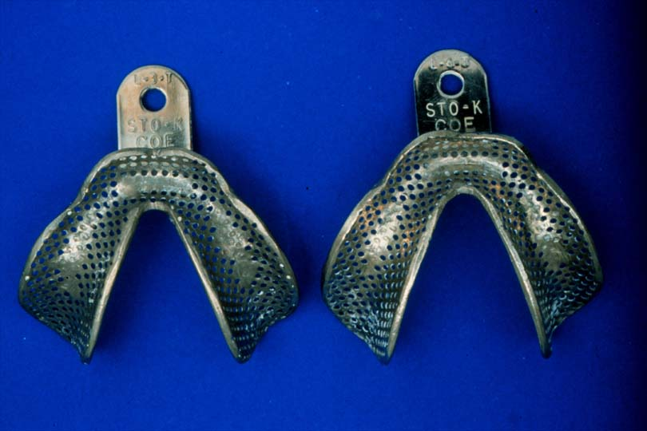
Tray Selection
Stock edentulous trays
Short flanges, so don’t distort vestibule

Slide 12
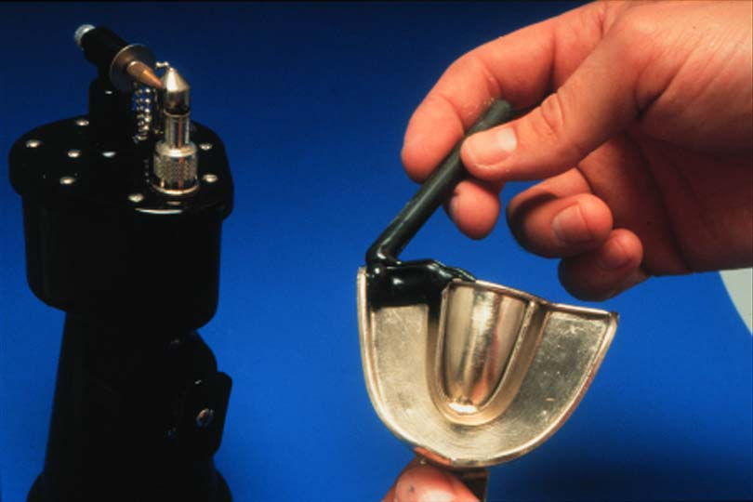
Tray Modification
Trays can be modified with compound or wax to extend the tray if desired

Slide 13
Preliminary Edentulous Impression Materials
Alginate (irreversible hydrocolloid) is used for edentulous primary impression and it is indicated when there are flappy ridges or severly undercut ridges
Impression compound is also used for edentulous primary impression

Slide 14
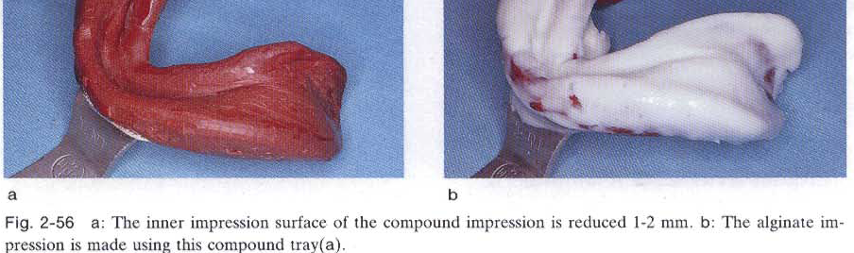
If Severly Resorped Ridge?

Slide 15
Preliminary edentulous impression materials
When using alginate :
Make stiff or thick for edentulous impression
The mouth should be relatively dry
Elastic so suitable for ridges with severe undercuts
Not very dimensionally stable so should be poured within 15 minutes

Slide 16
Alginate Storage
Deteriorates if:
  Stored above 54°C
  Repeated openings
Deterioration results in:
  Thin mixtures
  Reduced strength
  Permanent deformation

Slide 17
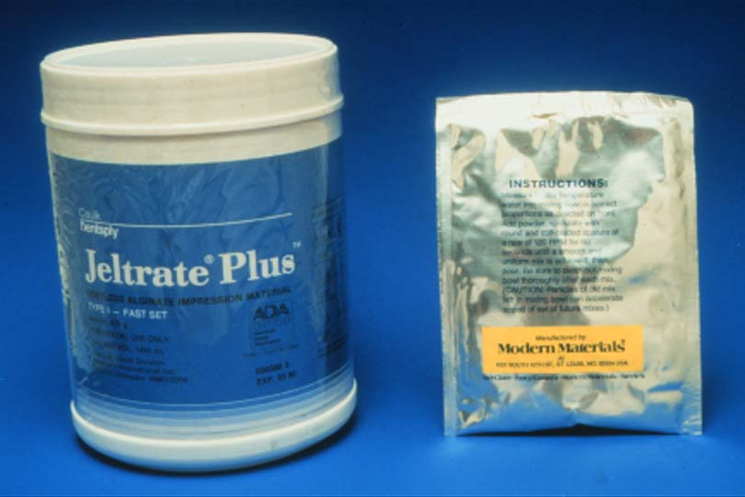
Alginate Storage
Pre-weighed pouches
  Easier dispensing
  Minimizes contamination
Bulk material
  Store in cool dry airtight containers

Slide 18
Patient Preparation
Practice placing tray
Rotate into place

Slide 19
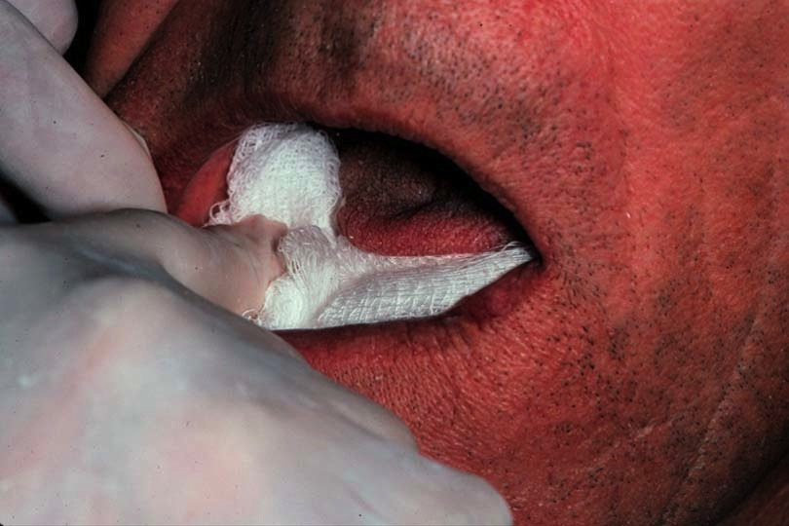
Patient Preparation for alginate impression
Dry the mucosa
  Dry the maxilla with folded gauze
  Don’t let patient close

Slide 20
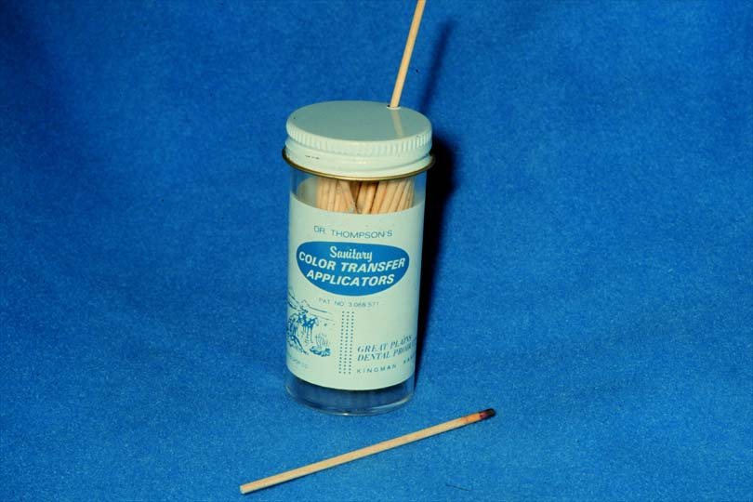
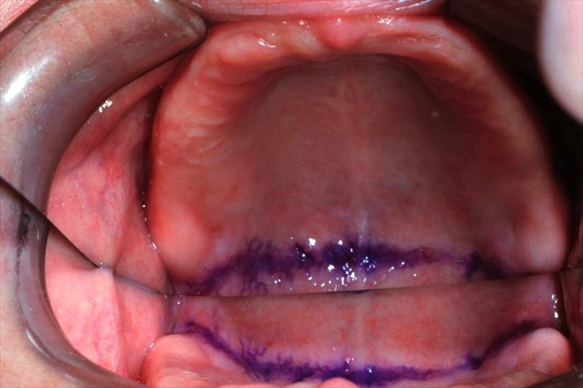
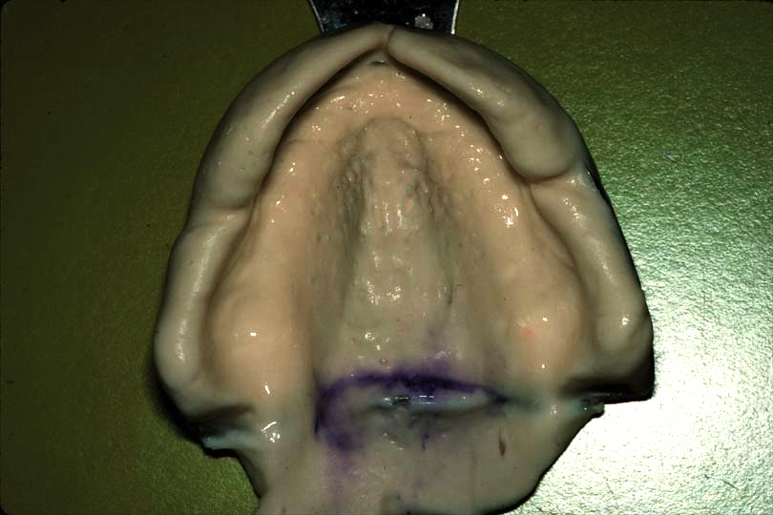
Mark Vibrating Line
Prior to making preliminary & final impressions

Slide 21
Locate & Mark the Hamular Notch
Use the head of a mirror, to palpate the notch
Mark with an indelible marker

Slide 22
Indelible Marks Prior to Impression
Transfer to the impression and cast when it is poured
Eliminates error
Tissue should be relatively dry to be most effective

Slide 23
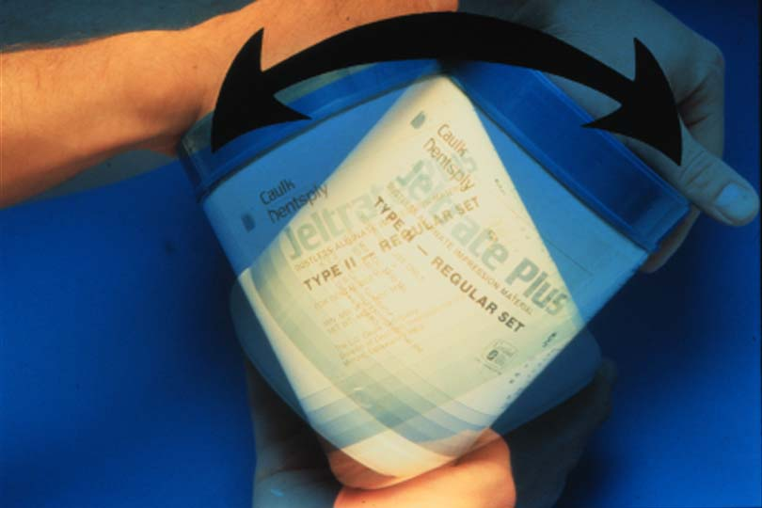
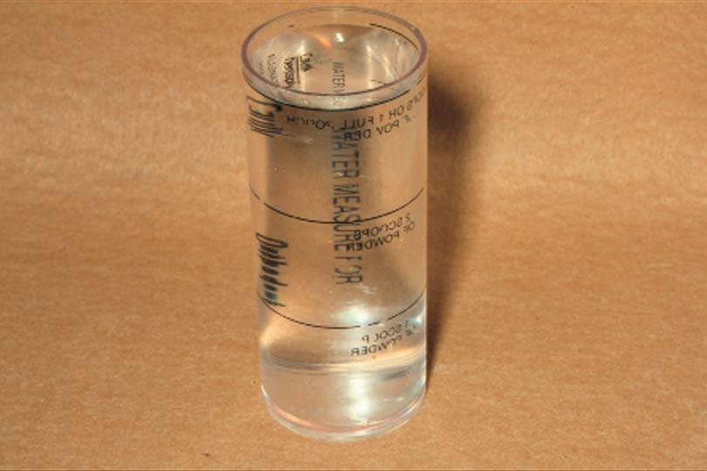
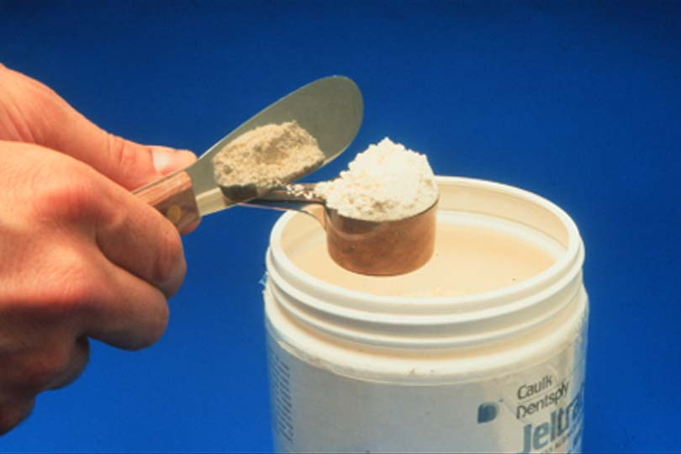
Measuring Powder
Fluff (shake) the powder, measure, tap and flatten the scoop with powder
Follow the manufacturer’s instructions

Slide 24
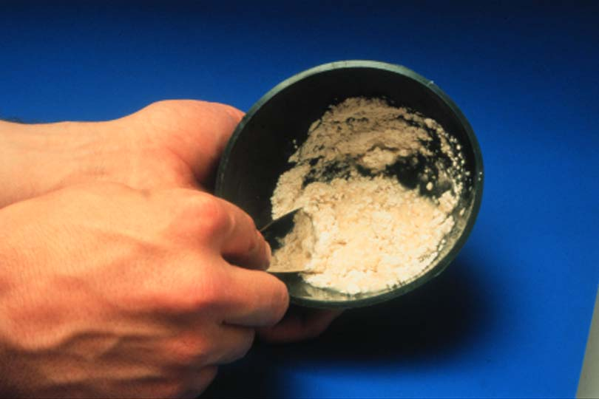
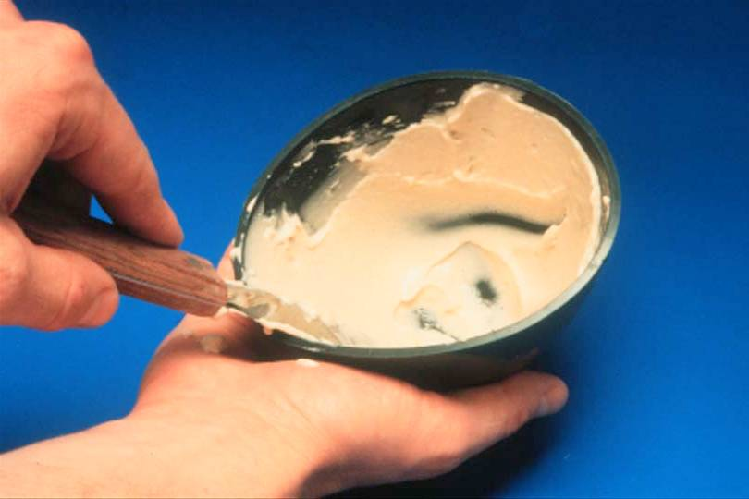
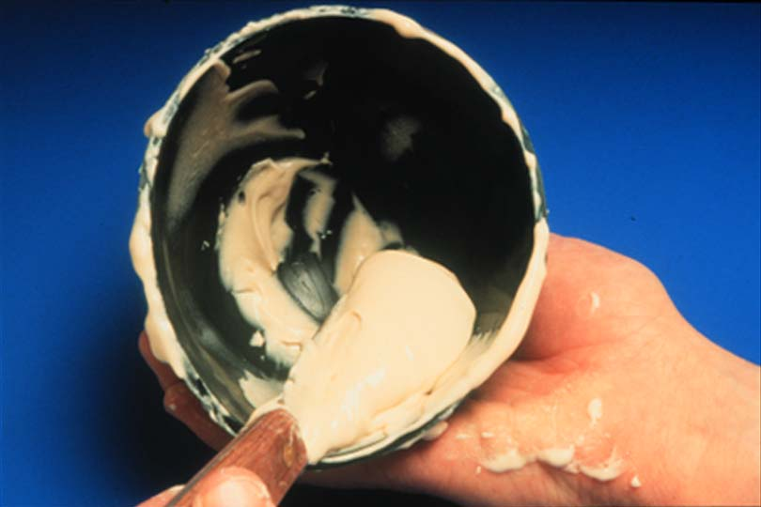
Mixing
Smooth creamy homologous mixture that glistens
Not granular or lumpy

Slide 25
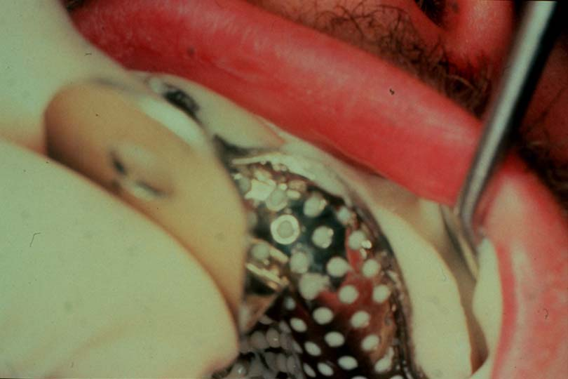
Cheek Retraction
Use a mirror, instead of a finger
Provides better visibility, more maneuverability

Slide 26
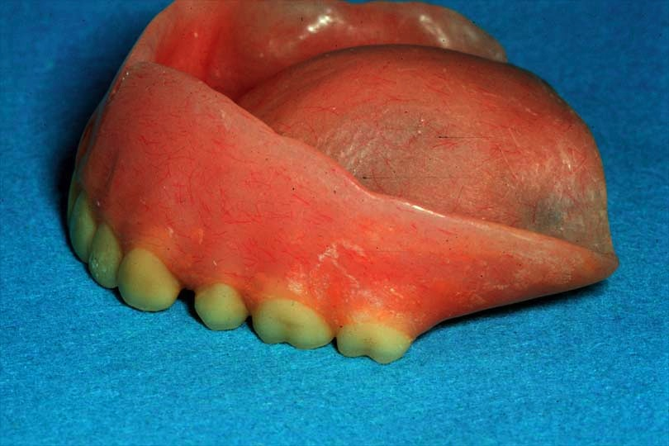
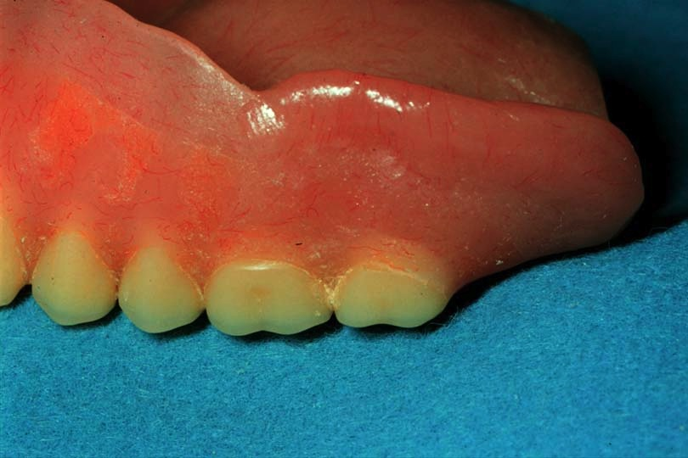
Alginate Syringe Technique
Critical anatomy registration*
  Retromylohyoid area
  Hamular notches
  Retrozygomal area
  Deep palatal vaults
  Occlusal surfaces of teeth in partially edentulous
Notes:
* Preload some alginate material in these areas either with syringe or with your finger before inserting the loaded tray. This is recommended to reduce air entrapment and to improve detail.

Slide 27
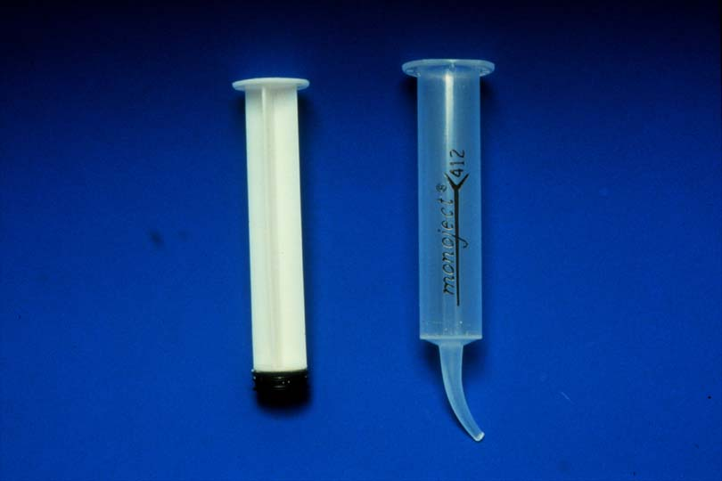
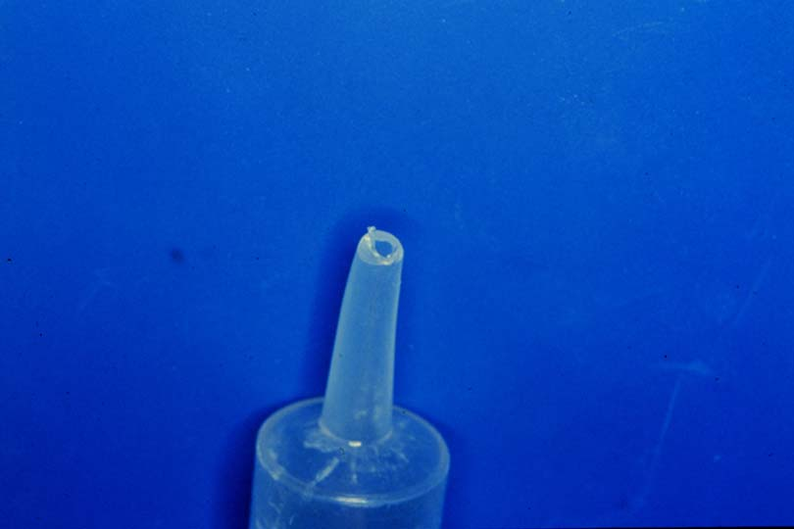
Syringe Preparation
12 cc disposable syringe
Cut off the tip where it begins to curve
5 mm orifice

Slide 28
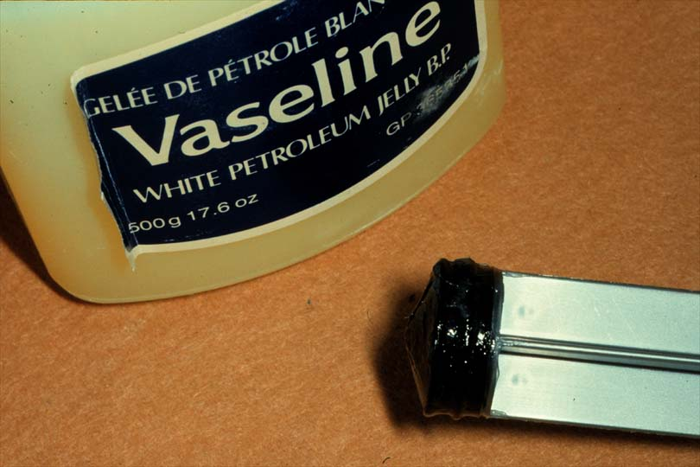
Plunger Preparation
Vaseline plunger
Ease of extruding material
Use:
  Uncontaminated bowl, spatula
  Regular set alginate

Slide 29
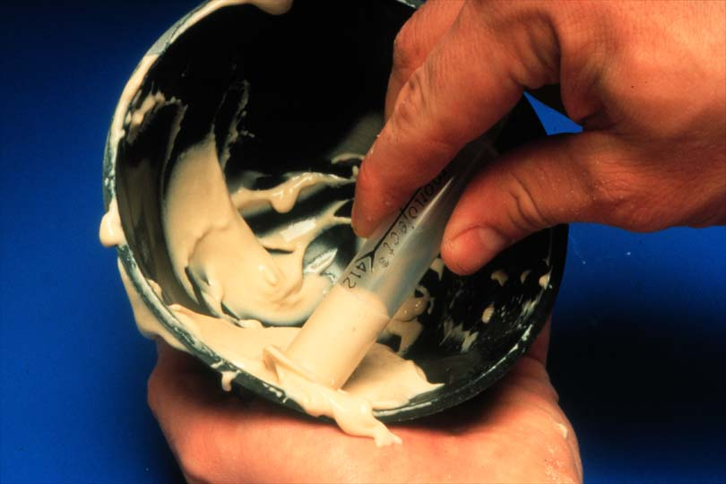
Syringe Loading
The assistant loads the syringe nearly full from the back and inserts plunger

Slide 30
Preliminary Impressions
Place the anterior portion of the tray first, then seat the posterior of the tray

Slide 31
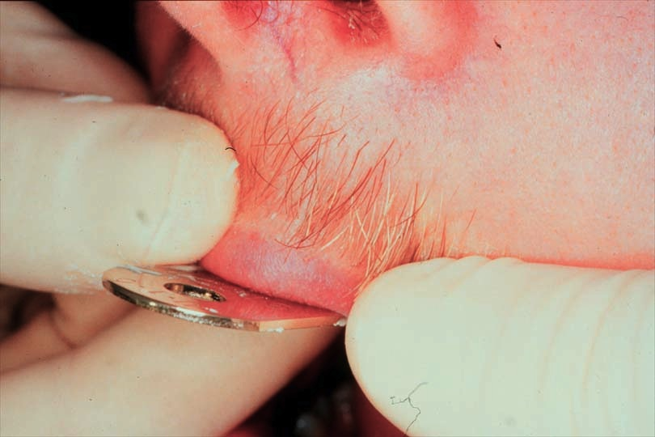
Preliminary Impressions
Less gagging if the patient is lying down
Mold the vestibular area
Pull on the cheeks and lips to activate muscles and frena

Slide 32
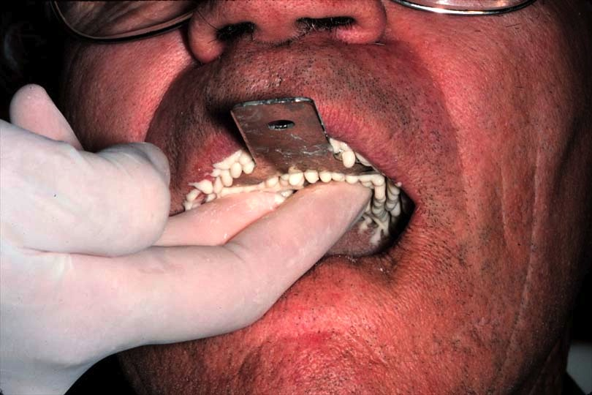
Preliminary Impressions
Support the tray during setting - do not leave the patient
Movement causes distortion

Slide 33
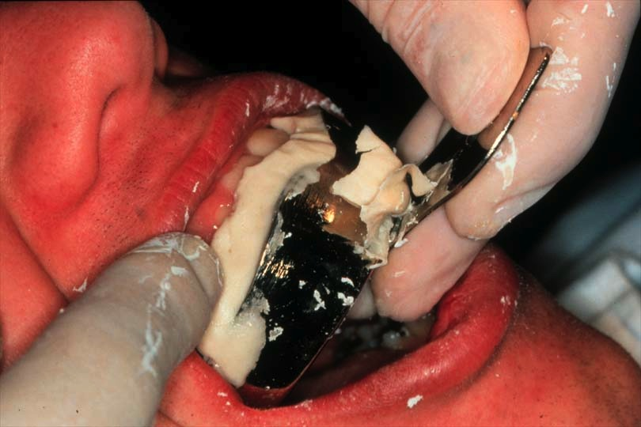
Preliminary Impressions
Break peripheral seal
  Pull up cheek and let air in
  Wiggle tray until hear seal break

Slide 34
Preliminary Impressions
Once seal broken, remove quickly (to avoid permanent deformation)
Evaluate impression
Pour within 15 minutes

Slide 35
Preliminary Impressions
Rinse thoroughly with water
Gently shake to remove excess water

Slide 36
Preliminary Impressions
Spray with disinfectant to coat all surfaces, wrap in wet paper towel and seal in a bag

Slide 37
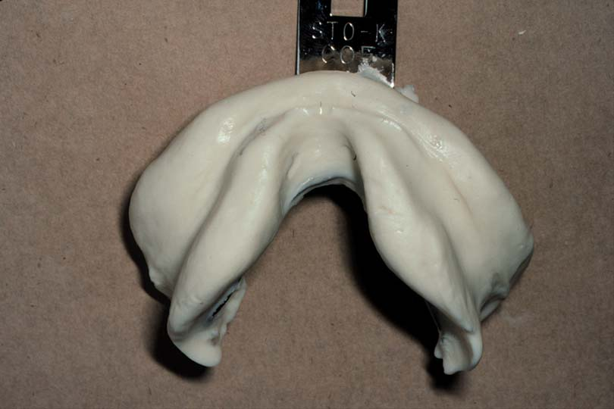
Sample Impressions

Slide 38
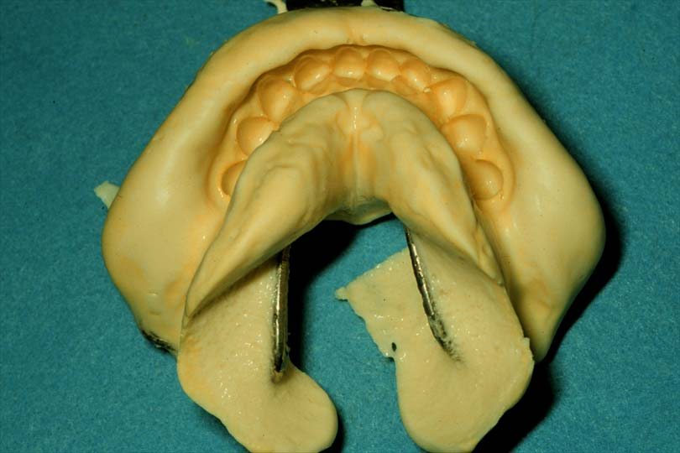
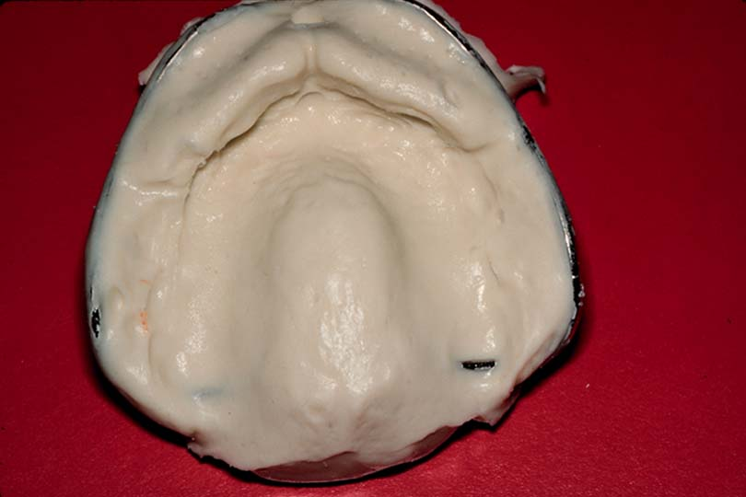
Sample Impressions

Slide 39
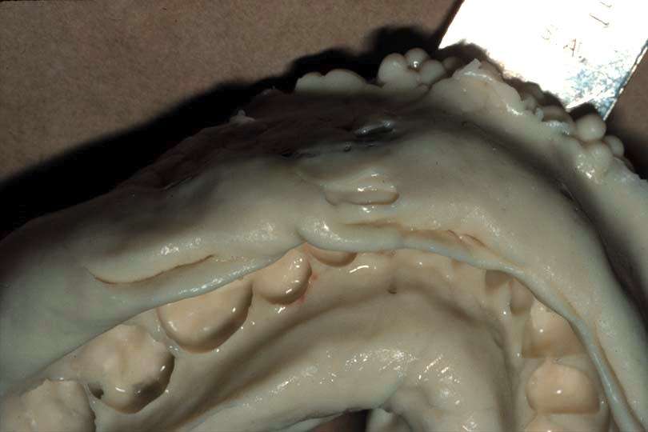
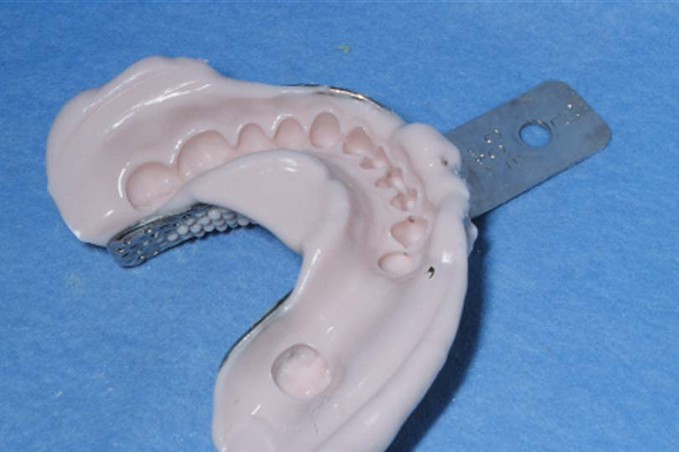
Some Problems
Vestibular material may not join the tray material
  Saliva contamination
  Insufficient material

Slide 40
Some Problems
Trapping tongue under the tray will result in underextension of the lingual vestibule

Slide 41
Watch Alginate Impression Video & Primary Impression Video

Slide 42
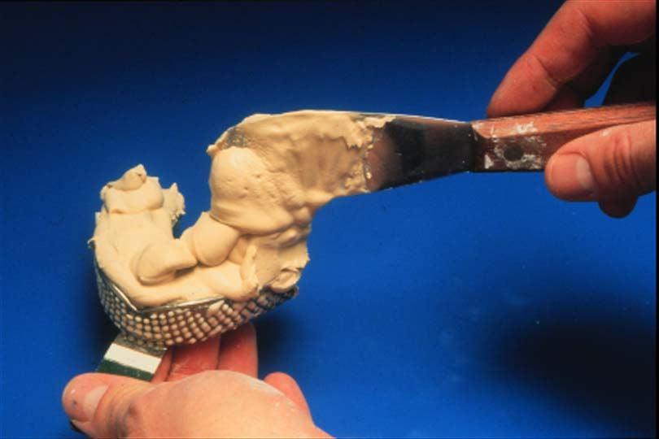
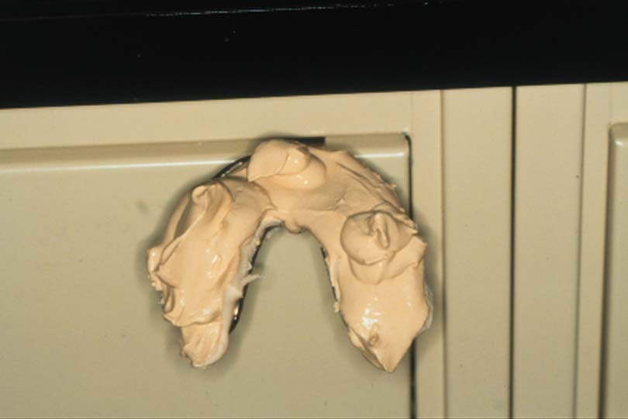
Pouring a Model
Weighing powder, measure water
Vacuum mix (less time, stronger cast)

Slide 43
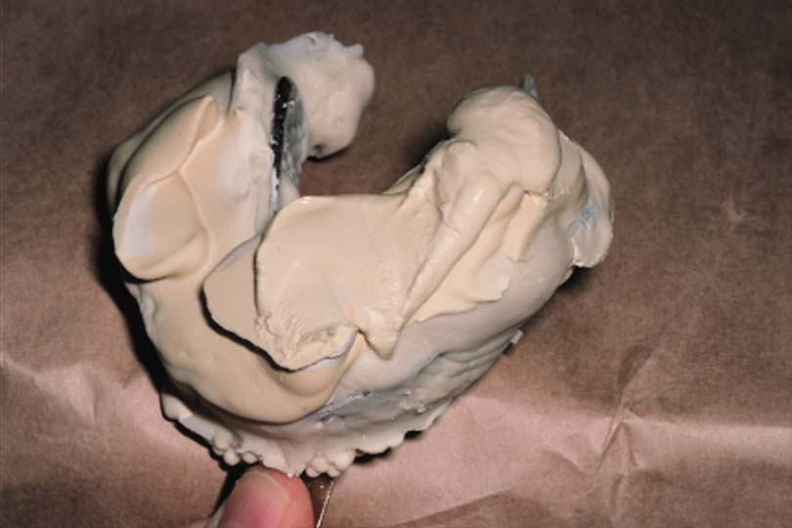
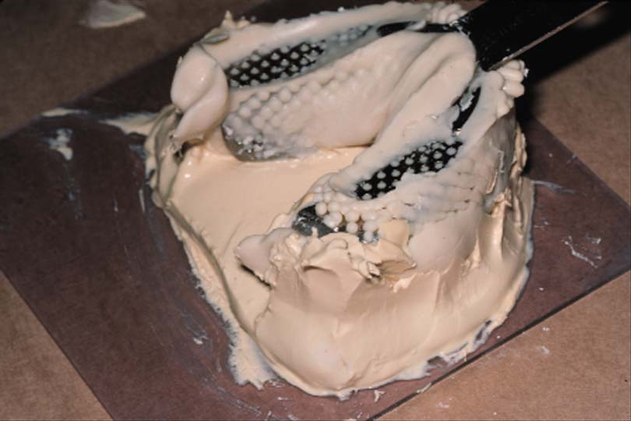

Slide 44
Pouring a Model
Casts should be a minimum of 12 mm (0.5 inch) in thinnest part
Separate the alginate impression from the stone cast after 45 minutes

Slide 45
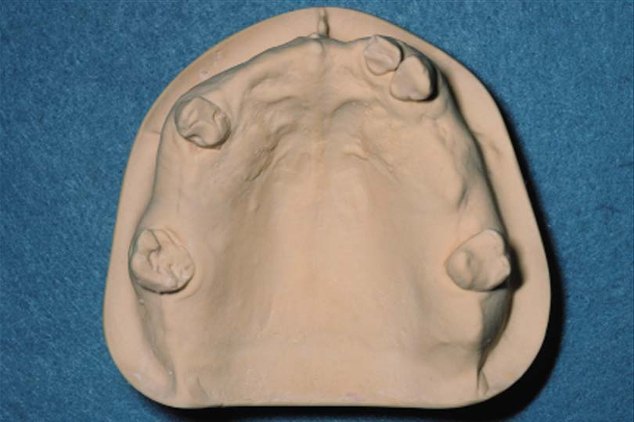
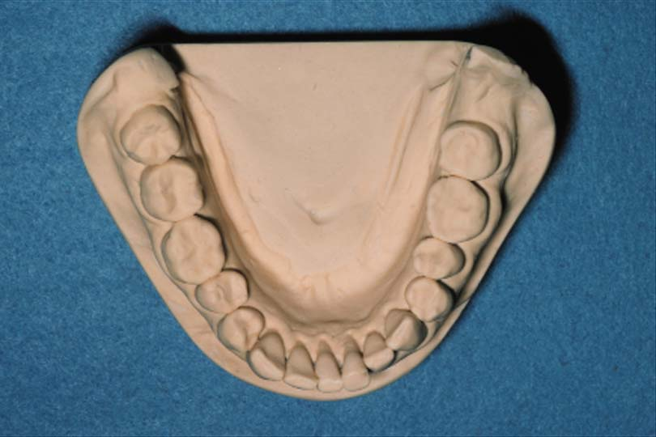
Trimming Casts
Trim the base on the model trimmer parallel to the residual ridges
Leave the vestibular reflection intact for making a custom tray

Slide 46
Trimming Casts
All anatomical surfaces should be included with minimum voids

Slide 47
Custom Trays

Slide 48
Custom Trays
Individualized trays for making final impressions
Made on a diagnostic cast

Slide 49
Purpose of a Custom Tray
Improve retention (border molded)
Minimize:
  Impression material distortion
    Uniform thickness
    Rigid tray

Slide 50
Purpose of a Custom Tray
Minimize:
  Tissue distortion
    Less viscous material
    Accurately adapted tray
  Costs
    less impression material used

Slide 51
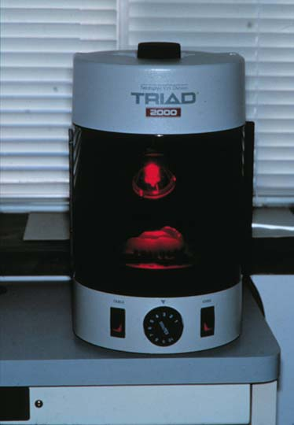
Custom Material
Light-cure resins (Triad)
Auto polymerizing acrylic resin
Vacuum-form poly vinyl
Thermoplastic materials

Slide 52
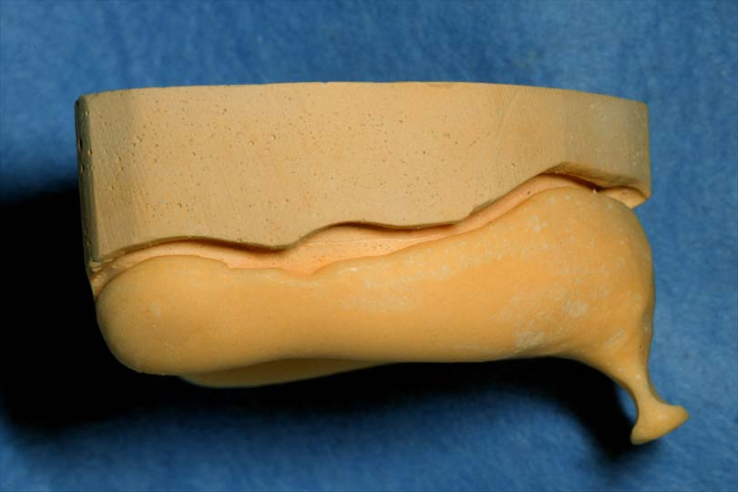
Extension
2-3 mm short of the vestibular depth
Diagnostic casts usually overextended (irreversible hydrocolloid)

Slide 53
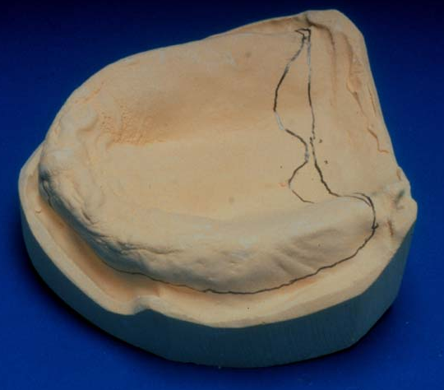
Extension
Outline the depth of vestibule
  vertical portion turns toward horizontal
  Through hamular notches across vibrating line
Provide room for frenal attachments

Slide 54
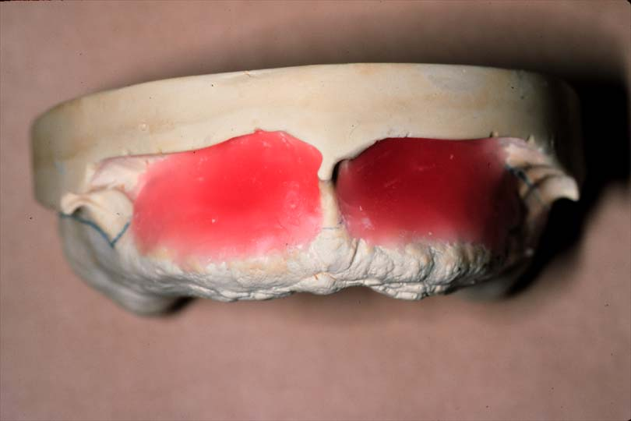
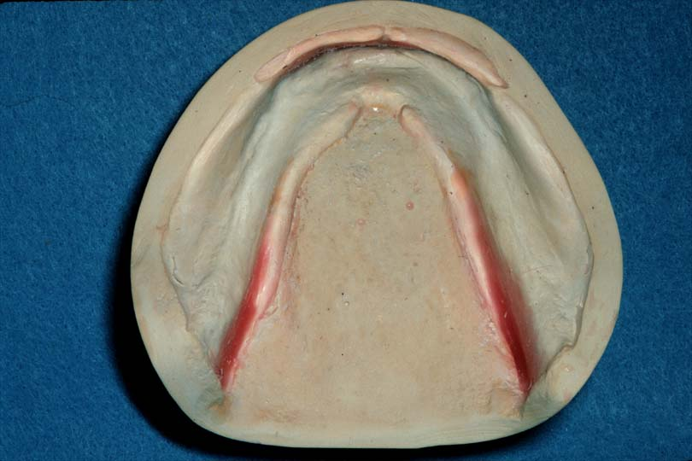
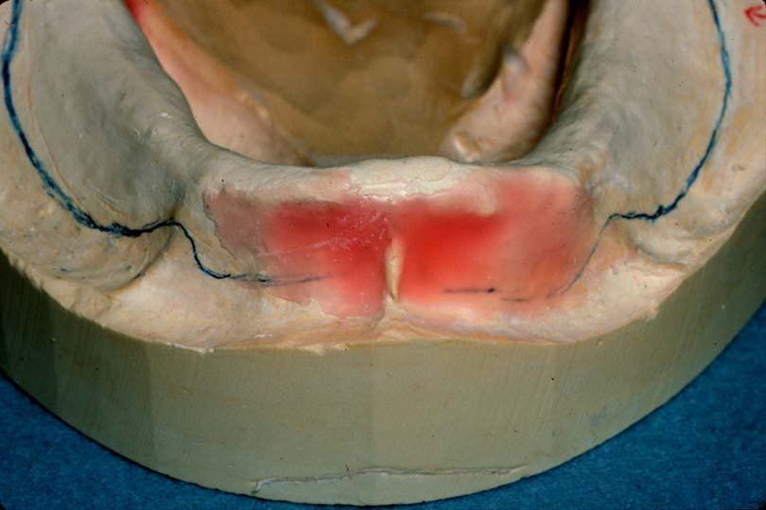
Block-Out Undercuts
Baseplate wax
Prevent tray from locking onto cast
Lubricate cast (Petroleum jelly or Alcote)

Slide 55
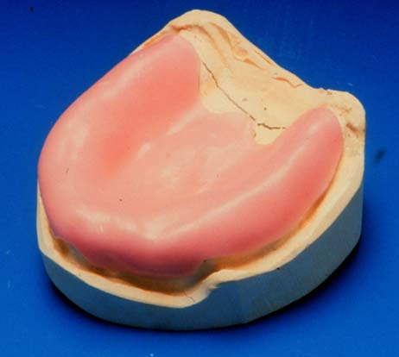
Wax Spacer
One thickness of base plate wax over the maxillary cast *
Trim line in vestibule
Trim to“butterfly” configuration glandular tissue
Notes:
* Don’t put wax spacer for mandibular cast

Slide 56
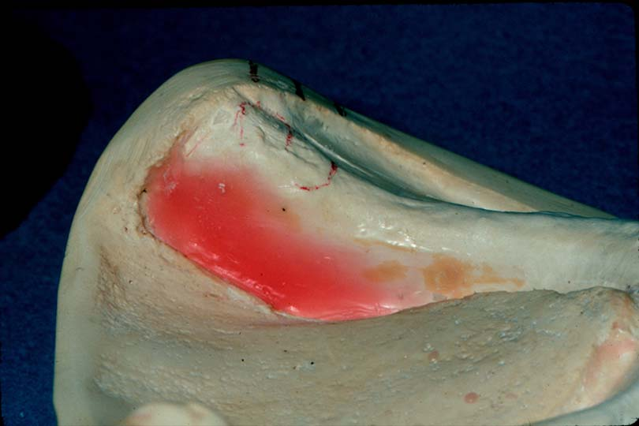
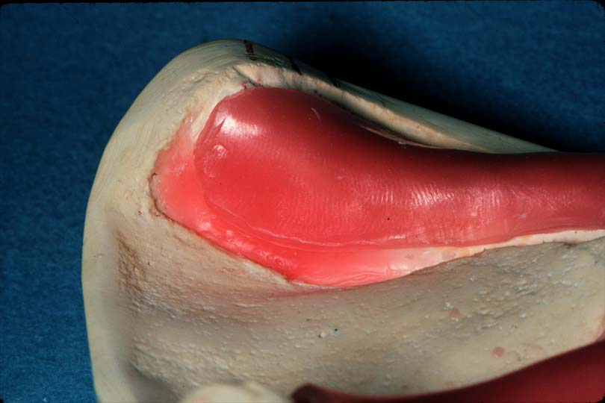

Wax Spacer
Minimizes hydraulic pressures
  Do not place relief over blockout
  Already space from tissue
Provides room for impression material

Slide 57
Trimming the Tray

Slide 58
Handle Addition
Small vertical handle

Slide 59


Auxiliary Handles
Mandible
For stabilization
Orientation the tongue
Area of 2nd premolars / 1st molars

Slide 60
Finish
Arbor-bands and acrylic burs
Round and smooth edges
Mask and eye protection

Slide 61
Custom Trays - Quality Failures
Border extensions significantly longer or shorter than standard.
Tray not stable (flexible) due to insufficient thickness.
Tray cracked or damaged.
Improper handle position (interferes with border molding or insertion).
Sharp and/or rough edges, which may irritate the patient.

Slide 62

Check custom tray in mouth prior to border molding

Slide 63
References
Dalhousie Continuing Education
Complete Denture Prosthodontics, 1st Edition, 2006 by John Joy Manappallil, Chapter 6

