Slide 1
Surveying the Master cast & Framework Fabrication
Rola M. Shadid, BDS, MSC

Slide 2
The master cast must be surveyed as a new cast,
But the prepared proximal guiding plane surfaces will indicate the correct anteroposterior tilt

Slide 3
Surveying Master Cast
1. To delineate the height of contour of the abutment teeth both to locate clasp arms & to identify the location & magnitude of retentive undercuts *
Notes:
Retention will be determined by (1) the magnitude of the angle of cervical convergence below the point of convexity; (2) the depth at which the clasp terminal is placed in the angle; and (3) the flexibility of the clasp arm.
For example, cast circumferential or cast bar retention on the tooth-supported side of a Class II design should be balanced against the 18-gauge wrought-wire retention on a distal abutment only if the more rigid cast clasp engages a lesser undercut than the wrought-wire clasp arm. Therefore the degree of undercut alone does not ensure relatively equal retention unless clasp arms of equal length, diameter, form, and material are used.
Undercuts of 0. 01 inch are often adequate for retention by cast retainers. Tapered wrought-wire retention may safely use up to 0. 02 inch without inducing undesirable torque on the abutment tooth, provided the wire retentive arm is long enough (at least 8 mm). The use of 0. 03 inch is rarely, if ever, justified with any clasp. When greater retention is required, such as when abutment teeth remain on only one side of the arch, multiple abutments should be used rather than increasing the retention on any one tooth.

Slide 4
Surveying Master Cast
2. To delineate soft tissue contours
3. To indicate with carbon marker any areas of interference to the rigid parts of the framework during seating and removal to locate areas to be blocked out or relieved.

Slide 5
Blocking Out The Master Cast
4. After establishment of path of placement & location of undercut areas on master cast, any undercut areas that will be crossed by rigid parts of denture (which is every part of denture framework but retentive clasp terminals) must be eliminated by blockout.

Slide 6
Surveying Master Cast
5. To trim blockout of any remaining interference to placement and removal of the denture. The areas involved are those that will be crossed by rigid parts of the denture framework.

Slide 7
The final design may now be drawn on the master cast with a fine crayon pencil, preferably one that will not come off during duplication.

Slide 8
Blocking out the Master Cast
Areas crossed by denture framework during seating & removal (Parallel blockout)
Those areas not involved blocked out for convenience (Arbitrary blockout)
Ledges on which clasp patterns are to be placed (Shaped blockout)

Slide 9
Blocking out the Master Cast
Relief beneath connectors to prevent tissue impingement
Relief to provide for attachment of denture base to framework

Slide 10
Parallel Blockout
Proximal tooth surfaces to be used as guiding planes & below height of contour
Beneath all minor connectors
Tissue undercuts to be crossed by rigid connectors
Notes:
They do require the use of the surveyor.
Hard inlay wax may be used satisfactorily as a blockout material. It is easily applied and is easily trimmed with the surveyor blade. Trimming is facilitated by slightly warming the surveyor blade with an alcohol torch. Whereas it is true that any wax will melt more readily than a wax-clay mixture if the temperature of the duplicating material
is too high, it should be presumed that the duplicating material will not be used at such an elevated temperature.

Slide 11
Parallel Blockout
Deep interproximal spaces to be covered by minor connectors or linguoplates
Beneath bar clasp arms to gingival crevice
Tissue undercuts to be crossed by origin of bar clasps

Slide 12
Arbitrary Blockout *
Over FGM
Gross tissue undercuts situated below areas involved in design of denture framework
Tissue undercuts distal to cast framework
Notes:
They do not require the use of the surveyor.
Should be blocked out with hard baseplate wax or oil-base modeling clay (artist's modeling clay).

Slide 13
Arbitrary Blockout
Labial surfaces & labial undercuts not involved in denture design & sublingual & distolingual areas beyond limits of denture design.

Slide 14
Shaped Blockout
On buccal and lingual surfaces to locate wax patterns for clasp arms
Notes:
Top figure, Wax ledges on buccal surfaces of premolar and molar abutments have been duplicated in refractory cast for exact placement of clasp molar pattern and the premolar wrought wire clasp. Bottom figure, Pattern and wrought wire in position at wax pattern stage. The molar ledge has been placed slightly below the outline of cast clasp arm to allow the gingival edge of clasp arm to be polished and still remain in its planned relationship to tooth when denture is seated. It should also be noted that wax ledge definitively establishes planned placement of direct retainer tip into measured undercut.

Slide 15
Block out Vs. Relief
What is the difference between blockout and relief ?
Notes:
The difference between blockout and relief must be clearly understood. For example, tissue undercuts that would offer interference to the seating of a lingual bar connector are blocked out with blockout wax and trimmed parallel to the path of placement. This does not in itself necessarily afford relief to prevent tissue impingement. In addition to such blockout, a relief of varying thickness must sometimes be used—depending on the location of the connector, the relative slope of the alveolar ridge, and the predictable effect of denture rotation. Vertical downward rotation of the denture bases around posterior abutments places the bar increasingly farther from the lingual aspect of the alveolar ridge when this surface slopes inferiorly and posteriorly. Adequate relief of soft tissues adjacent to the lingual bar is obtained by the initial finishing and polishing of the framework in these instances. However, excessive upward vertical rotation of a lingual bar will impinge on lingual tissues if the alveolar ridge is nearly vertical or undercut to the path of placement. The region of the cast involving the proposed placement of the lingual bar should, in this situation, be first relieved by parallel blockout and then by a 32-gauge wax strip.

Slide 16
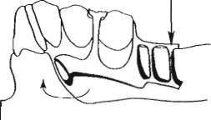
Block out Vs. Relief
Notes:
Sagittal section of cast and denture framework. Lingual alveolar ridge slopes inferiorly and posteriorly (upper figure). When force is directed to displace denture base downward, lingual bar rotates forward and upward but does not impinge on soft tissue of alveolar ridge (lower figure). Therefore in such instances, adequate relief to avoid impingement is gained when tissue side of lingual bar is highly polished during finishing process.

Slide 17
Block out Vs. Relief
Notes:
Undercut alveolar ridge was blocked out parallel to path of placement in fabricating lingual bar (upper figure). Application of vertical force to create rotation of lingual bar upward can cause impingement of lingual tissue on
alveolar ridge (lower figure). To avoid impingement in these instances, not only should master cast be blocked out parallel to path of placement but also an additional relief of 32-gauge sheet wax should be used in blocking out cast in such undercut areas.

Slide 18
Relief
Relief is ordinarily not used beneath palatal major connectors, as it is with mandibular lingual bar connectors, except when maxillary tori cannot be circumvented or when resistive median palatal raphae are encountered.

Slide 19
Relief
Beneath framework extensions onto ridge areas for attachment of resin bases (20-gauge wax)

Slide 20
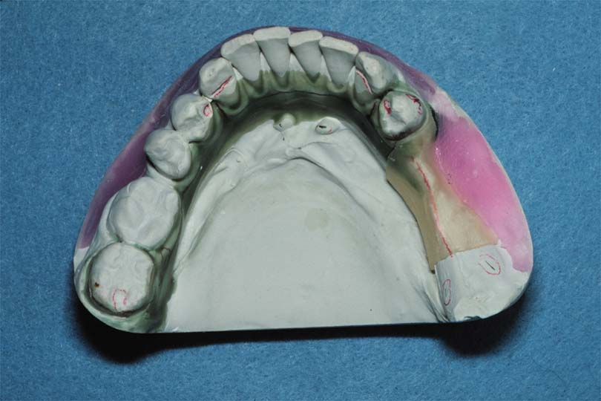
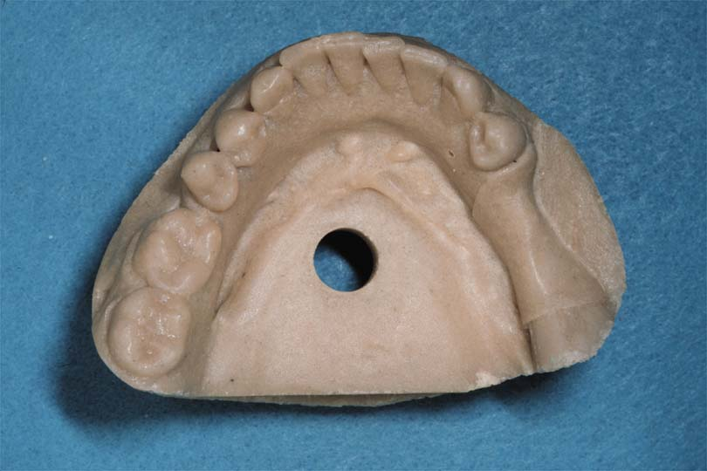
Relief Under the Gridwork
Relief wax is placed in the edentulous areas
1-1.5 mm of relief

Slide 21
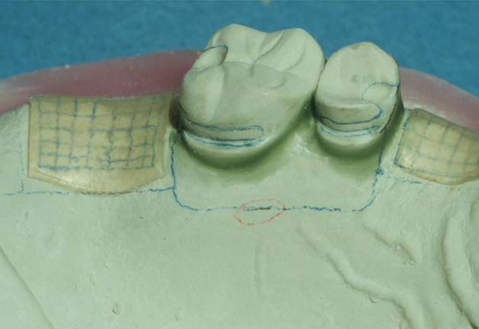
Relief Under the Gridwork
Should begin 1.5 - 2 mm from the abutment tooth

Slide 22
Relief Under the Gridwork
Creates a metal to tissue contact adjacent tooth
Preferable since it wears less
Less porous, (hygiene)

Slide 23
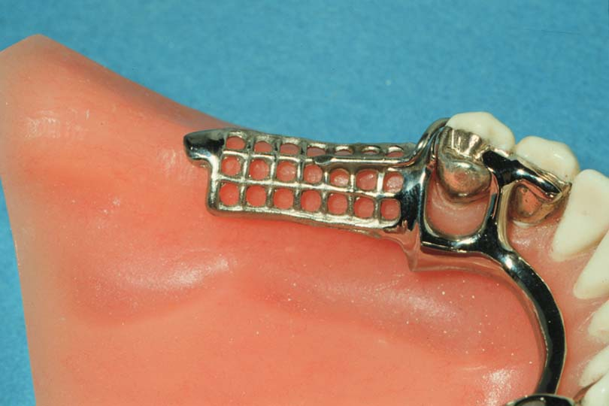
Mandibular Tissue Stops
Contact of metal with cast at posterior of distal extension gridwork
Prevents distortion at free end during hydraulic pressure of processing

Slide 24
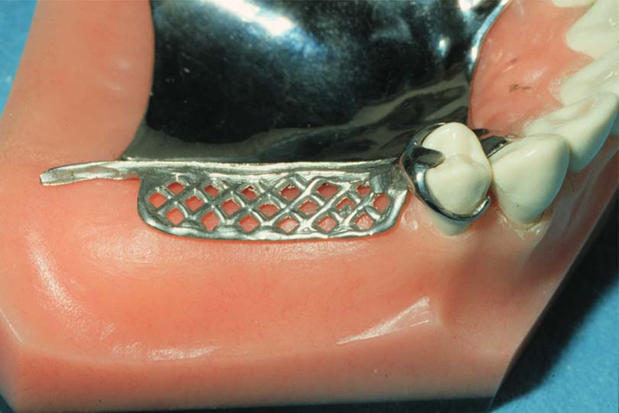
No Tissue Stops In Maxilla
Maxillary major connector acts as a tissue stop (no relief)

Slide 25
Differentiations Between Parallel Blockout, Shaped Blockout, Arbitrary Blockout, & Relief

Slide 28
The Master Cast is Now Ready for Duplication

Slide 29
Laboratory Procedures
Duplicating the blocked-out master cast
Waxing the RPD framework
Spruing, investing, burnout, casting
Finishing of the RPD framework

Slide 30
RPD framework is constructed by waxing on a refractory cast made by duplication of a blocked-out master cast.
The refractory cast serves as the foundation for waxing and casting procedures.

Slide 31
Master Cast Duplication
Duplication
Refractory cast duplicated from master cast
Blocked-out master cast

Slide 32
Framework Wax-up on Refractory Cast
secondary cast
Refractory Cast which was duplicated from master cast
Framework wax-up on refractory cast

Slide 33
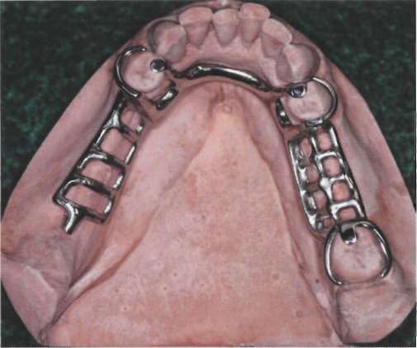

Slide 34
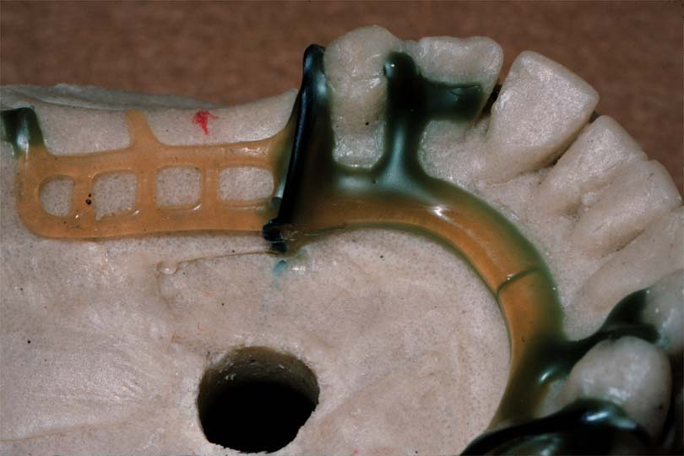
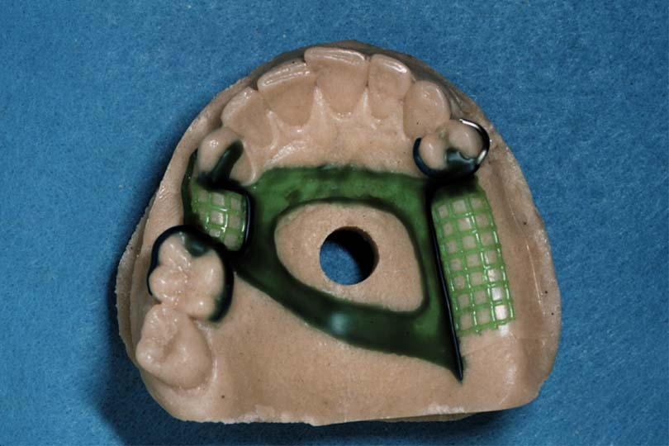
RPD Framework Fabrication
Duplicate Master Cast with Refractory material
Withstand casting temperature
Wax-up framework using design on secondary cast or paper equivalent
Prefabricated wax patterns

Slide 35
RPD Framework Fabrication
Invest Refractory Cast
Burnout wax
Cast in a chrome cobalt or other alloy
Finish & polish
Return to dentist

Slide 36
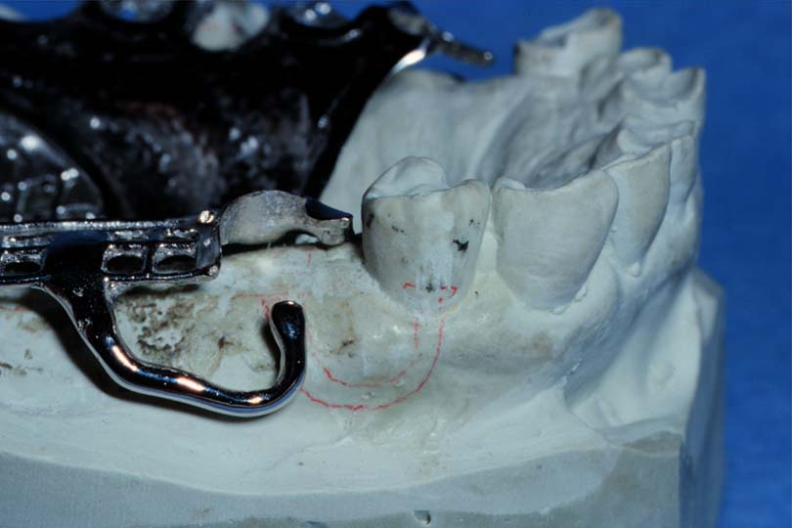
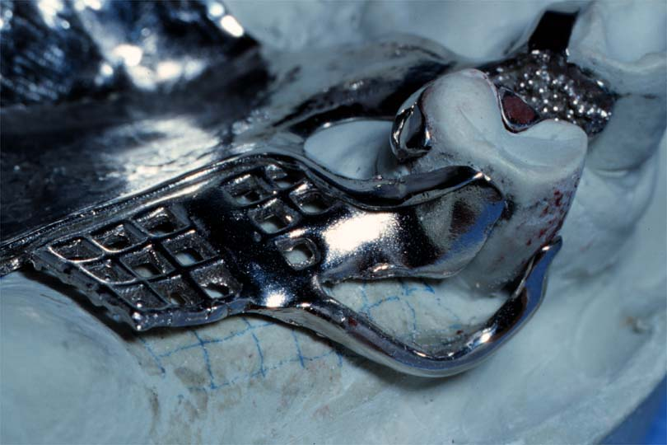
Framework Evaluation on Master Cast

Slide 37
Partial Denture Framework Adjustment
75% of frameworks don’t fit perfectly (Rudd & Kuebker)
Active - orthodontic movement
Adjust to make passive

Slide 38
Partial Denture Framework Adjustment
Adjust without denture base
Adjust soon after fabrication
Prevent tooth migration

Slide 39
Preclinical Inspection
Framework should fit master cast
If it does not, probably will not fit intraorally
Notes:
Finished removable partial denture framework should accurately fit master cast. Adjustment of framework by grinding to fit master cast or mouth is largely eliminated when blockout of cast has been meticulously carried out.

Slide 40
You will take “Partial Denture Framework Adjustment” in Fourth year insha’a Allah

Slide 41
Reference
McCracken's Removable Partial Prosthodontics P.178-184

