Slide 1
Support for the Distal Extension Denture Base
Rola M. Shadid, BDS, MSC

Slide 2
Factors Influencing Support of the Distal Extension Base
1. Contour and quality of the residual ridge
2. Extent of residual ridge coverage by the denture base
3. Type and accuracy of the impression registration
4. Accuracy of the fit of the denture base
5. Design of RPD framework
6. Total occlusal load applied

Slide 3
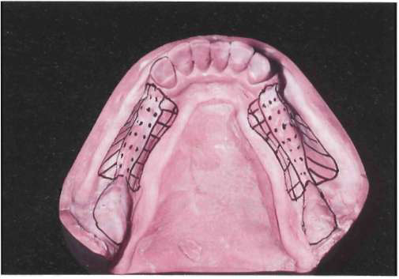
Contour and Quality of the Residual Ridge (Mandibular)
Notes:
Dotted portion outlines crest of residual ridge, which should be recorded in its anatomic form in impression procedures. Similarly, retromolar pads should not be displaced by impression. Buccal shelf regions (diagonal lines) serve as primary support and therefore additional pressures may be placed on these regions for vertical support of denture base. Lingual slopes of residual ridge (cross-hatched) may furnish some vertical support to restoration; however, these regions principally resist horizontal rotational tendencies of denture base and should be recorded by impression in undisplaced form.

Slide 4
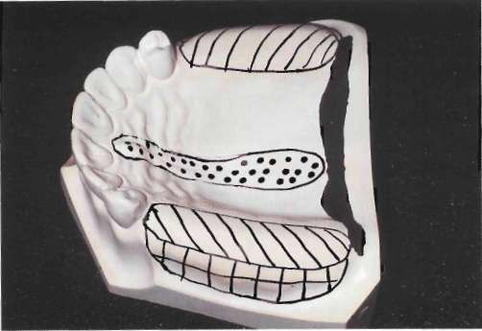
Contour and Quality of the Residual Ridge (Maxillary)
Notes:
Crest of maxillary residual ridge (diagonal lines) is primary supporting region for maxillary distal extension denture base. Buccal and palatal slopes may furnish limited vertical support to denture base. It seems logical that their primary role is to counteract horizontal rotational tendencies of denture base. Dotted portion outlines incisive papilla and median palatal raphe. Relief must be provided for these regions, especially if tissues covering palatal raphe are less displaceable than those covering crest of residual ridge.

Slide 5
Contour and Quality of the Residual Ridge
The immediate crest of the bone of the maxillary
residual ridge may consist primarily of cancellous
bone. Unlike in the mandible, oral tissue that overlies
the maxillary residual alveolar bone is usually of a
firm, dense nature (similar to the mucosa of the hard
palate) or can be surgically prepared to support a
denture base.

Slide 6
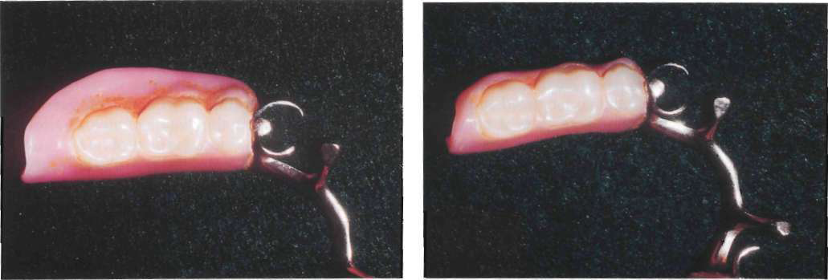
Extent of Residual Ridge Coverage by the Denture Base
Notes:
The broader the residual ridge coverage, the greater the distribution of the load, which results in less load per unit area. A denture base should cover as much of the residual ridge as possible and be extended the maximum amount within the physiological tolerance of the limiting border structures or tissue.

Slide 7
Design of RPD Framework
Mesial Rest Concept
  Provides axis of rotation that directs applied forces in more vertical direction so more of residual ridge receives vertically directed occlusal forces to support denture base
  Will tend to tip terminal abutment tooth mesially & thus be reinforced by other adjacent teeth

Slide 8
Total Occlusal Load Applied
The number of artificial teeth, the width of their occlusal surfaces, and their occlusal efficiency influence the total occlusal load applied to RPD
Kaires concluded "the reduction of the size of the occlusal table reduces the vertical and horizontal forces that act on RPD & lessens the stress on the abutment teeth & supporting tissue

Slide 9
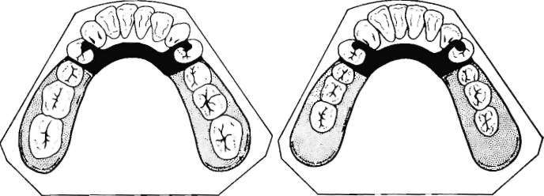
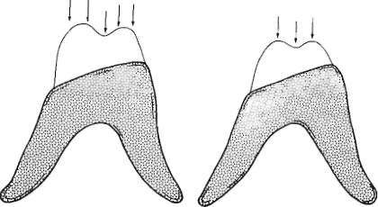
Total Occlusal Load Applied
Notes:
Total occlusal load applied may be reduced by using comparatively smaller posterior teeth represented by right-hand illustration. Less muscular force will be required to penetrate food bolus with reduced occlusal table, thereby reducing forces to supporting oral structures.

Slide 10
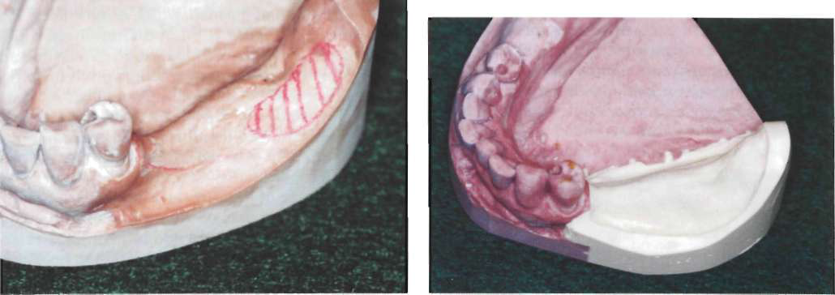
Type and Accuracy of the Impression Registration
Comparison of anatomic and functional ridge forms. Original mandibular
cast showing left residual ridge area recorded in its anatomic form. Buccal shelf region is outlined. Right: same cast after left residual ridge area has been repoured to its functional form as recorded by secondary impression. Functional form is less irreqular *
Notes:
A denture base processed to the functional form is generally less irregular and has greater area coverage than
does a denture base processed to the anatomic or resting form. Moreover, and of far greater significance, a denture base made to anatomic form exhibits less stability under rotating and/or torquing forces than does a denture base processed to functional form and thus fails to maintain its occlusal relation with the opposing teeth.

Slide 11
What Happens if One-stage Anatomic Impression Tech. is Made for Distal Extension RPD?
A distal extension RPD fabricated from a one stage impression which only records the anatomic form of basal seat tissue, places more of the masticatory load on the abutment teeth and that part of the bone that underlies the distal end of the extension base. *
Notes:
This results in a traumatic load to the bone underlying the distal end of the base and loosening of the abutment tooth.
A denture base processed to the functional form is generally less irregular and has greater area coverage than
does a denture base processed to the anatomic or resting form. Moreover, and of far greater significance, a denture base made to anatomic form exhibits less stability under rotating and/or torquing forces than does a denture base processed to functional form and thus fails to maintain its occlusal relation with the opposing teeth.
Also, some tissueward movement can be minimized by providing the best possible support of denture base.

Slide 12
What Types of Impression Techniques Should be Made for Distal Extension RPD?
1. Functional impression tech.
2. Selective pressure "dynamic" impression technique *
Notes:
No single impression material can record both the anatomic form of teeth and tissue in dental arch, and at the same time, the functional form (preferable selective pressure) of residual ridge. Therefore, secondary or corrected impression method must be used (altered cast tech.)
Selective pressure tech. has the advantage of directing the force to the portions of ridge that are most capable of withstanding force and at the same time relieving the tissue of the residual ridge that cannot withstand functional
loading and remain healthy.

Slide 13
How could you make selective pressure "dynamic" impression technique?
By fabricating a specially designed individual tray, you could control the flow of impression material by:
    Amount of wax relief
    Venting
Notes:
Obtaining support from the primary support areas is achieved by the manner in which the flow of the impression material is controlled during the impression-making procedure. Restricting the flow of the material in the primary stress-bearing areas (by minimizing the amount of relief over the area when the custom tray was made) causes greater pressure to be exerted on the tissue in this area (compared with other areas of unrestricted flow where a greater amount of relief or venting of the impression tray was provided).

Slide 14
Impression Tech. for Distal Extension Bases (Mandibular)
Since the goal is to maximize soft tissue support and also use teeth to their supportive advantage, a secondary impression (selective pressure) made in custom trays attached to the framework is a means to coordinate both (Altered cast tech) *
Notes:
A removable partial denture fabricated from a one-stage impression, which only records the anatomic
form of basal seat tissue, places more of the masticatory load on the abutment teeth and that part of the
bone that underlies the distal end of the extension base.

Slide 15
Altered Cast Technique

Slide 16
Altered Cast Technique
Corrected Cast
Modified Cast

Slide 17
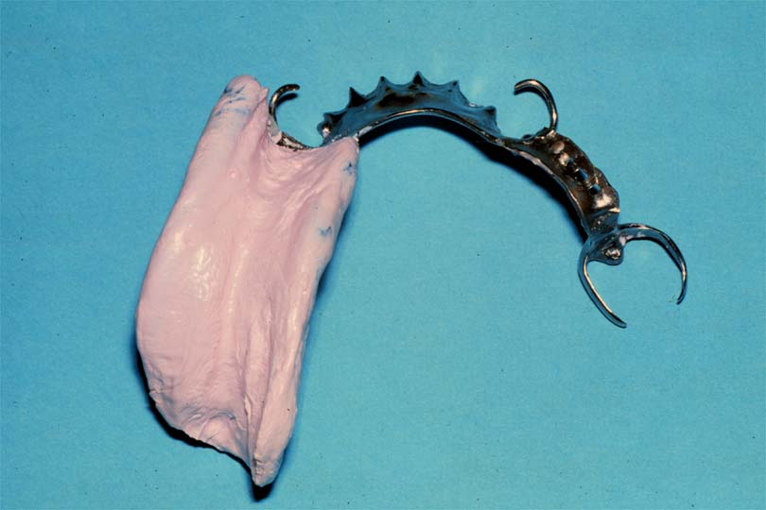
Altered Cast Impressions
Impression of residual ridge
Custom impression tray attached to the framework

Slide 18
Purpose
Provide maximum support for distal extens.RPD
More accurate relationship between abutments & ridge
Equalize stress between ridge & abutments
Minimize tissueward movement of distal extension base
Maintain occlusal contact between both natural & artificial dentition
Correct peripheral adaptation
Notes:
No philosophical difference in the requirement of support and coverage by bases of distal extension RPDs and complete dentures, either maxillary or mandibular, because the objective of maximum support is the same

Slide 19
When Needed?
Class I & II - relationship most needed
Extensive Class III & IV cases
Tooth mobility + compressible mucosa
Less necessary in maxilla

Slide 20
Procedure

Slide 21
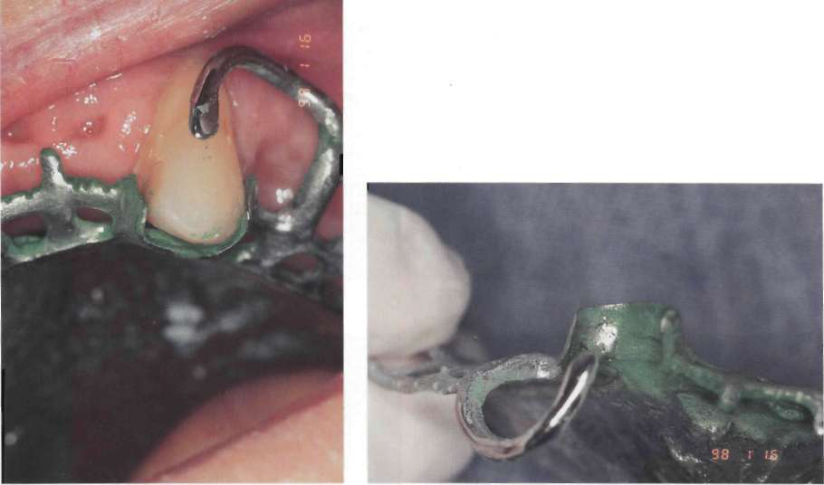
1. Well Fitting Framework
Notes:
Use of a disclosing media to identify interferences to completely seating the removable partial denture framework

Slide 22
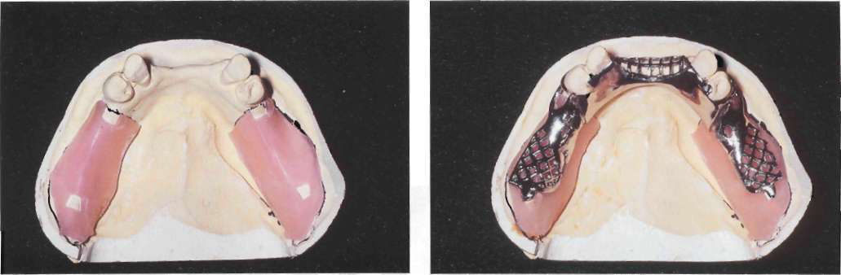
2. Place relief over ridge
  1 mm wax relief
  Heat and fully seat the framework

Slide 23
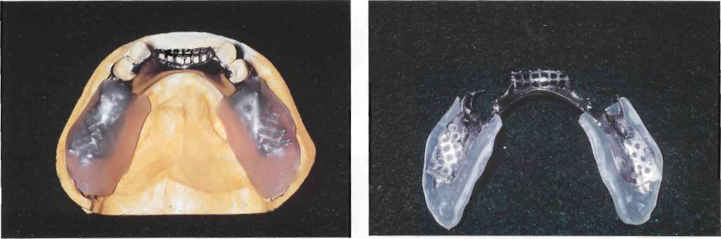
  3. Separator (Tinfoil substitute (Alcote) or model release agent) +Acrylic tray adaptation
Notes:
All regions of cast that will be contacted by autopolymerizing acrylic resin or VLC resin are painted with tinfoil substitute (Alcote) or model release agent (MRA). A sheet of VLC resin material is adapted to cast and over the framework with finger pressure. Excess material over borders of cast is removed with sharp knife while material is still soft.
Holes will be placed in trays corresponding to crest of residual ridge and retromolar pads to allow escape of excess impression material when impression is made. Holes should not be placed in trays in buccal shelf areas

Slide 24
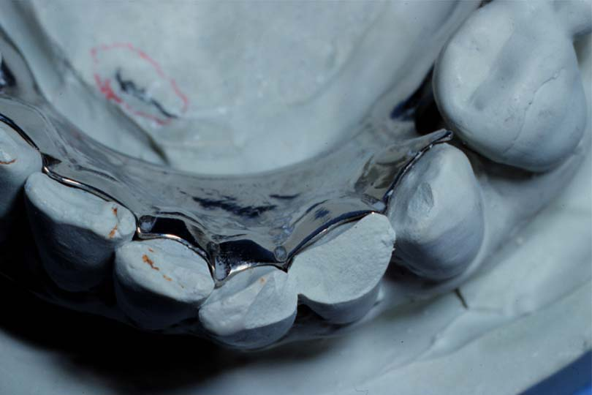
4. Check Seating
If not seated, remove, repeat
  Rests fully seated
  Tissue stop contacts cast
  Metal adjacent abutment contacts cast
  No resistance as framework seated

Slide 25
5. Check Peripheries
2-3 mm short of vestibule
No displacement when:
  Pull on cheeks, lips
  Patient activates tongue

Slide 26
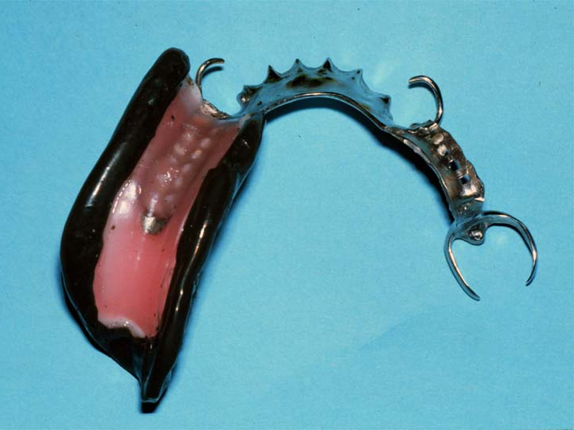
6. Border Mold
Simulate final denture border

Slide 27
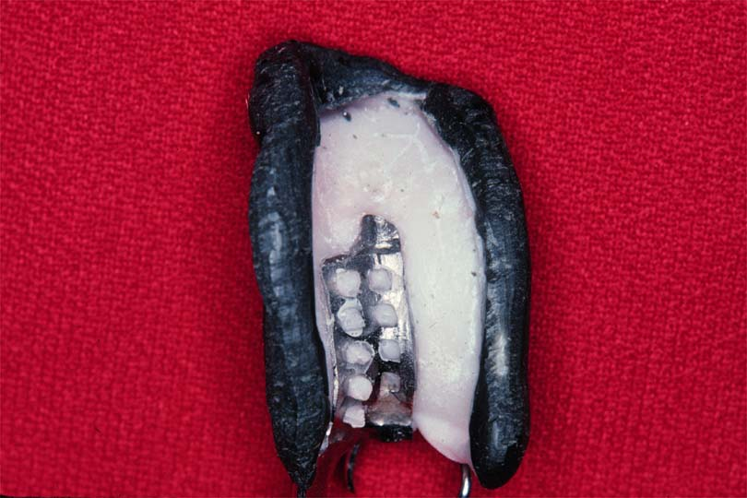
7. Make Altered Cast Impression
Ensure tray is well retained by framework
Remove wax spacer
Coat tray with adhesive If you want to make impression with addition silicone

Slide 28
Altered Cast Impression Material
  Polyvinyl siloxane (Light or medium body)
OR
Metallic oxide paste impression material
Carefully load tray
No material under rests, guiding planes, max.
major connector, etc.
Seat with pressure over Rests

Slide 29
No Pressure Over Gridwork
Fulcruming or tissue compression
Spring back and lack of tissue contact

Slide 30
8. Remove & Inspect Impression
Absence of voids
Minimal burnthrough
Covers supporting tissues
Fully seated, etc.

Slide 31
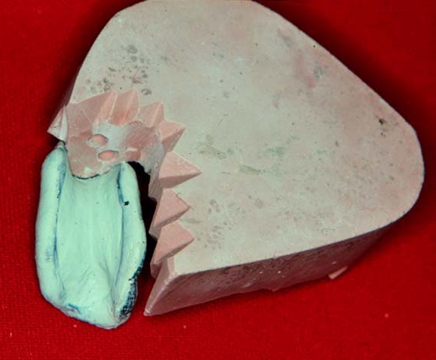
9. Send to Laboratory
Lab Steps
  Section residual ridge from cast
  Ensure no contact between impression & cast
  Place retentive grooves in cast
  Sticky wax in place

Slide 32
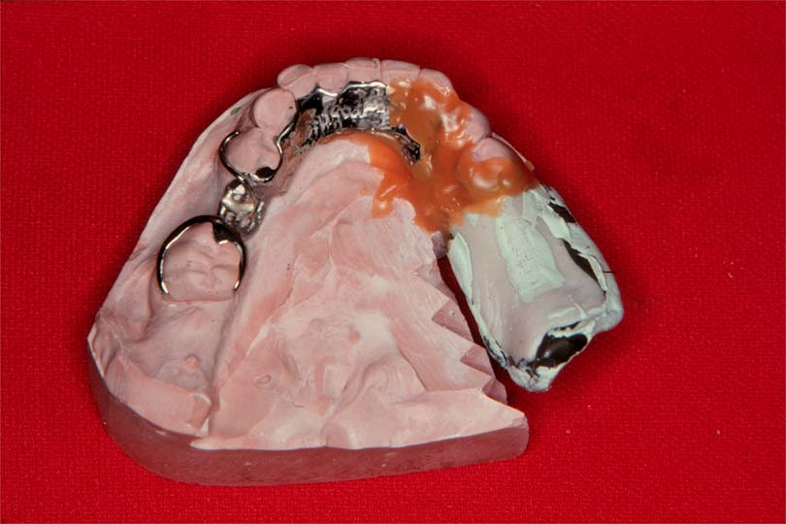
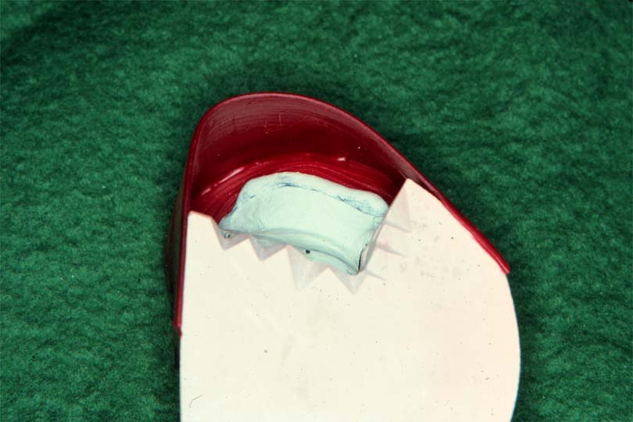
Lab Steps
  Box impression
  Ensure water tight seal
  Seal retainer, major & minor connector borders
  Pour new ridge areas in
  different color stone

Slide 33
  Pour new ridge areas in different color stone

Slide 34
Problems with the Altered Cast Technique
If tray is added carelessly, it can alter passive relationship
Excess impression material under framework
If inadequately sealed, stone over teeth, can’t articulate model

Slide 35
Why is the altered cast method most commonly used for mandibular distal extension RPD not for maxillary?
Notes:
Because a common clinical finding in the mandibular distal extension cases is a greater variation in tissue mobility and tissue distortion or displaceability, which necessitates some selective tissue placement to obtain the desired support from this tissue. This variability in tissue mobility is probably related to the pattern of mandibular residual ridge resorption.

Slide 36
Why is the altered cast method seldom used in the maxillary arch?
Notes:
Because of the nature of the masticatory mucosa and the amount of firm palatal tissue present to provide soft tissue support. This tissue seldom requires placement to provide the required support. If excessive tissue mobility is present, it is often best managed by surgical resection as this is a primary supporting area.

Slide 37
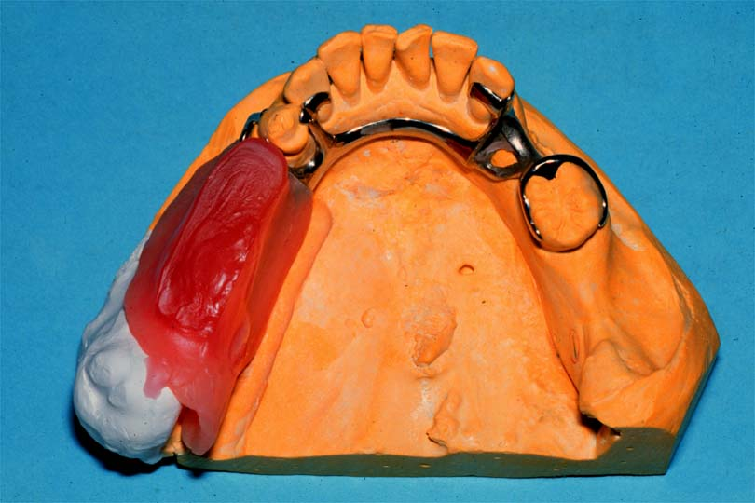
Record Base for Wax Setup
Place Denture Base
  Hard baseplate wax
    Easier to remove during processing
    Can melt or distort
  Acrylic resin
    Harder to remove
    More rigid and stable for jaw relation

Slide 38
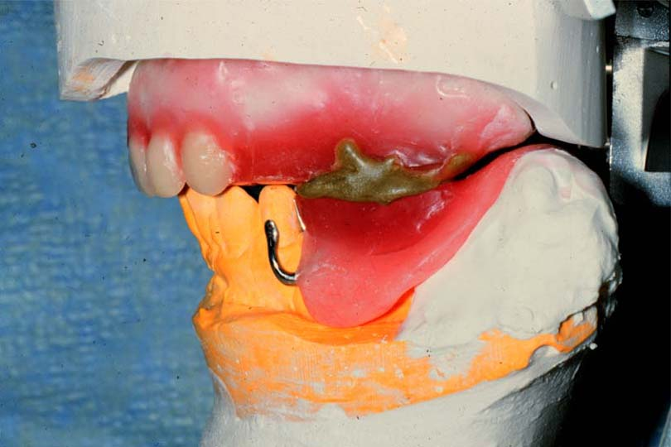
Jaw Relation Records
Mount Casts on Articulators
  Centric Record
    Maxilla to mandible position
  Protrusive Record
    Program articulator for excursions

Slide 39
References
McCracken’s Removable Prosthodontics, 11th Edition 2005 by McGivney GP, Carr AB. Chapter 16
Dalhousie continual education

