Slide 1
Record Bases & Occlusion Rims
Rola M. Shadid, BDS, MSc

Slide 2
Record Bases
An interim denture base used to support the record rim material for recording maxillomandibular records
The primary function is to serve as a base to fabricate and support the wax occlusion rims and trial dentures

Slide 3
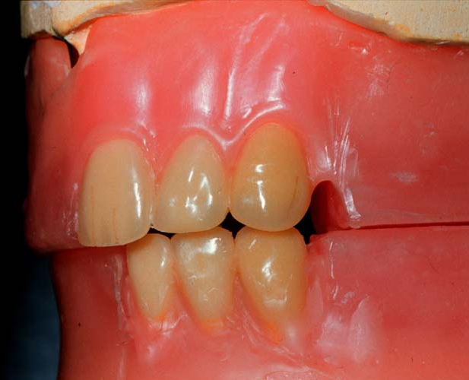
Record Bases & Occlusion Rims
Wax occlusion rims simulate the position of the teeth

Slide 4
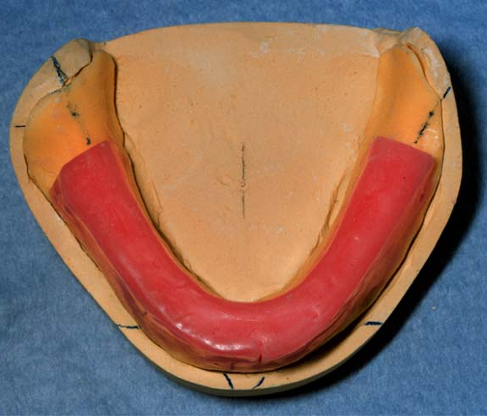
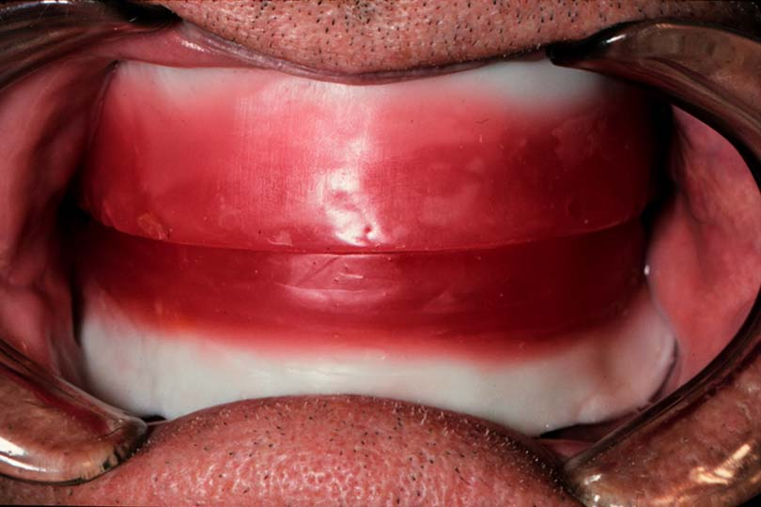
Record Bases & Occlusion Rims
Occlusion rims slightly bulkier to provide additional stability during record making

Slide 5
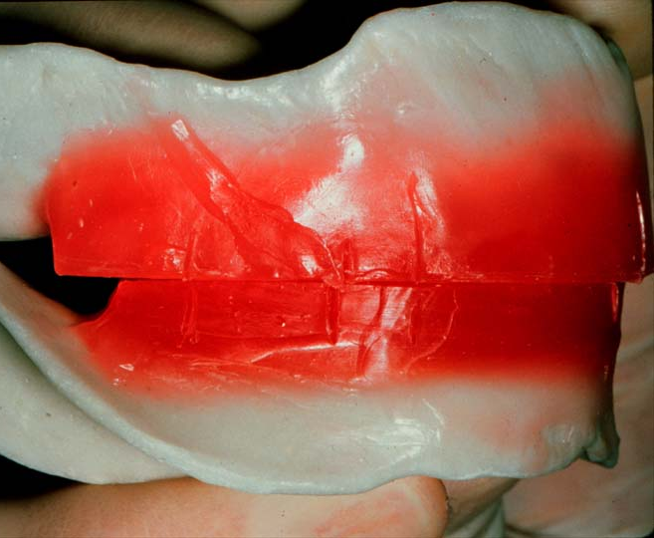
Arbitrary Adjustment of Occlusion Rims (Refer to lab. manual)
Adjust separately using average dimensions:
Maxillary - 22 mm
Mandibular - 18 mm

Slide 6
Maxillary Occlusion Rim Adjustment
Maxillary rim slightly facial to compensate for ridge resorption

Slide 7
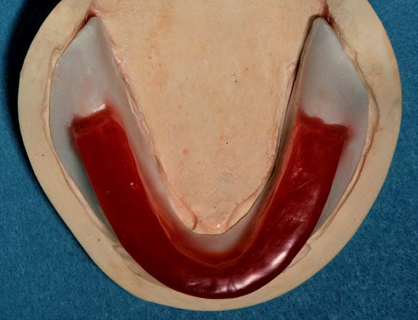
Mandibular Occlusion Rim Adjustment
Centered over the ridge to maximize stability

Slide 8
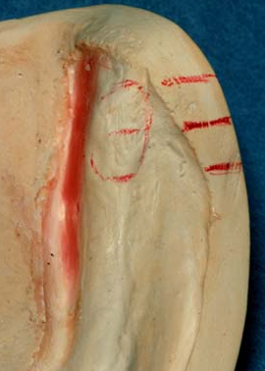
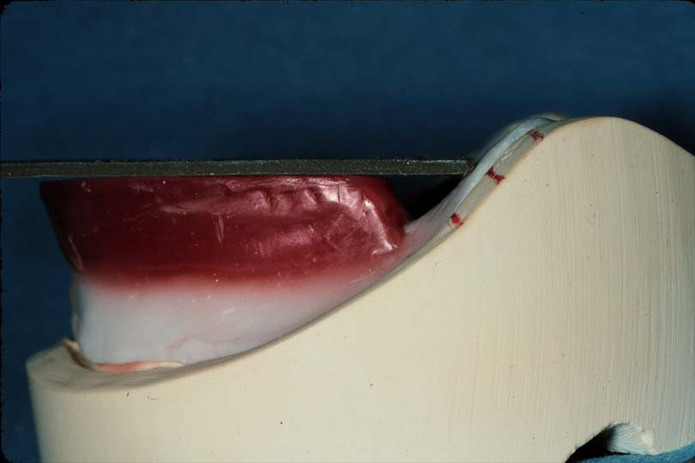
Mandibular Occlusion Rim Adjustment
Posteriorly, the occlusion rim intersects 1/2 - 2/3 up the retromolar pad

Slide 9
Requirements of Record Bases
Well adapted
Stable and retentive in mouth
Rigid and dimensionally stable
Smooth
No more than 1 mm thick on the crest and facial slope of ridge
2 mm thick in the palatal and lingual slope region for rigidity
Smooth and rounded borders

Slide 10
Record Bases
Temporary bases
Permanent bases

Slide 11
Temporary Record Bases’ Materials
Shellac
Autopolymerizing acrylic resin
Vacuum formed vinyl or polystyrene
Baseplate wax

Slide 12
Permanent Record Bases’ Materials
Heat cured acrylic resin
Gold alloy
Chrome cobalt alloy
Chrome nickel alloy
Swaged metal base

Slide 13
Occlusion Rims
Occluding surfaces fabricated on interim or final denture bases for making maxillomandibular relationship records and arranging teeth

Slide 14
Uses of Occlusion Rims
Determination of lip support
Arch form
Plane of occlusion
Teeth size and position
Contour of the polished surface
Transfer jaw relation
Arrangement of teeth

Slide 15
References
1. Complete Denture Prosthodontics, 1st Edition, 2006 by John Joy Manapallil, Chapter 8
2. Dalhousie Continual Education

Slide 16
Jaw Relations

Slide 17
Basic Mandibular Positions
Rest position (physiologic rest position) PRP
Intercuspal position (maximum intercuspation, centric occlusion, tooth position) CO
Centric relation (ligamentous position, posterior border position, Retruded contact position ) CR

Slide 18
Physiologic Rest Position (PRP)
The vertical and horizontal position the mandible assumes when the mandibular musculature is relaxed and the patient is upright.
When the mandible is in the rest position there is a space between the occlusal surfaces of the teeth which is known as the freeway space or interocclusal rest space.
This space is wedge-shaped, being larger anteriorly where the separation between the teeth is most commonly within the range 2–4 mm.

Slide 19
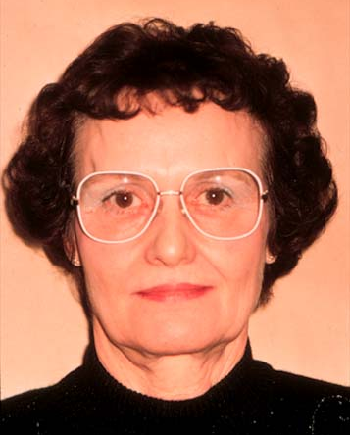
Physiologic Rest Position (PRP)
At rest, lips barely touching
Occlusion rims should not touch
Intraorally no contact

Slide 20
Occlusal Vertical Dimension (OVD)
The distance between two selected points, one related to the maxilla and one related to the mandible, when the upper and lower teeth are in contact.
When the mandible is in its resting position, this distance is the rest vertical dimension
The difference between the measurements
is the freeway space.

Slide 21
Occlusal Vertical Dimension (OVD)
Distance between maxilla & mandible when teeth or wax rims contact in centric position

Slide 22
Freeway Space or Interocclusal Distance (ID)
Space between wax rims at physiologic rest position
Usually 2-4 mm

Slide 23
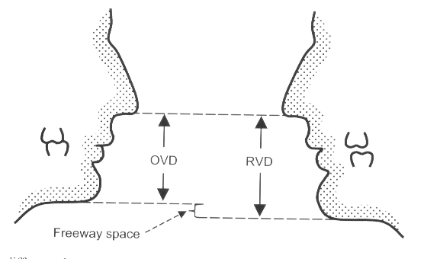

Slide 24
Variation in the Rest Position
It is found that the rest position of the mandible was not constant throughout life.
The rest position of the edentulous patient can be affected by short-term variables, and by long-term variables.

Slide 25
Short-Term Variables
Patient supine: Reduced
Head tilted back: Increased
Head tilted forwards: Reduced
Insertion of lower denture or record block: Increased
Stress: Reduced
Pain: Reduced
Drugs: Variable

Slide 26
Long-Term Variables
If the same dentures are worn for many years and are not maintained, a reduction in the occlusal vertical dimension occurs as a result of alveolar resorption and occlusal wear. The rest position of the mandible adapts to this change and takes up a position closer to the maxilla. As a result, the freeway space becomes larger.

Slide 27
Long-Term Variables
Where these changes have taken place in young patients, it is often possible to recover much of the lost vertical dimension when new dentures are constructed.
However, with the elderly patient, any attempt to restore the occlusal vertical dimension to its original level may be met with problems.

Slide 28
Long-Term Variables
The long-term variables will not affect the reproducibility of the rest vertical dimension during the period of a dental appointment

Slide 29
Intercuspal Position (Centric Occlusion)
The intercuspal position is the vertical and horizontal position of the mandible in which maximum occlusal contact occurs.
In the denture wearer, the intercuspal and centric relation positions should coincide.

Slide 30
Centric Relation
The maxillomandibular relationship in which the condyles articulate with the thinnest avascular portion of their respective disks with the complex in the anterior-superior position against the shapes of the articular eminencies.
This position is independent of tooth contact. This position is clinically discernible when the mandible is directed superior and anteriorly. It is restricted to a purely rotary movement about the transverse horizontal axis (GPT-5)

Slide 31
Centric Relation (CR)
It is usually defined by the position of the condyles, rather than the teeth. Therefore it does not alter when the natural teeth are extracted or when a new occlusal surface replaces an unsatisfactory one.
Centric relation can be thought of as a treatment position, which is not necessarily ideal or normal in the natural dentition.

Slide 32
When to Use CR?
When entire occlusion being restored (i.e. no remaining posterior centric stops)
When complex fixed, or removable partial dentures involve the entire occlusion
if a nonpathologic natural occlusion exists (posterior centric stops present), and there is no valid reason to change it, then restorations should be made in maximum intercuspation

Slide 33
Significance of CR (Reasons for Using CR in Edentulous Patients)
Artificial teeth are best to occlude evenly at CR
Conducive to health - not pathogenic
Relatively repeatable (reproducable) over a period of time - so the patient can find stable occlusal contacts easily
A hinge position - allows change in the vertical dimension easily and so the patient can find stable occlusal contacts easily
A relatively symmetrical position - avoids muscle strain which might occur in excursive positions

Slide 34
Significance of CR (Reasons for Using CR in Edentulous Patients)
6. This position is independent of presence or absence of teeth
7. If CR and CO of artificial teeth don’t coincide , there is instability of dentures and patient subjected to pain or discomfort

Slide 35
Significance of CR (Reasons for Using CR in Edentulous Patients)
8. Allows function to all positions
9. 24% of normal population has CR=CO

Slide 36
References
Basker’s Prosthetic treatment of the edentulous patient. Fourth edition. Chapter 5.
Dalhousie Continual Education

