Slide 1
Border Molding & Final Impression
Rola M. Shadid, BDS, MSc

Slide 2
Impression Techniques
1. Close mouth or pressure impression technique
Records impression in a condition that assumes under masticatory load
Notes:
This technique believes that occlusal loading during impression will record the tissues in a functional form as during swallowing and eating.
Advocates of this technique believe that the periphery of dentures must be established during function.
Disadvantages:
The total time during 24 hours associated with direct functional occlusal force application to periodontal tissue is 17.5 minutes. Thus dentures are in function for a short period of time each day.
Dentures will fit well during mastication, and will lift up at rest due to tissue rebound. This results in premature contacts.
Due to constant pressure on the tissues, mucosal tissue reaction and resorption may result.

Slide 3
Impression Techniques
2. Non pressure or mucostatic impression technique
Records impression of the tissue in an anatomical form without pressure
Notes:
Advocates of this technique believe that impression must be recorded in an anatomic form of the tissues (resting form). Dentures constructed by mucostatic impression technique have shorter flanges. Short flanges are used to prevent the dentures moving in lateral direction and NOT for border seal.
Metal bases which are dimensionally stable are used.
Disadvantages:
Dentures do not cover broad areas
Inadequate support
Short flanges do not support the lips and cheeks

Slide 4
Impression Techniques
3. Selective compression impression technique
Records impression with more compression on the tissue in certain selected areas than on other areas.
Notes:
Primary stress bearing areas are recorded under pressure
The secondary stress bearing areas are recorded with minimal pressure
Peripheral areas are recorded under compression to develop seal
The pressure can be selectively applied to the tissue by the custom trays for making final impression

Slide 5
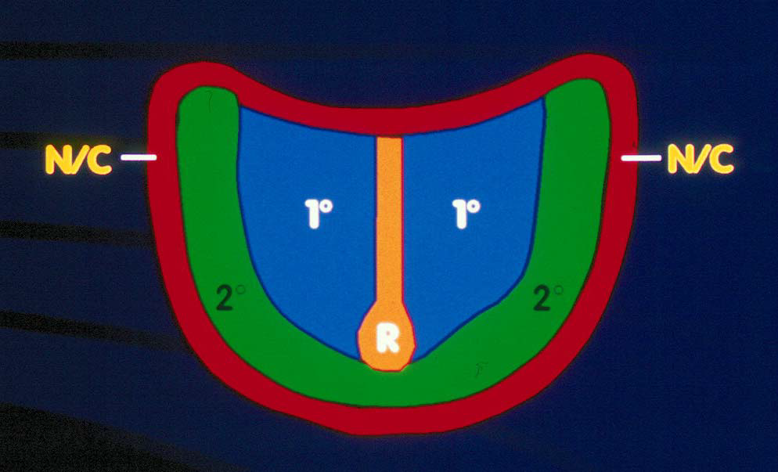
Anatomy of Edentulous Maxilla
Primary stress bearing area
Horizontal portion of hard palate (1)
Secondary stress bearing area
Ridge crest & rugae (2)
Non stress bearing area
Ridge slopes ( n/c )

Slide 6
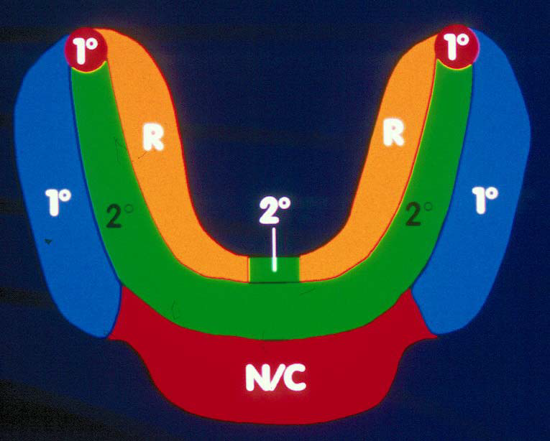
Anatomy of Edentulous Mandible
Primary stress bearing area
Buccal shelf (1)
Secondary stress bearing area
Ridge crest & genial tubercles (2)
Non stress bearing area:
Labial and lingual inclines (n/c)

Slide 7
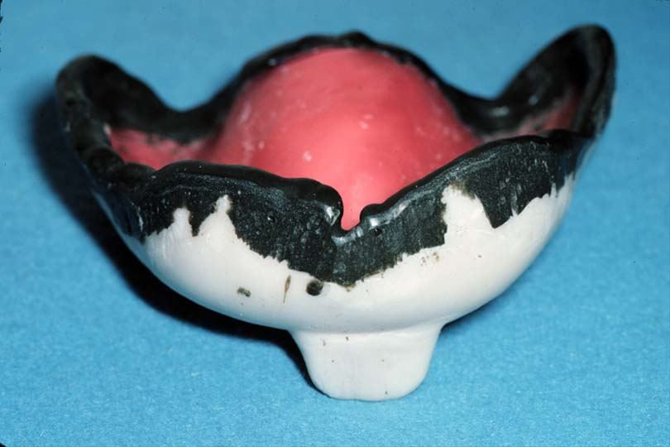
Border Molding
The shaping of the border areas of an impression tray by functional or manual manipulation of the soft tissue adjacent to the borders to duplicate the contour and size of the vestibule
The glossary of prosthodontic terms, 2005
Notes:
Border molding is performed to:
a. ensure an optimal peripheral seal, and to
b. allow the muscles to function in harmony with the denture
Functional movements by the patient like smiling, sucking, licking the lips and other tongue movements, swallowing…
Manual or digital method: the dentist manipulates the lips and cheeks of the patient to simulate their influence on the denture

Slide 8
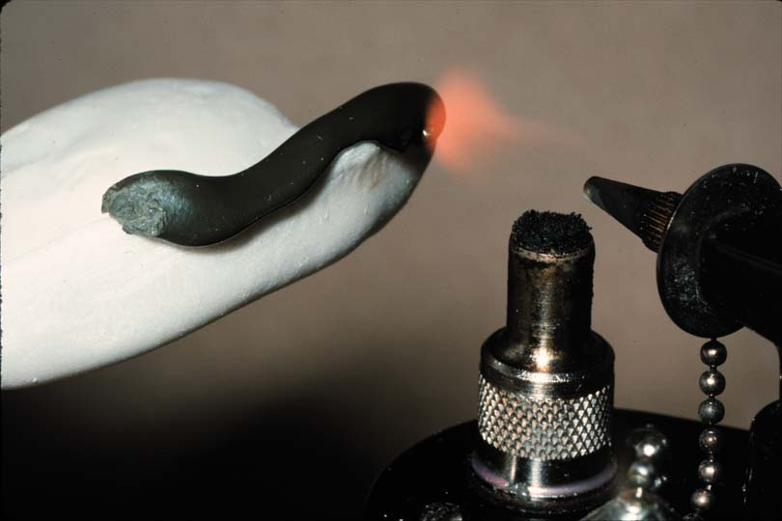
With Which Materials Border Molding is Performed?
  Thermoplastic modeling compound (the most popular)
  Waxes
  Impression materials
  (polyether)

Slide 9
Sequence of Border Molding
May be done:
segment by segment (with modeling compound) or
in one step (with polyether)

Slide 10
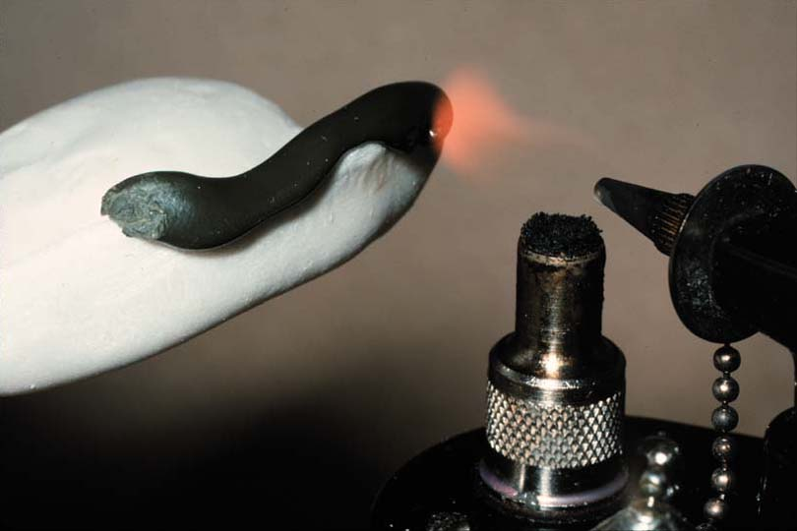
Procedure of Border Molding

Slide 11
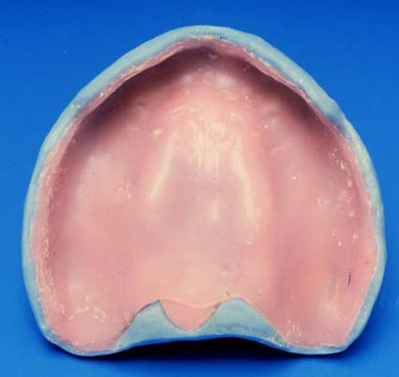
Tray Wax Spacer
Remains in place during border molding procedures

Slide 12
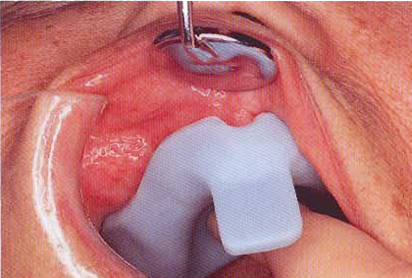
Custom Tray
Comfortable
2-3 mm short from vestibule (maxilla & mandible)
Dry periphery of tray (Compound will not stick to tray otherwise)

Slide 13
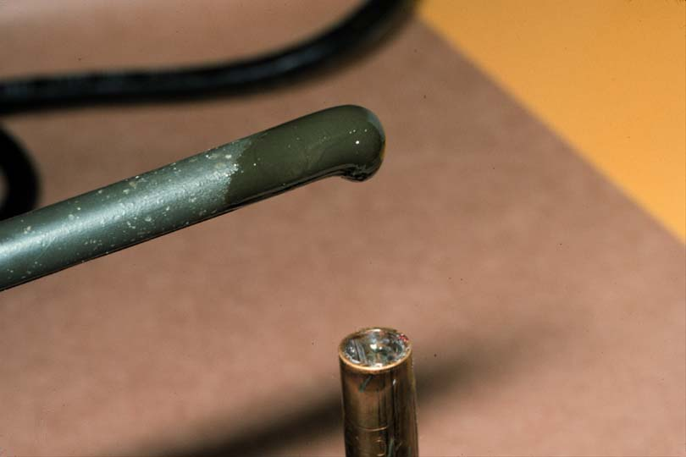
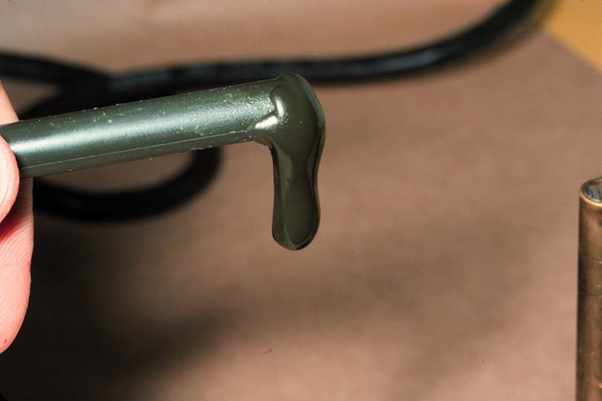
Heating Compound
Warm until it starts to droop
Do not overheat – if catches fire or boils, it will not mold properly

Slide 14
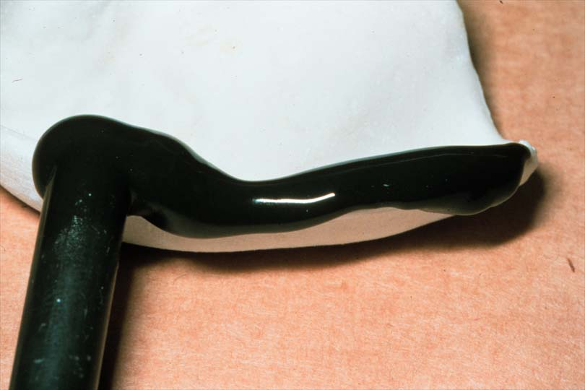
Compound Application
Apply over periphery of tray, in a thickness just slightly narrower than the compound stick

Slide 15
Re-soften After Application
Flame with a hand torch until all seams or sharp contours have disappeared
Do not melt wax spacer inside tray

Slide 16
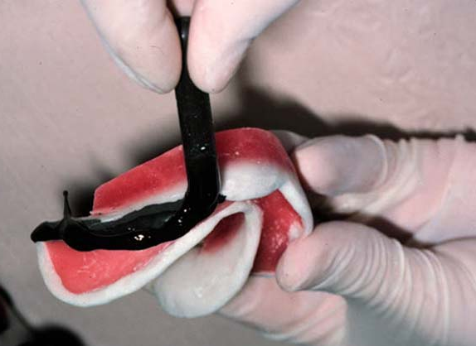
Prevent Slumping
Hold the tray upside down so that compound droops toward the depth of the vestibule

Slide 17
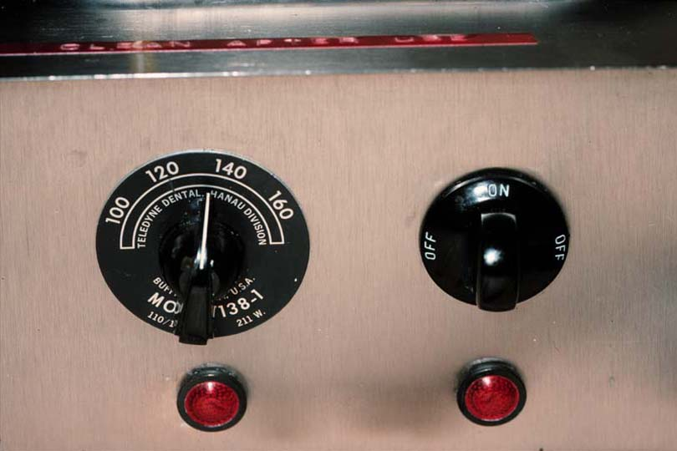
Temper the Compound
Temper in a water bath (135-140°F) for several seconds
  Prevent burning
  Hot water bath will keep compound soft for an extended period
Notes:
Keep wax spacer out of hot water bath to prevent melting because if it melts:
a. Difficult to replace tray intraorally in the same position
b. Results in uneven border molding

Slide 18
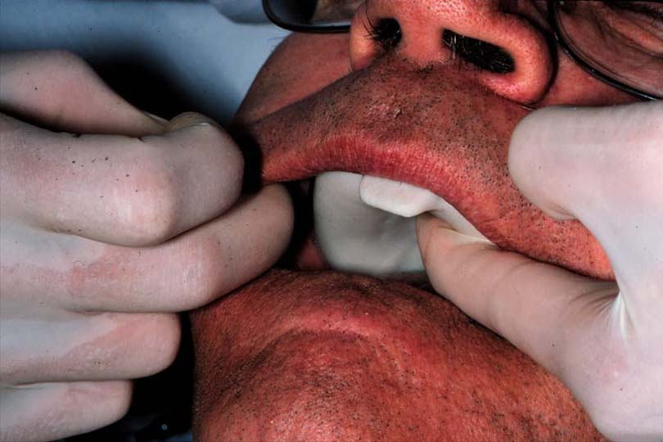
Prepare Patient
Patient seated, head against headrest, mouth open & relaxed
If patient “opens wide”, commisures constrict, limiting access

Slide 19
Maxilla - Seating the Tray
Place intraorally by rotating into place
Seat tray firmly in mid-palatal area during border molding procedures

Slide 20
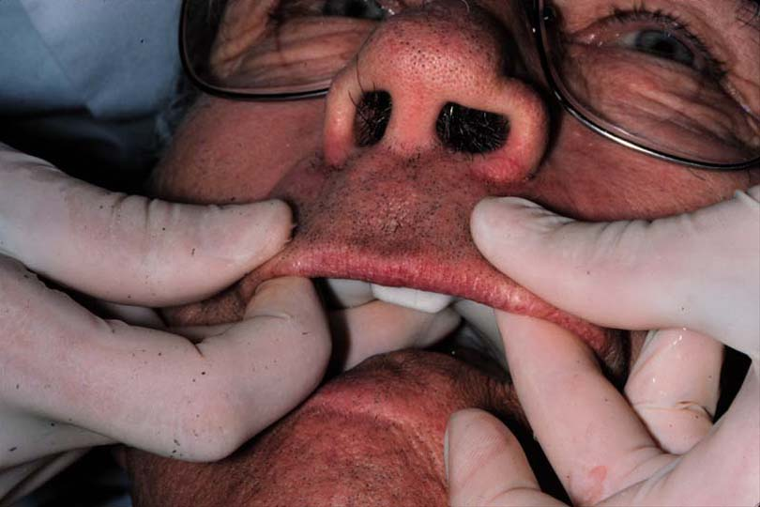
Maxilla - Labial Frenum
Pull lip outward , downward & inward
  Do not pull to one side

Slide 21
Maxilla – buccal frenum & buccal flange
Mold buccal area by pulling cheek outward, downward, inward, & finally forward & backward

Slide 22
Maxilla – Coronoid Notch on Distobuccal Region
Pull the cheek outward,
downward and inward while patient moves mandible from side to side & opens wide *
  Molds the retrozygomal area
  Allows for movement of coronoid process
  Prevents impingement of pterygomandibular raphe
Notes:
* These maneuvers create an imprint on the outer portion of distobuccal corner and also reduce the space available for the denture in this area. This must be preserved during the wax up of the denture. Failure to record the coronoid activity may lead to soreness and dislodgement in this region.

Slide 23
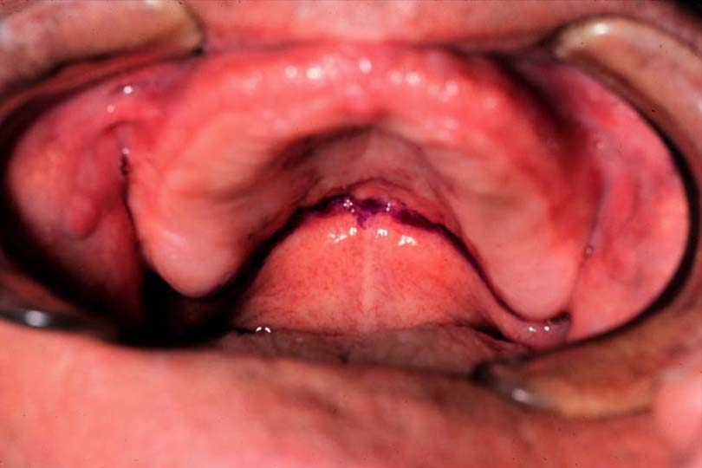
Maxilla - Posterior Border
Terminates at vibrating line and hamular notches
Mark with an indelible stick
  Insert tray & check visually, trim tray until it reaches the vibrating line

Slide 24
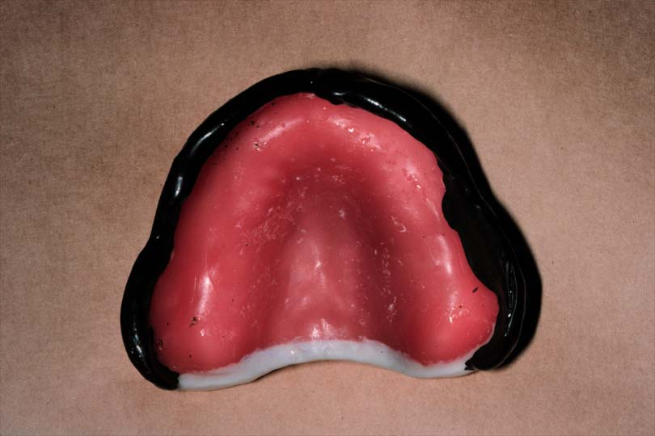
Maxilla - Posterior Border
Add compound across the top of the tray (not at the edge), insert tray in mouth, & press gently on posterior border

Slide 25
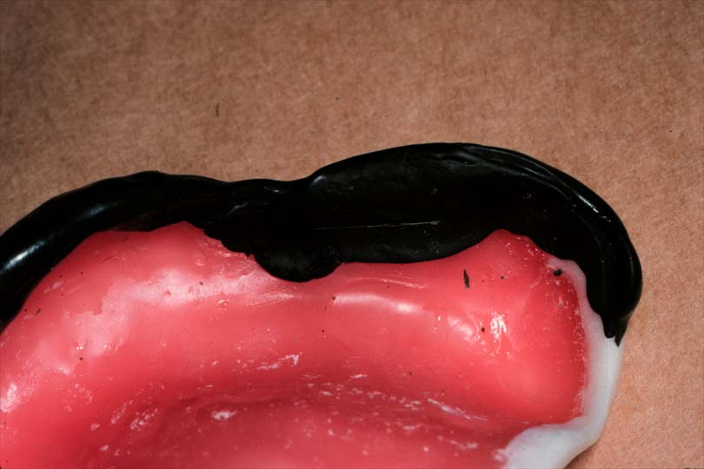
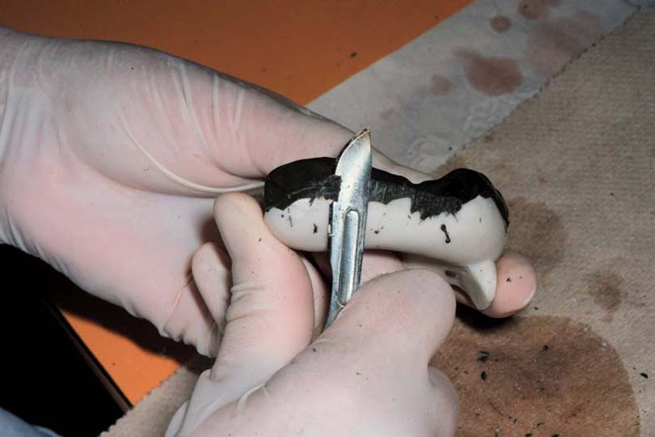
After Removal From Mouth?
Chill in cold water
Trim excess over wax spacer or external material that is thicker than 4-5 mm
  Clean debris from tray

Slide 26

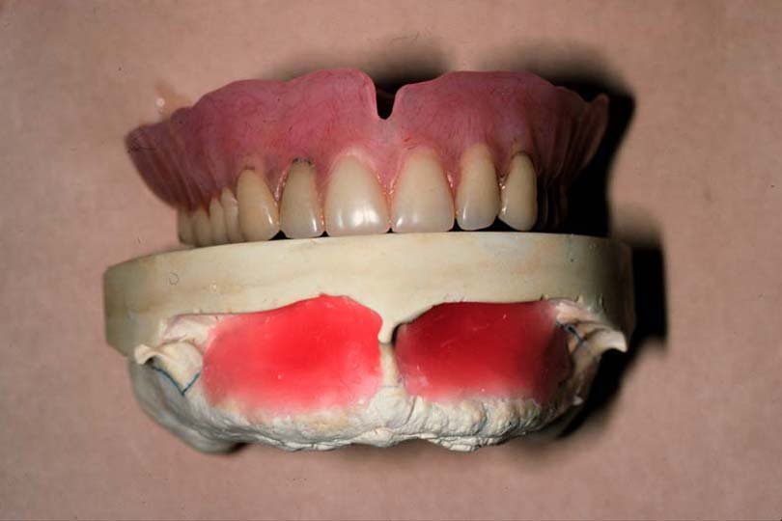
Maxilla-Evaluating Border Molding
1. Relatively symmetrical

Slide 27
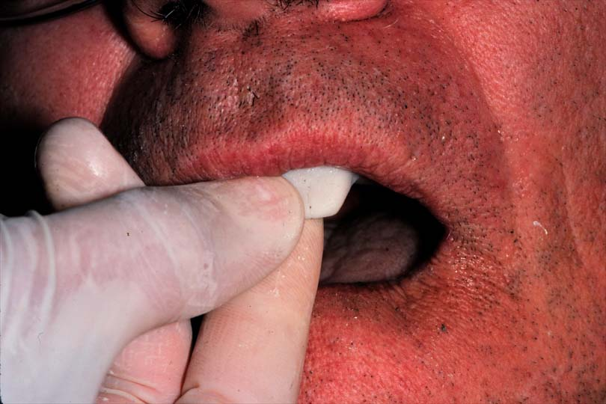
Maxilla-Evaluating Border Molding
2. Retentive

Slide 28
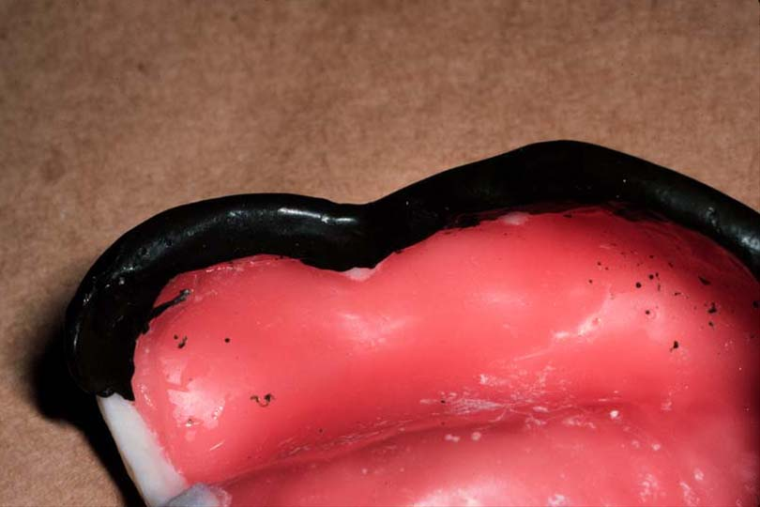
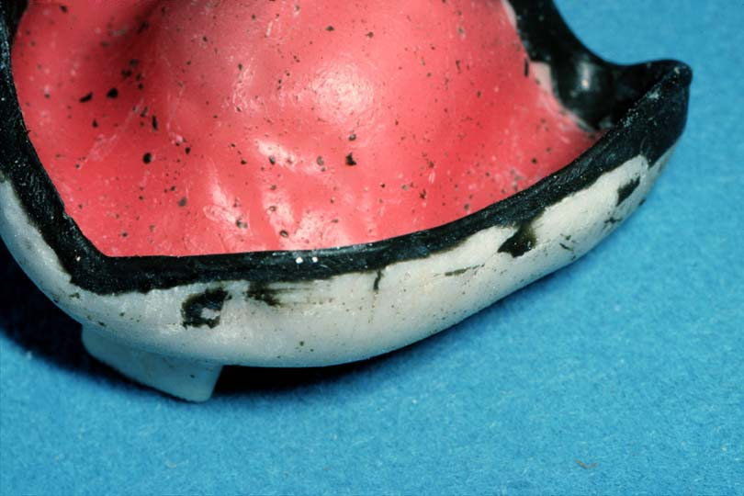
Maxilla-Evaluating Border Molding
Proper thickness (no more than 3-5 mm)
No overlap
No sharp border
Matt not glossy surface
Notes:
If glossy, this means to add more modeling compound.
If border is sharp or has seams, re-flame, temper and readapt intraorally, repeat until periphery is rounded and completed.

Slide 29
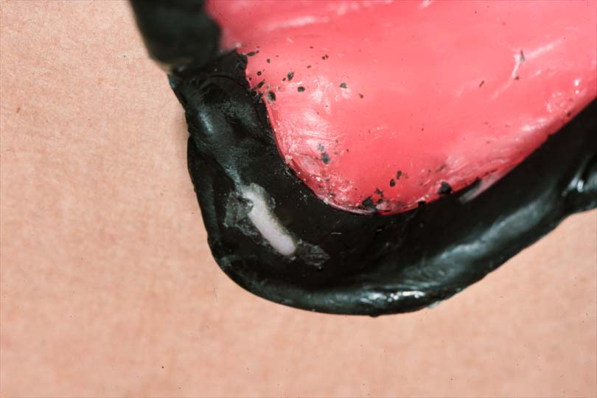
Maxilla-Evaluating Border Molding
7. Overextensions of tray are readily detected because tray will protrude through the material (burnthrough)
Relieve tray & repeat border molding in this area

Slide 30
Maxilla-Evaluating Border Molding
8. Labial frenum should be narrow
9. Buccal frena usually broader, “V-shaped”

Slide 31
Mandible- Border Molding
More difficult
Changing position of the floor of the mouth

Slide 32
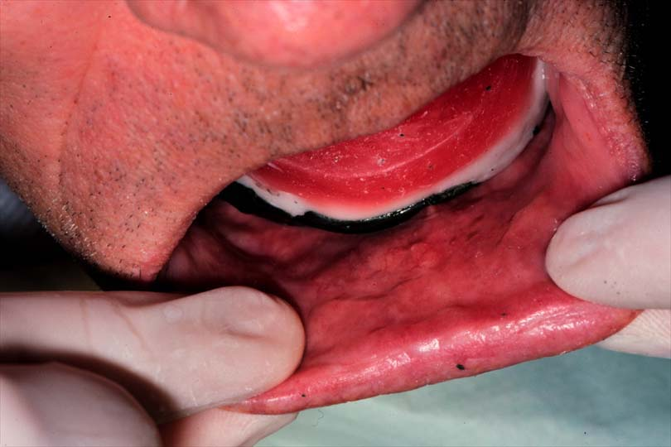
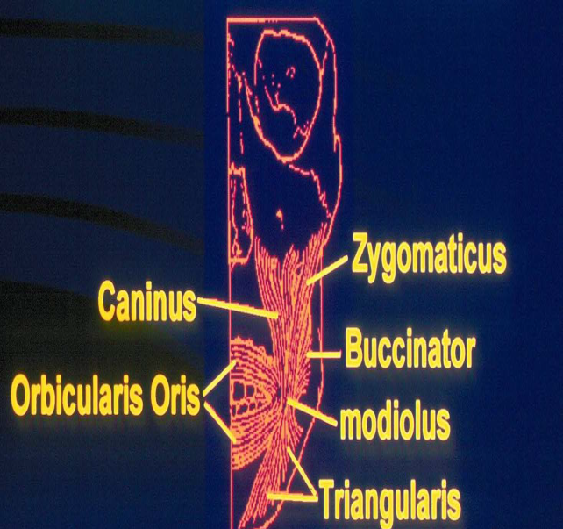
Mandible-Labial flange & labial frenum
Pull lip outward, upward & inward while holding tray in place
Notes:
Start border molding beginning with labial flange (1) , buccal flanges (2) and finally lingual
flanges (3)

Slide 33
Mandible-Buccal flange & buccal frenum
Pull cheek outward, upward, inward & then forward & backward
Have patient suck cheeks inward while holding tray in place

Slide 34
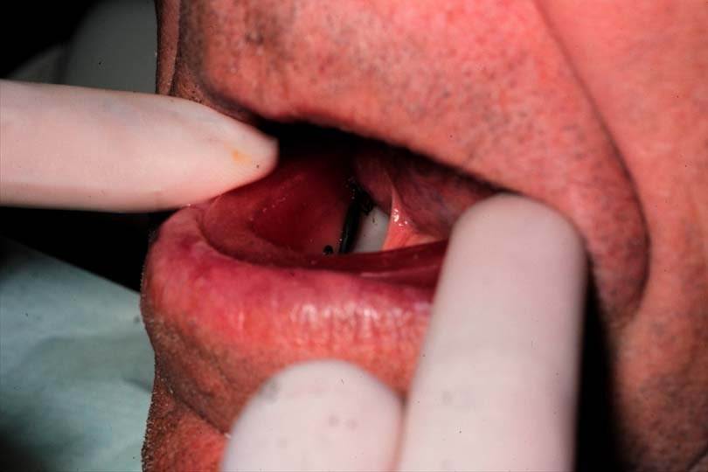
Mandible-Masseter Muscle
Distal buccal extension
The compound is softened in this region
Ask patient to close his jaw against downward pressure from your thumbs in molar region
Notes:
This activates the masseter and appears as massetric notch in impression.

Slide 35
Mandible-Retromolar Pad
Should be covered (at least partially) to provide a seal and comfort to the patient

Slide 36
Mandible-Anterior Lingual (from premolar to premolar)
Patient lifts tongue to palate to develop the thickness of the flange,
Then to corners of mouth and protrudes the tongue to determine the height of anterior lingual flange

Slide 37
Mandible-Mylohyoid portion of lingual flange (premolar-molar area)
Have patient touch his tongue to the corners of the mouth, to the palate and protrude the tongue out of mouth

Slide 38
Mandible- Retromylohyoid (distolingual portion)
Have patient open the mouth and protrude the tongue (activates superior constrictor muscle)
Instruct the patient to forcefully close the mouth.The resulting contraction of the medial pterygoid muscles limits the retromylohyoid area

Slide 39
Retromylohyoid Portion
Distolingual border can extend
  Straight down from the retromolar pads
  Anteriorly to varying degrees
  Almost never angles posteriorly from retromolar pads

Slide 40
Mandible-Evaluating Border Molding
The contour of the border should be rounded
Any deficient area can be corrected
Overextensions are readily detected because tray will protrude through the material (burnthrough)
Lower tray should not lift with normal tongue movements
Labial frenum is narrow, buccal frena are broad & “V-shaped”

Slide 41
Refer to Border Molding Video

Slide 43
Final Impression
The impression that represents the completion of the registration of the surface or object

Slide 44
Goals of Final Impressions
1.Maximum coverage of denture bearing areas-less force/unit area = less trauma
2.Stabilization of dentures
3.Retention:
Adhesion by contact
Border seal
4. Esthetics

Slide 45
Final Impression Materials
Zinc oxide and eugenol - fast set, rigid (undercuts difficult), poor taste
Polysulfides - poor taste, poor dimensional stability, poor elastic recovery
Polyethers - poor taste, dimensionally stable, elastic recovery, expensive
Silicones - addition reaction – acceptable taste, dimensionally stable, elastic recovery

Slide 46
Addition Reaction Silicone
Polyvinyl Siloxanes
Inherently hydrophobic but newer materials more hydrophilic
Good dimensional stability
Excellent elastic recovery
Excellent dimensional accuracy
Material of choice

Slide 47
Prepare Patient for Final Impression
The patient should be told what to do & what to expect
A couple of practice may be done because no time for confusion after mixing is started
If old denture wearer, leave dentures out 24-48 hours, or use tissue conditioner instead for tissue recovery

Slide 48
Prepare Patient for Final Impression
If you want to use zinc oxide eugenol impression material, protect the mouth by applying light coat of petroleum jelly (vaseline) to skin around lips and mouth to prevent adhering to them

Slide 49
Prepare Patient for Final Impression
Drying the Mouth Prior Impression
For polyvinylsiloxane, the mouth should be absolutely dry
For zinc oxide eugenol, should be relatively dry

Slide 50
Preparing the Custom Tray to Secure the Final Impression
Remove minimal amount of compound from undercuts that will still allow for tray seating
Remove remaining pink wax spacer

Slide 51
Preparing the Custom Tray to Secure the Final Impression
Place holes with no. 6 round bur in tray to allow release of hydraulic pressure
Place small holes all along midline and along the ridge crest of maxillary tray.
Place holes along the ridge crest of mandibular tray.

Slide 52
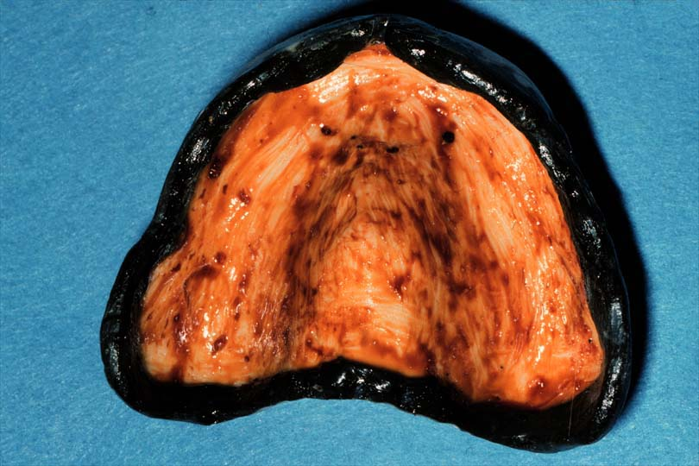
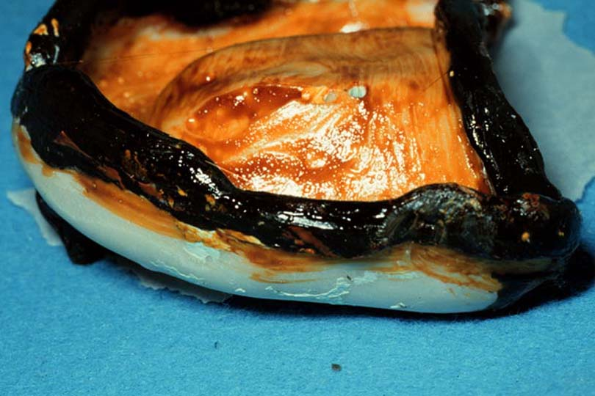
Preparing the Custom Tray to Secure the Final Impression
Apply adhesive if the impression material doesnot adhere to tray like polyvinylsiloxane
Paint inside of tray & border molding
Allow to dry 7-15 minutes
Notes:
While zinc oxide eugenol doesnot need adhesive

Slide 53
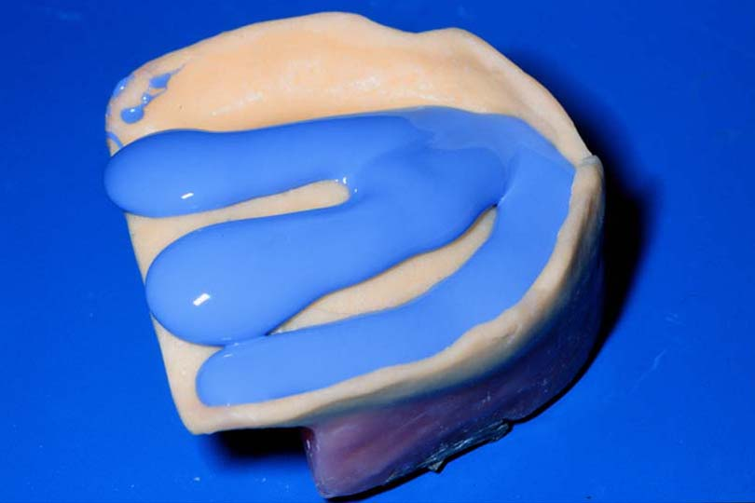
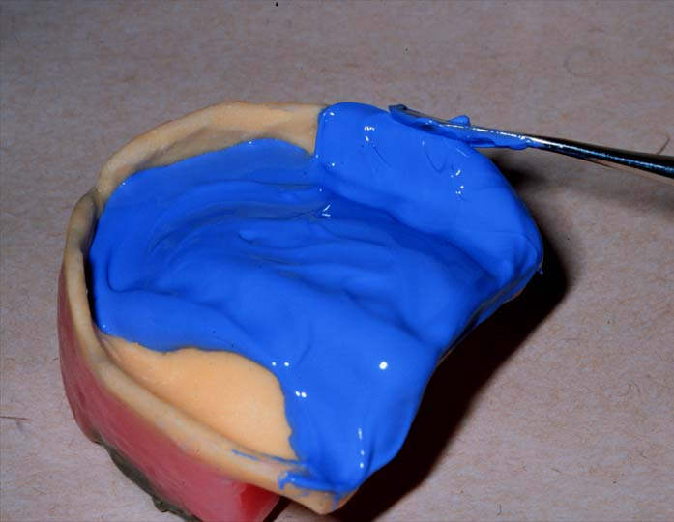
Loading Impression Material
Enough material to replace wax spacer
Load quickly
Avoid bubbles when loading tray
Notes:
Add enough light-body PVS to tray so it is slightly thicker than the pink wax spacer that you have removed
Use cement spatula to coat the tray evenly, as well as over green compound borders
Rotate tray into mouth and seat to place

Slide 54
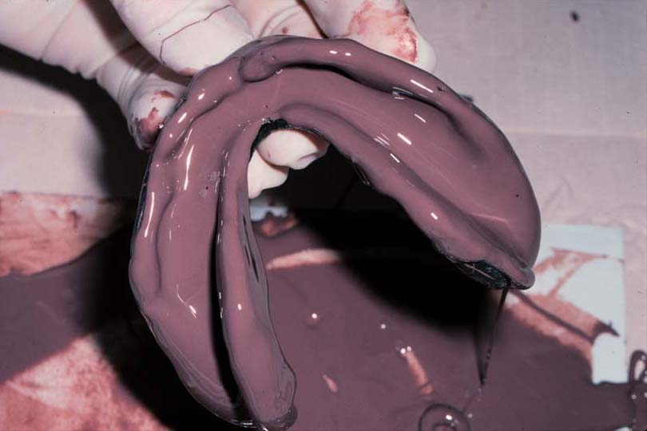
Loading Impression Material
Cover all border molding with impression material

Slide 55
Impression Insertion
Insert side of tray against commissure of mouth & rotating the tray into place while pulling outward on the commissure of the contralateral side

Slide 56
Impression Insertion
Go through border molding movements, hold tray in place until PVS is set
For mandibular impression:
-start with lingual movements, finishing with posterior buccal movements
-Have patient move tongue & keep it in protruded position till impression sets
-Have patient close to a relaxed position while impression sets

Slide 61
Refer to “Final Impression” & “Evaluation of Final Impression” Videos

Slide 62
When Should you Remake the Final Impression?

Slide 63
Reasons for Repeating the Impression
Incorrect positioning of the tray (the most common reason)
A thick buccal border on one side with a thin buccal border on the opposite side (the tray was out of position in the direction of thick border)

Slide 64
2. A thin labial border with the tray showing on the inside surface of the labial flange (the tray was placed too far posteriorly & not centered correctly over the anterior ridge)
3. A thick lingual border on one side with a thin lingual border on the opposite side
(the lower tray was out of position in the direction of thin border)

Slide 65
4. A thin anterior lingual border with the tray showing on the inside surface of the lingual flange & a thick labial border (the lower tray was too far forward)
5. Excess thickness of impression material over the fitting surface of the tray & material unsupported by the border of the tray (the tray was not seatd down sufficiently on residual ridge)

Slide 66
6. The tray showing through the impression material over the fitting surface of the tray & the borders showing through the final impression material (the tray has been seated on residual ridge with excessive pressure)

Slide 67
Other reasons to Repeat an Impression
Voids that are too large to be corrected accurately
Incorrect consistency of the final impression material
Movement of the tray while the final impression material was setting
The use of either too much or too little impression material
Incorrect border molding procedures

Slide 68
Factors Which Complicate Impression Making

Slide 69
Factors Which Complicate Impression Making
Uncooperative patients
Cosultation with the concerned physician, counseling or even premedication is usually indicated

Slide 70
Factors Which Complicate Impression Making
Excessive salivation
Difficult to work & reduce the accuracy of impression material, cause minute pits on impression surface *
Notes:
*Management:
1. Use cotton rolls and remove them prior to impression
2. Use saliva ejector
3. Ask patient to rinse mouth with asringent mouthwash prior to impression
4. Prescribe antisialogue in extreme cases

Slide 71
Factors Which Complicate Impression Making
Hyperactive gag reflex reasons
Iatrogenic: sight of mouth mirror, impression tray, odors, sounds of gagging from another patient, physical stimuli like placement of tray.
Systemic problems like pharyngitis, sinusitis, diaphragmatic hernia, gastrointestinal disturbances
Psychological problems

Slide 72
Continue/
Hyperactive gag reflex reasons
Current medication
Problems in the existing prosthesis like overextended borders, poor retention, poor occlusion, smooth shiny denture surface, inadequate freeway space

Slide 73
Management of Gagging
Reduction of stimuli (avoid overextended trays, avoid loading excess materials especially on posterior region , use fast setting material, have patient sit in upright position leaning forward with head tilted downward, saliva ejector)

Slide 74
Management of Gagging
Distraction meneuvers (example: ask patient to breathe deeply and audibly through the nose & rhythmically tap right foot on floor
Progressive desensitization (example: the patient takes the tray to home & practices placing it every day until he gains confidence
Medication like antihistamines, tranqulizers, sedatives, local anasthetic gels

Slide 75
Pouring the Final Impression

Slide 76
Pouring Final Impression
Boxing: the enclosure of an impression to produce the desired size & form of the base of the cast and to preserve desired details
Boxing by wax is used for most final impressions except alginate because wax doesnot adhere to alginate

Slide 77
Boxing Final Impression Objectives
Superior hardness of cast surface
Provides land area & preserves peripheral role
Minimizes trimming

Slide 81
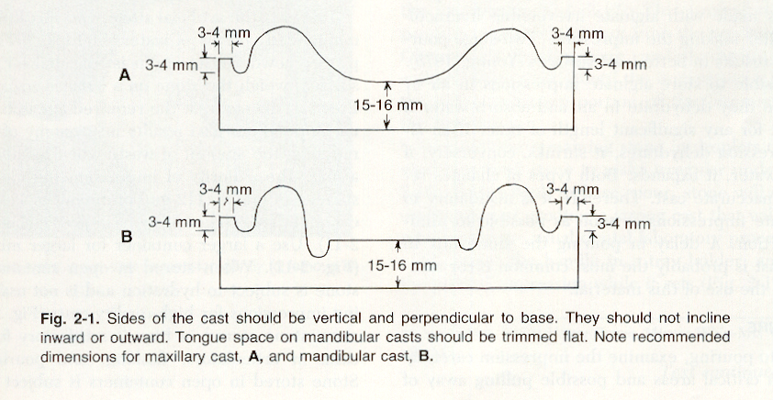
Trimmed the Cast

Slide 82
Pouring Stone
Type III stone (microstone) or dental stone is used for constructing the master cast
The stone cast is not separated from the impression for at least 1 hour

Slide 83
The master Cast
Care of the master cast:
Avoid any damage or scratches on the tissue surface of the master cast
If the cast is to be soaked in water, only slurry water should be used
Slurry water is a saturated gypsum solution made by collecting the runoff water from the cast trimming machine
Locating & blocking the undercuts

Slide 84
The master cast obtained from final impression is used for the construction of record base and occlusion rim.

Slide 85
References
1. Complete Denture Prosthodontics, 1st Edition, 2006 by John Joy Manappallil, Chapters 6 & 8
2. Dalhousie Continuing Education

