Slide 1
Anatomy of Maxillary Denture Bearing Area
Rola M. Shadid, BDS, MSc

Slide 2
Osteology
The osseous structures not only support the denture but also have an direct bearing on impression making procedure.
Maxillary denture is supported by two pairs of bones, maxillae & palatine bone.
Mandibular denture is supported by one bone, the mandible.

Slide 3
Mucous Membrane
Mucous membrane serves as a cushion between the denture base and supporting bone.
Mucous membrane is composed of mucosa and submucosa.
Submucosa is formed by connective tissue that varies from dense to loose areolar tissue and varies in thickness.

Slide 4
Mucous Membrane
Thickness and consistency of the submucosa are responsible for the support that the mucous membrane affords a denture, because the submucosa makes up the bulk of mucous membrane.
In healthy mouth the submucosa is firmly attached to the periosteum of bone and will withstand the pressure of dentures.
If submucosa is thin, soft tissue will be non resilient and mucous membrane will be easily traumatized.
Notes:
The mucosa is composed of stratified sqamous epithelium and a narrow layer of connective tissue known as lamina propria.

Slide 5
Types of Mucosa
Masticatory mucosa * covering the hard palate and the crest of residual ridge
Lining mucosa * covering the buccal cheek , the inner aspect of lips and soft palate, ventral surface of tongue and unattached gingiva covering the slopes of residual
Specialized mucosa covering the dorsum of the tongue
Notes:
Masticatory mucosa: characterized by well defined keratinized layer on its outer surface, firmly attached to the periosteum, its submucosa contains dense collagenous fibers.
Lining mucosa: the epithelium is thin and non keratinized and submucosa is formed by loosely arranged connective tissue fibers mixed with elastic fibers.

Slide 6
Anatomy of Supporting Structures
Hard Palate
Covered by keratinized stratified squamous epithelium .
In the region of medial palatal suture , the submucosa is extremely thin ; so relief should be provided to avoid trauma or rocking of the denture

Slide 7
Anatomy of Supporting Structures
Hard Palate
- Anterolaterally, the submucosa contains adipose tissue.
- Posterolaterally, it contains glandular tissue.
- The horizental portion of the hard palate provides the primary stress-bearing area.

Slide 8
Anatomy of Supporting Structures
Hard palate- rugae area:
It consists of series of ridges in the anterior part of the hard palate
Sets at an angle to residual ridge & covered by thin soft tissues
It is considered as a secondary stress bearing area

Slide 10
Anatomy of Supporting Structures
Residual Ridge
- Covered by keratinized stratified squamous
epithelium.
The submucosa is characterized by dense collagenous fibers that are contiguous with lamina propria.
Considered as a secondary stress-bearing area because it is subject to resorption contrary to horizontal portion of hard palate.

Slide 11
Shape of Supporting Structures
Factors that influence the form & size of the supporting bone :
- its original size & consistency
- general health
- surrounding musculature
- periodontal disease
- wearing a dental prostheses
- surgery at the time of extraction
- the relative length of time different parts of the jaws have been edentulous

Slide 12
The anatomical Features That Influence Shape of Hard Palate & Residual Ridge
Incisive foramen
Maxillary tuberosity
Sharp, spiny processes
Torus palatinus

Slide 13
Nasopalatine or Incisive Foramen
-Is located in the midline of the palate beneath the incisive papilla & posterior to the maxillary central incisors.
-Denture base should be relieved over the area to avoid pressure to the nerves & blood vessels.

Slide 14
Maxillary Tuberosity
It is the posterior convexity of the maxillary body.*
The medial & lateral walls resist the horizontal and torquing forces which would move the denture base in lateral or palatal direction.
Therefore, maxillary denture base should cover the tuberosities and fill the hamular notches.
Notes:
*Tuberosity region hang down abnormally if the maxillary teeth are retained after mandibular teeth extraction without replacement, these enlargement can be bony or fibrous.

Slide 15
Sharp Spiny Processes
In individuals with excessive resorpion of residual ridge, sharp spines can irritate soft tissue beneath denture
Posterior palatine foramen has a sharp spiny edge that irritates the covering soft tissue.
Need relief

Slide 16
Torus Palatinus
Covered by thin layer of mucous membrane that is easily traumatized so relief should be provided if it does not need surgical removal

Slide 17
Anatomy of Peripheral or Limiting Structures
Labial vestibule
Buccal vestibule
Vibrating line

Slide 18
Labial Vestibule
Divided into R & L by labial frenum *
The labial notch in the labial flange must be wide enough & deep enough
The outer surface of the labial vestibule is the orbicularis oris.* Its fibers run in a horizental direction; so it has an indirect effect on the denture base
The buccal frenum is the dividing line between the labial & buccal vestibules. It is related to three muscles, so it requires more clearance than the labial frenum
Notes:
*Labial frenum is a fold of mucous membrane at the median line, fan shaped, contains no muscle & has no action of its own
*Orbicularis oris muscle is the main muscle of the lips. Its tone depends on thickness of labial flange and position of teeth

Slide 19
Maxillary Arch Anatomy
Notes:
1.Labial frenum
2.Labial vestibule
3.Buccal frenum
4.Buccal vestibule
6.Crest of alveolar ridge
7.Maxillary tuberosity
8.Hamular notch
9.Hard palate
10.Fovea palatini
11.Mid-palatine raphe
12.Incisive papilla
13.Palatine rugae

Slide 20
Labial Vestibule-Buccal Frenum
A single fold of mucous membrane sometimes double & sometimes broad & fan shaped
The caninus ( levator anguli oris) attaches beneath and affects its position
The orbiculeris oris pulls the frenum forward and buccinator pulls backward
Notes:
Inadequate relief or thick flange can cause dislodgement of denture when cheeks are moved.

Slide 22
Buccal Vestibule
Extends from buccal frenum to hamular notch
Notes:
Its size varies with the contraction of buccinator, the position of the mandible, & the amount of bone lost from maxilla.

Slide 23
Buccal Vestibule
The size & shape of distal end of buccal flange must be adjusted to ramus, coronoid process of mandible & to masseter muscle
Notes:
The extent of buccal vestibule should be examined when mouth as nearly closed as possible.
The coronoid process may limit the width of maxillary denture in buccal vestibule

Slide 24
Buccal Vestibule
The root of zygoma opposite the 1st /2nd molar region becomes more noticeable with increasing resorption, it requires relief

Slide 25
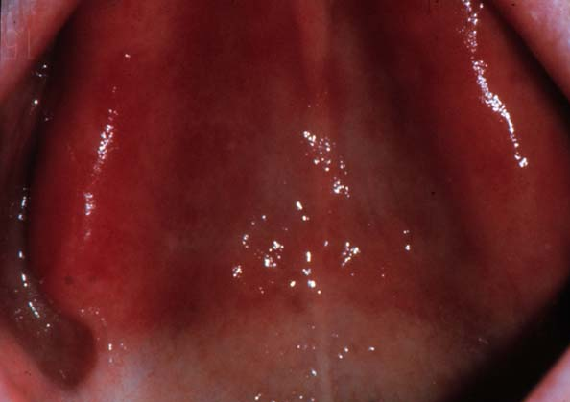
Buccal Vestibule
The centre of deep part of hamular notch forms distal border of denture
Notes:
Hamular notch is suited between the tuberosity and the hamulus of the medial pterygoid plate, the mucous membrane of hamular notch consists of thick submucosa made up of loose areolar tissue, this tissue can be safely displaced to achieve posterior palatal seal.

Slide 26
Hamular Notch
Notes:
Hamular notches
Over extension - extreme pain
Under extension - non-retentive
Must be captured in impression

Slide 27
Vibrating Line
An imaginary line (area) drawn across the palate from one hamular notch to the other
Marks the beginning of motion in the soft palate when the pt. says ‘ahh’
Usually and not always, lies within 3 mm in front of fovea palatine
Notes:
If vibrating line terminates on:
movable portion - displacement
hard palate - no retention
Over extension at the hamular notches will not be tolerated because trauma to pterygomandibular raphe occurs as the mouth is opened wide.
The distal end of the denture should end 1 to 2 mm posterior to the vibrating or at least to the vibrating line

Slide 28
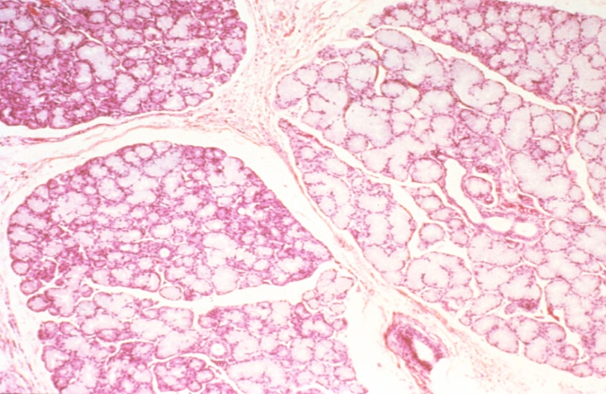
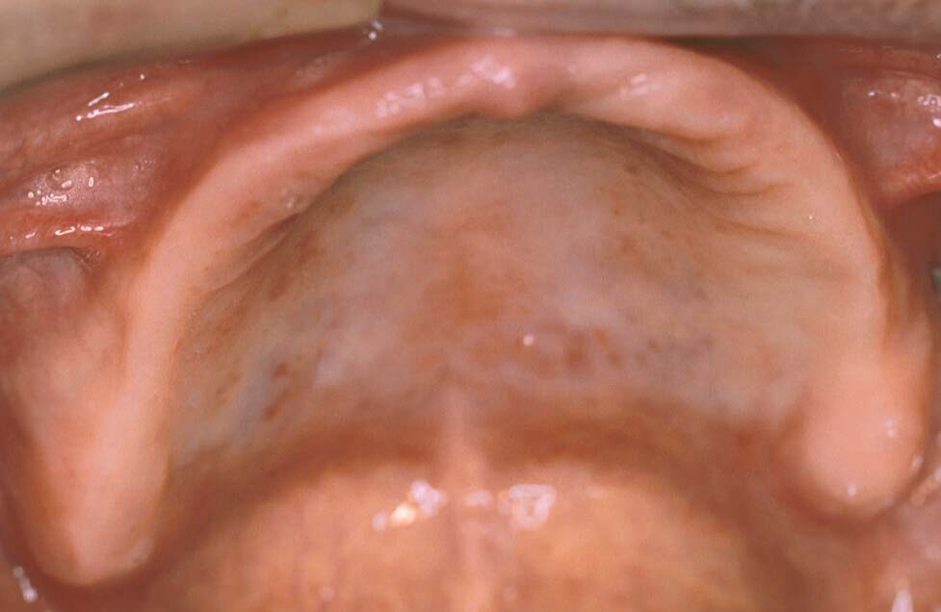
Vibrating Line
Glandular tissue
Posterior palatine salivary glands
Permits compression of tissues & improves adaptation of denture to compensate for shrinkage of resin
Posterior palatal seal
Notes:
Submucosa in region of vibrating line contains glandular tissue

Slide 29
Vibrating Line
The direction of the vibrating line usually varies with the shape of palate, the higher the vault the more abrupt and forward the vibrating line
In mouth with flat vault, the vibrating line is usually farther posterior and has a gradual curvature
Notes:
Refer to House’s classif. in lecture 2

Slide 30
Fovea Palatine
The fovea palatine are indentations near the midline of the palate formed by the coalescence of several minor mucous gland ducts
Notes:
They are closed to the vibrating line and always in the soft palate and, used as a guide for the location of posterior border of denture

Slide 31
Palatine Fovea

Slide 32
The Pterygomandibular Raphe
Behind hamular notches - significant when prominent
Have patient open wide as possible
Can displace denture – requires relief in extreme cases
Notes:
A tendinous band between buccinator and the superior constrictor - passes downwards and outwards from the hamulus to the posterior end of the mylohyoid line.
When the mouth is opened wide, this raphe raises a fold of mucosa that marks internally the posterior boundary of the cheek, and is an important landmark for an inferior alveolar nerve block.

Slide 34
References
Boucher's Prosthodontics Treatment for Edentulous Patients. Twelfth Edition. Chapter s 13 & 14.

