Slide 1
Indirect Retainers
Rola M. Shadid, BDS, MSc

Slide 2
Movement of Distal Extension RPD
Vertical movements in 2 directions
Movement toward the ridge tissues *
Movement away from the ridge tissues (resisted by the direct retainers)
Rotational movement about an axis (fulcrum line) #
Notes:
*will be proportionate to the displaceability of those tissues, the fit of the denture base and the load applied.
# This axis passes through rests of the most posterior abutment teeth and is called the fulcrum line

Slide 3
Movement of Tooth-Borne RPD
Usually do not exhibit rotational movements, due to their extensive tooth support.
However, any Class III or Class IV RPD that has mobile abutments may exhibit rotational movements

Slide 4
Fulcrum Line
This axis passes through rests of the most posterior abutment teeth
The axis about which the denture will rotate when the bases move away from the residual ridge

Slide 5
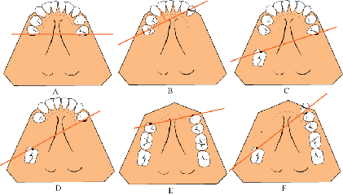
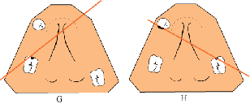
Primary Fulcrum Lines *
Notes:
The fulcrum line on a Class I partial denture as passes through the rest areas of the most posterior abutment on either side of the arch (A and B). On a Class II partial denture, the fulcrum line is always diagonal, passing through the occlusal rest area of the abutment on the distal extension side and occlusal rest area of the most distal abutment on the other side (C). If a modification area is present on that side, the additional abutment lying between the two principle abutments may be used for support of the indirect retainer if it is far enough from the fulcrum line (D).
In a Class IV partial denture, the fulcrum line passes through the two abutments adjacent to the single edentulous space (E and F). In a tooth and tissue supported Class III partial denture, the fulcrum line is determined by considering the weaker abutment as nonexistent and that end of the base as being a distal extension (F and H).

Slide 6
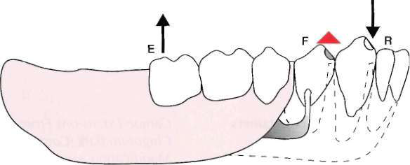
Indirect Retainer
The rigid components of the partial denture framework that are located on definite rests on the opposite side of the fulcrum line away from the distal extension base

Slide 7
Indirect Retainer Main Function
Prevent rotational displacement of denture from tissue base
Rotation occurs around rests

Slide 8
Indirect Retainers
Should be 90 ° from primary fulcrum line (usually most posterior rests)
As far from primary fulcrum as possible

Slide 9
Indirect Retainer
Should be placed as far from the distal extension base as possible in a prepared rest seat on a tooth capable of supporting its function.
Consists of one or more rests & the supporting minor connectors

Slide 10

Factors Influencing Effectiveness of Indirect Retainers
1. The principal occlusal rests on the primary abutment teeth must be reasonably held in their seats by the retentive arms of the direct retainers. *
Notes:
If rests are held in their seats, rotation about an axis should occur, which activates the indirect retainers.
If total displacement of the rests occurs, there would be no rotation about the fulcrum, and the
indirect retainers would not be activated.

Slide 11
Factors Influencing Effectiveness of Indirect Retainers
2. Distance from the fulcrum line
a. Length of the distal extension base
b. Location of the fulcrum line
c. How far beyond the fulcrum line the indirect retainer is placed

Slide 12
Factors Influencing Effectiveness of Indirect Retainers
3. Rigidity of the connectors supporting the indirect retainer
4. Effectiveness of the supporting tooth surface
Tooth inclines and weak teeth should NEVER be used to support indirect retainers.

Slide 13
AUXILIARY FUNCTIONS OF INDIRECT
RETAINERS

Slide 14
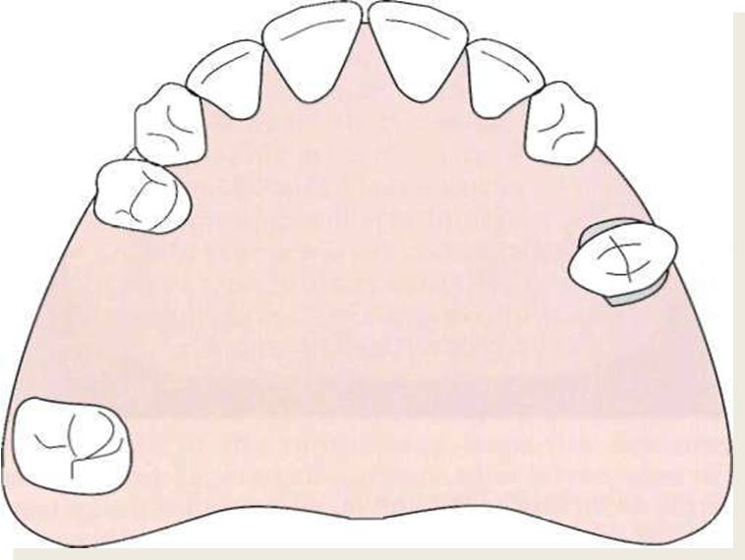
AUXILIARY FUNCTIONS OF INDIRECT
RETAINERS
Reduce anteroposterior-tilting leverages on the principal abutments. (especially if isolated tooth is being used as an abutment)

Slide 15
AUXILIARY FUNCTIONS OF INDIRECT
RETAINERS
2. Contact of its minor connector with axial tooth surfaces aids in stabilization against horizontal movement of the denture. May also act as auxiliary guiding planes.
3. Anterior teeth supporting indirect retainers are stabilized against lingual movement.

Slide 16
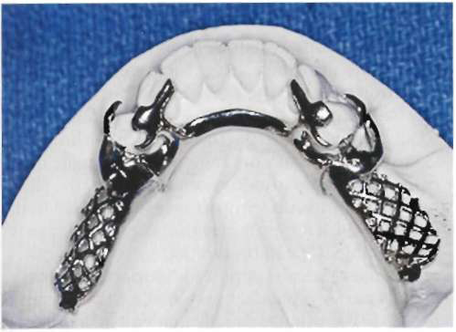
AUXILIARY FUNCTIONS OF INDIRECT
RETAINERS
4. It may act as an auxiliary rest to support a portion
of the major connector facilitating stress
distribution.
5. It may provide the first visual indications for the need to reline an extension base partial denture

Slide 17
FORMS OF INDIRECT RETAINERS

Slide 18
Although the most effective location of an indirect retainer is commonly in the vicinity of an incisor tooth, that tooth may not be strong enough to support an indirect retainer and may have steep inclines that cannot be favorably altered to support a rest.

Slide 19
In such a situation, the nearest canine tooth or the mesioocclusal surface of the first premolar may be the best location for the indirect retention, despite the fact that it is not as far removed from the fulcrum line.*
Notes:
Whenever possible, two indirect retainers closer to the fulcrum line are then used to compensate for the compromise in distance.

Slide 20
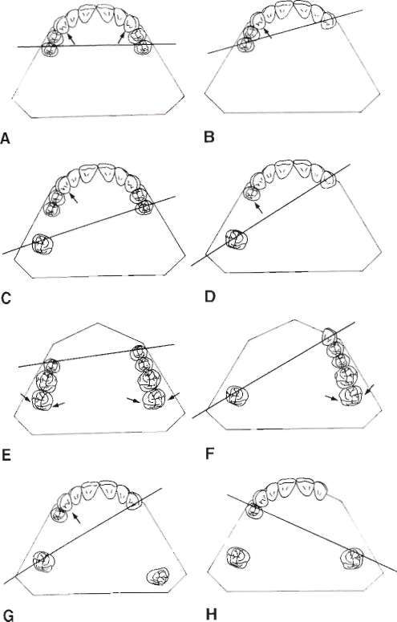

Slide 21
Auxiliary Occlusal Rest
The most commonly used indirect retainer is an auxiliary occlusal rest located on an occlusal surface and as far away from the distal extension base as possible.

Slide 22
K Class I arch indirect retainer
Bilateral rests on mesial marginal ridge of first premolars are quite effective, even though they are located closer to the axis of rotation *
Notes:
*The ideal position for the indirect retainer perpendicular to the fulcrum line would be in the vicinity of the central incisors, which are too weak and have lingual surfaces that are too perpendicular to support a rest.

Slide 23
K Class II indirect retainer
On marginal ridge of first premolar tooth on the opposite side of the arch from the distal extension base
Bilateral rests are seldom indicated except when an auxiliary occlusal rest is needed for support of the major connector or when the prognosis of the distal abutment is poor and provision is being considered for later conversion to a Class I partial denture.

Slide 24
Canine Rests
When the mesial marginal ridge of the first premolar is too close to the fulcrum line or when the teeth are overlapped so that the fulcrum line is not accessible, a rest may be used on the adjacent canine tooth *
Notes:
Such a rest may be made more effective by placing the minor connector in the embrasure anterior to the canine, either curving back onto a prepared lingual rest seat or extending to a mesioincisal rest.

Slide 25
Canine Extensions From Occlusal Rests
Occasionally a finger extension from a premolar rest is placed on the prepared lingual slope of the adjacent canine tooth*
Notes:
This method is particularly applicable when a first premolar must serve as a primary abutment.

Slide 26
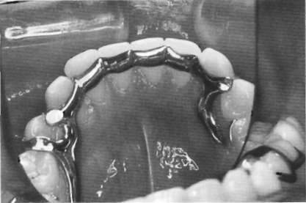
Cingulum Bars (Continuous Bars) and Linguoplates
Cingulum bars (continuous bars) and linguoplates are not indirect retainers *
Notes:
Because they rest on unprepared lingual inclines of anterior teeth. The indirect retainers are actually the terminal rests at either end in the form of auxiliary occlusal rests or canine rests

Slide 27
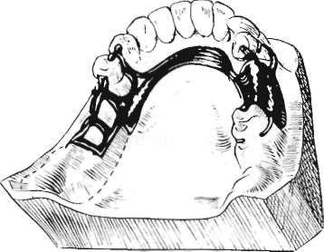
Modification Areas
Occlusal rest on a secondary abutment in a Class II partial denture may serve as an indirect retainer *
Notes:
This use will depend on how far from the fulcrum line the secondary abutment is located.

Slide 28
Modification Areas
If the occlusal rest on the secondary abutment lies far enough from the fulcrum line, it may serve adequately as an indirect retainer. Its dual function then is tooth support for one end of the modification area and support for an indirect retainer *
Notes:
The most typical example is a distal occlusal rest on a first premolar when a second premolar and first molar are missing and the second molar serves as one of the primary abutments. The longest perpendicular to the fulcrum line falls in the vicinity of the first premolar, making the location of the indirect retainer nearly ideal.

Slide 29
Modification Areas
On the other hand, if only one tooth, such as a first molar, is missing on the modification side, the occlusal rest on the second premolar abutment is too close to the fulcrum line to be effective. In such a situation, an auxiliary occlusal rest on the mesial marginal ridge of the first premolar is needed, both for indirect retention and for support for an otherwise unsupported major connector.

Slide 30
Modification Areas
Support for a modification area extending anteriorly to a canine abutment is obtained by any one of the accepted canine rest forms. In this situation the canine tooth provides nearly ideal indirect retention and support for the major connector as well.

Slide 31
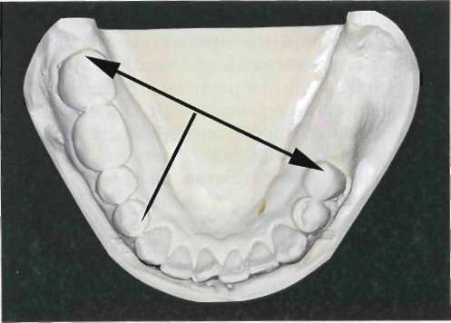
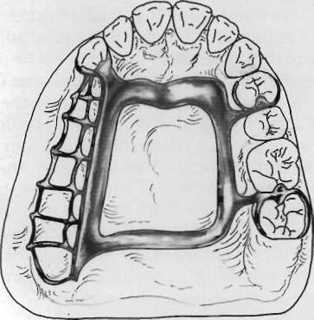
If the modification space were not present, as in an unmodified Class II arch, auxiliary occlusal rests and stabilizing components in the same position would still be essential to the design of the denture

Slide 32
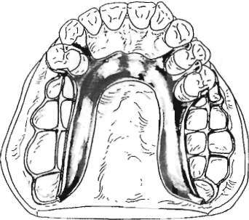
Rugae Support ?
Tissue support is less effective than positive tooth support
Rugae coverage is undesirable if it can be avoided

Slide 33
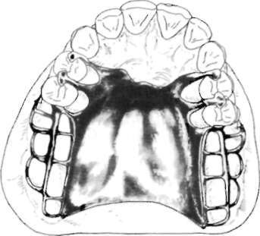
Full Palatal Coverage
With any Class I maxillary RPD extending distally from the first premolar teeth, except when a maxillary torus prevents its use, palatal coverage may be used to advantage (act as indirect retainer) *
Notes:
In the absence of full palatal coverage, an indirect retainer should be used with other designs of major palatal connectors for the Class I RPD

Slide 34
References
McCracken’s Removable Prosthodontics, 11th Edition 2005 by McGivney GP, Carr AB. Chapter 8

