Slide 1
Impression Materials for Removable & Complete Dentures
Rola Shadid, BDS, MSc

Slide 2
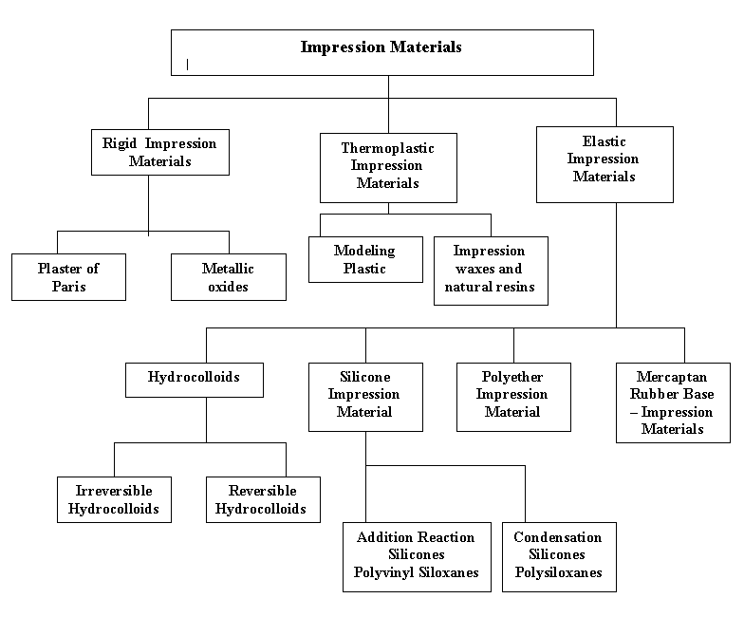

Slide 3
Rigid Impression Materials
Are those that set to a rigid consistency
It is capable of recording tooth and tissue details accurately , they cannot be removed from the mouth without fracture and reassembly

Slide 4
Plaster of Paris
Plaster of paris was once the only material available for partial denture impression, but now elastic materials have replaced them
used by many dentists to record maxillomandibular relationship

Slide 5
Metallic Oxide Paste
Metallic oxide paste is some form of a zinc oxide – eugenol combination
Not used as primary impression materials , and not used for impressions that include remaining natural teeth
Not used in stock tray

Slide 6
Metallic Oxide Paste
Border molding with metallic oxide impression pastes is not advisable because wrinkles will occur if movement is permitted at the time of setting
All metallic oxides have a setting time during which they should not be disturbed and after which no further border molding is effective

Slide 7
Metallic Oxide Paste
Mixing time 30 to 45 secs
Setting time 3 to 5 mins
Brittle, messy, sometimes irritates patient due to eugenol content

Slide 8
Metallic Oxide Paste Uses
Secondary impression for complete denture
Altered cast technique
Relining distal extension denture bases

Slide 9
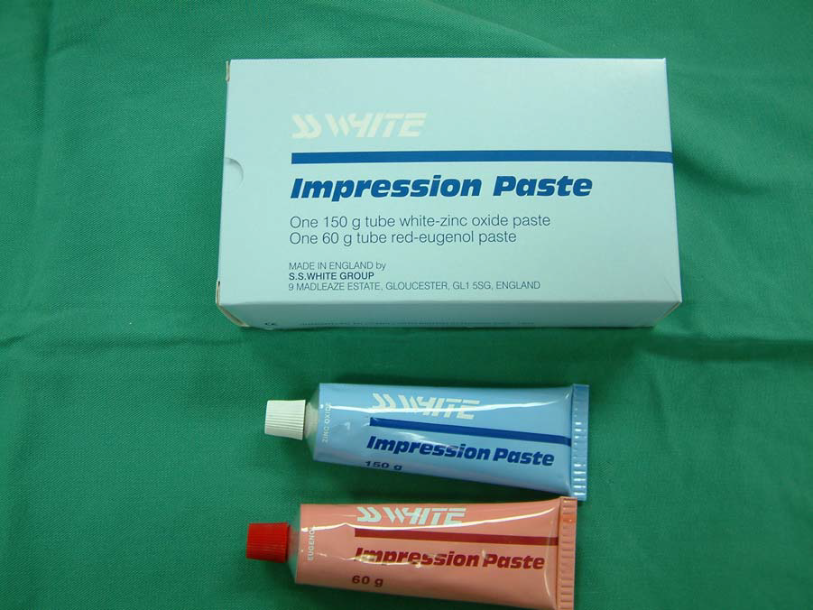
Metallic Oxide Paste

Slide 10
Thermoplastic Impression Material
Are those that become plastic at higher temperature and resume their original form when cooled

Slide 11
Modeling plastic
It is manufactured in several different colors, each color being an indication of the temperature range at which the material is plastic and workable
If modeling plastic is softened at a temperature above that intended by the manufacturer , the material becomes brittle and unpredictable , also there is the danger of burning patient's mouth

Slide 12
Modeling plastic Forms
1. Red brown material in cake form
2. Red, gray, green modeling plastics in stick form

Slide 13
Modeling plastic
Used in border molding of impression tray
The modeling plastic are used as a secondary impression material to record edentulous ridges in partial denture construction (building up the underside of the denture before recording the tissue with secondary impression material)

Slide 14
Red brown material in cake form
The most commonly used modeling plastic for corrected impressions of extension base areas for Kennedy Class I and II partial denture bases
It should be dipped and kneaded until soft and subjected to no more heat than necessary before loading the tray and positioning it in the mouth, then it should be chilled in cold water after each removal from the mouth

Slide 15
Red, gray, green modeling plastics in stick form
Used in border molding of impression tray
Red and gray sticks have a higher and broader working range than do the cake of like color
The modeling plastic are used as a secondary impression material to record edentulous ridges in partial denture construction, when this is done it is generally used only as a mean of building up the underside of the denture before recording the tissue with secondary impression material

Slide 16
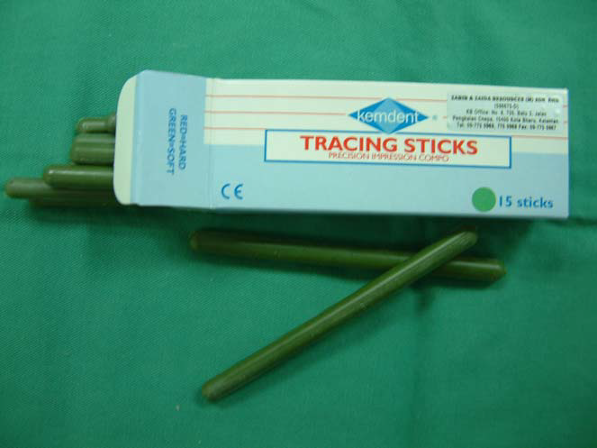
Modeling Plastic (Compound)

Slide 17
Impression waxes and natural resins
They are mouth temperature waxes
Iowa may be used as a secondary impression material or as impression material for relining
Since mouth temperature waxes have the ability to flow as long as they are inside mouth they permit equalization of pressure and prevent over displacement of tissues

Slide 18
Impression waxes and natural resins
Impression waxes may be used to correct borders of impressions made of more rigid materials (useful for correction of small imperfection in ZnOE impression)
Other type of waxes have more resinous base , they are used to record tissues under an occlusal load
Resinous waxes are not ordinarily used in partial denture impression technique except for secondary impression for recording partial lower free end

Slide 19
Elastic materials
Are those that remain in an elastic or flexible state after they have set and have been removed from the mouth

Slide 20
Hydrocolloids
Reversible vs. irreversible hydrocolloids
All hydrocolloids are dimensionally stable only during a brief period of time
They are hydrophilic materials so can gain water and expand (imbibition), so must not be immersed in water
They lose water rapidly and shrink if exposed to air

Slide 21
Hydrocolloids
The principal difference between reversible and irreversible hydrocolloids is that reversible hydrocolloid convert from the gel form to sol by application of heat , it may be revert to gel form while irreversible hydrocolloids become a gel via a chemical reaction and this change is irreversible

Slide 22
Hydrocolloids
They should be poured immediately no more than 15 minutes delay and stored during this period in a saturated atmosphere ( wrapping impression in a damp paper towel )

Slide 23
Hydrocolloids
Hydrocolloids exhibit a phenomenon known as syneresis , which is associated with the giving off a mucinous exudates that will affect the gypsum material and produce soft or chalky cast surface
This can be prevented by pouring the cast immediately and using some chemical accelerators as potassium sulfate *
Notes:
All modern irreversible hydrocolloid impression materials have an accelerator incorporated into the powder and no longer need to be treated with a fixing solution.

Slide 24
Irreversible hydrocolloids (Alginate) *
Used for making diagnostic casts, orthodontic treatment casts, master casts for removable partial denture
Notes:
Mixing time: 1 min
Setting time: 2 -4.5 mins
Fast set: 1-2 mins
Do not alter powder liquid ratio to change setting time

Slide 25
Advantages of Alginate
Pour well with stone
Pleasant taste , odor , nontoxic , nonstaining and inexpensive

Slide 26
Disadvantages of Alginate
Low tear strength
Provide less surface details than other materials
Not dimensionally stable

Slide 27
Disadvantages of Alginate
Gelation reaction takes place next to the tissues and any movement of the tray during setting will result in internal stresses that will cause impression distortion
It must be introduced to the mouth at approximately 70 F which result in an immediate increase in the viscosity and surface tension , air bubbles are harder to dispel and so more air will be trapped than in a reversible impression.

Slide 28
Precautions to be Observed in the
Handling of Hydrocolloid Impressions
Should not be exposed to air
Should not be immersed in water
Mucinous exudate has a retarding effect on the chemical reaction of gypsum products *
Should be protected from dehydration by placing it in a humid atmosphere or wrapping in a damp paper towel
Notes:
This can be prevented by pouring the cast immediately or by first immersing the impression in a solution of accelerator, if an accelerator is not included in the formula.

Slide 29
Mercaptan rubber – base impression materials (Polysulfide, Thiokol)
It can be used for RPD impressions especially for altered cast technique or secondary impression
To be accurate the impression must have a uniform thickness that does not exceed 3mm
Notes:
Non-Aqueous Elastomers:
Polysulfides
Condensation Silicones
Addition Curing Silicones
Polyethers

Slide 30
Mercaptan rubber – base
Materials that are highly cross_ linked
(medium and heavy body ) do not recover well from deformation and should not be used in large multiple undercuts
The long term dimensional stability is poor because of water loss
It should be left for 7 to 15 minutes to rebound from deformation after it is removed from mouth

Slide 31
Mercaptan rubber – base
High tear strength
Long working , setting time (8 to 10 minutes)
Because of long setting time they lend themselves better to border molding in adequate supporting trays more than hydrocolloids
Notes:
Offensive odor,
Water accelerates the setting reaction
Heat accelerates the setting reaction

Slide 32
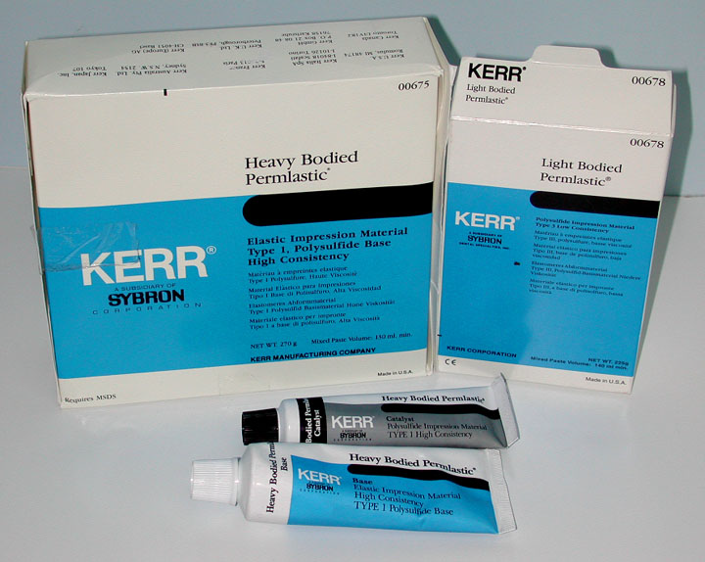
Mercaptan rubber – base

Slide 33
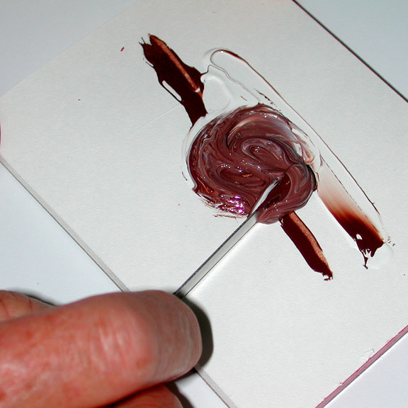
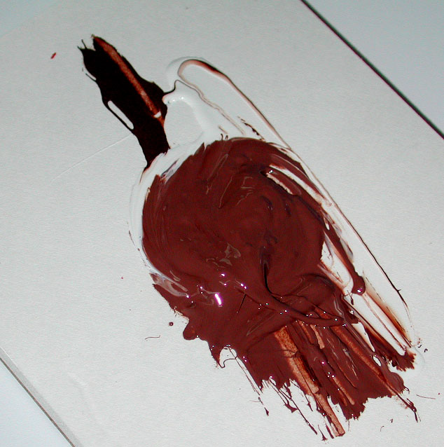
Mercaptan rubber – base

Slide 34
Polyether impression materials
Excellent accuracy and wetting
Good dimensional stability
Very good shelf life (~ 5years, less in warm conditions)
Thixotropic *
Notes:
*Thixotropic (flow readily when stressed –when the tray is seated) and cease to flow thereafter; so produces good surface detail of hard and soft tissue without drawing back into the throat and make them useful for border molding procedures

Slide 35
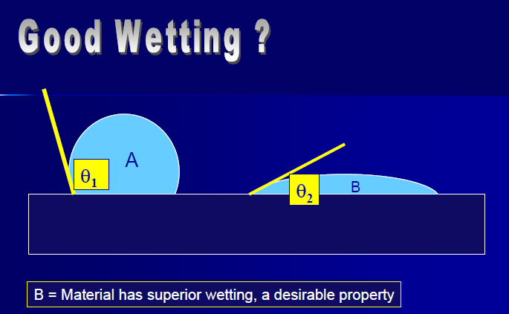

Slide 36
Polyether impression materials
Low to moderate tear strength
Flexibility is the lowest of any of the elastic impression materials, this limits its use in RPD impressions
Shorter working time than PVS silicones
Stiff material may lead to breakage of cast on removal of cast from impression
Unpleasant taste
Higher permanent deformation than polyvinyl siloxanes

Slide 37
Polyether impression materials
Polyether impression materials are not compatible with polyvinyl siloxane, so should not be used with polyvinyl siloxane custom tray
The material absorb water, must not be stored in water

Slide 38
Polyether impression materials
The material should be poured within 2 hours; but if they are kept dry, acceptable casts can be poured within 7 days

Slide 39
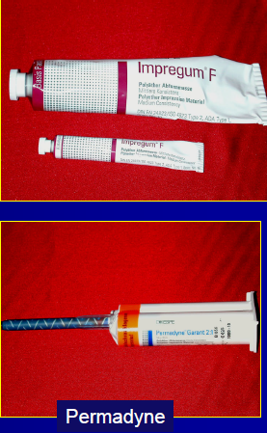
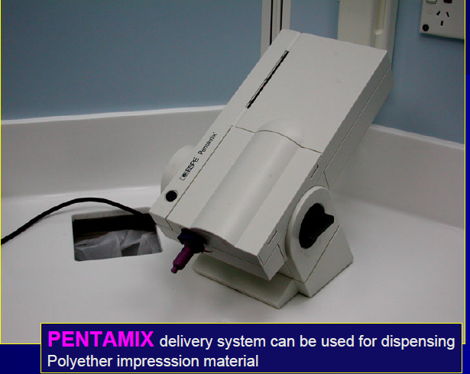
Polyether impression materials

Slide 40
Silicone impression materials
There are two types of silicone impression material :
Condensation silicones ( polysiloxanes )
Addition reaction silicones (polyvinyl siloxanes)

Slide 41
Condensation silicones
( polysiloxanes )
5 to 7 minutes working time that can be altered by adjusting the amount of accelerator
Pleasant odor
High tear strength
Excellent recovery from deformation
Should be poured within 1-2 hours

Slide 42
Addition reaction silicones
( polyvinyl siloxanes )
Can be poured within up to 1 week
Thixotropic
Sulfur in latex gloves and in ferric and aluminum sulfate retraction solution may inhibit polymerization
Available in hydrophilic and hydrophobic forms

Slide 43
Addition reaction silicones
( polyvinyl siloxanes )
The working time 3 to 5 minutes , can be adjusted with the use of retarders and temperature control

Slide 44
Addition reaction silicones
( polyvinyl siloxanes )
hydrophobic can make cast formation a problem
More expensive than other elastic impression materials

Slide 45
Addition reaction silicones
The most accurate of the elastic impression material
Less polymerization shrinkage
Low distortion, fast recovery from deformation
High tear strength
No smell, no taste

Slide 46
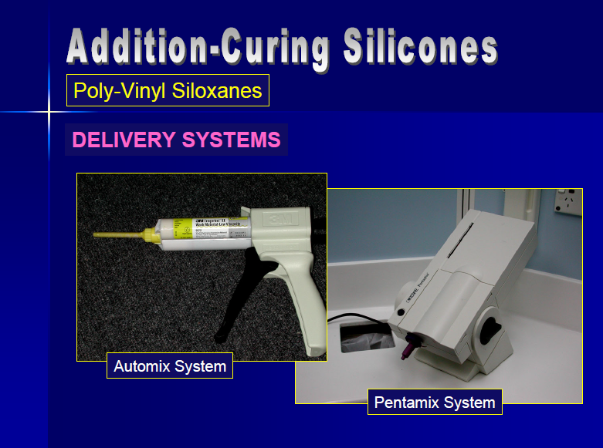

Slide 47
Step-by-step Procedure for Making Alginate Impression

Slide 48
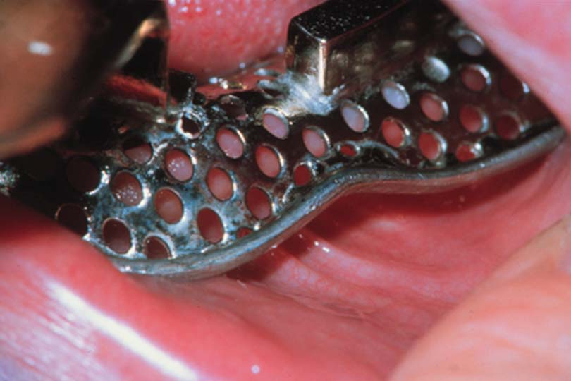
Tray Selection
Large enough with 5mm of clearance to provide a 4- to 5-mm thickness of impression material between the teeth & tissue, & the tray
Hydrocolloid requires bulk for accuracy, strength and stability
Notes:
Select a suitable, sterilized, perforated or rim lock impression tray that is large enough to provide a 4- to 5-mm thickness of the impression material between the teeth and tissue, and the tray.

Slide 49
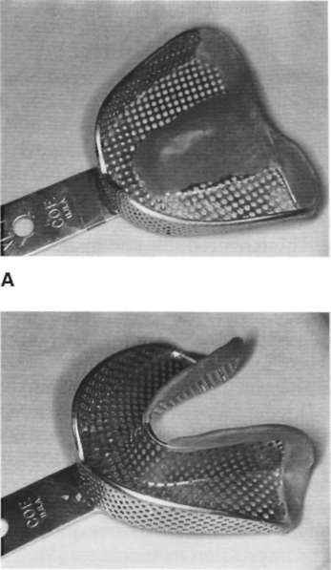
Build up the palatal portion of the maxillary impression tray with wax or modeling plastic *
Material can be syringed into the palate
Smooth with a finger, or voids may occur
Notes:
*to ensure even distribution of the impression material and to prevent the material from slumping away from the palatal surface. it is also helpful to pack the palate with gauze that has been sprayed with a topical anesthetic. This will serve to anesthetize the minor salivary glands and mucous glands of the palate and thus prevent secretions as a response to smell or taste or to the physical presence of the impression material. If gelation occurs next to the tissue while the deeper portion is still fluid, a distorted impression of the palate may result, which cannot be detected in the finished impression. This may result in the major connector of the finished casting not being in contact with the underlying tissue.

Slide 50
The lingual flange of the mandibular tray may need to be lengthened with wax in the retromylohyoid area or to be extended posteriorly, but it rarely ever needs to be lengthened elsewhere

Slide 51
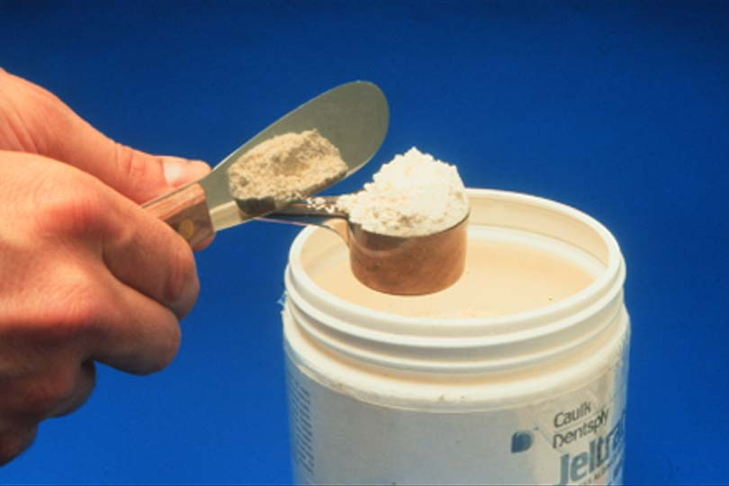
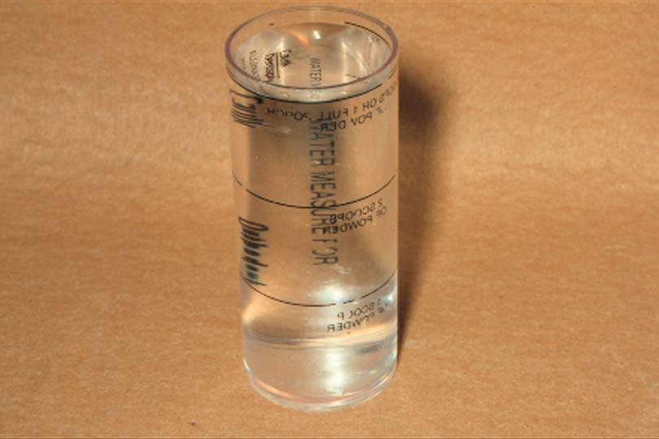
Place the measured amount of water (at 70° F) in a clean, dry, rubber mixing bowl (600-ml capacity). Add the correct measure of powder

Slide 52
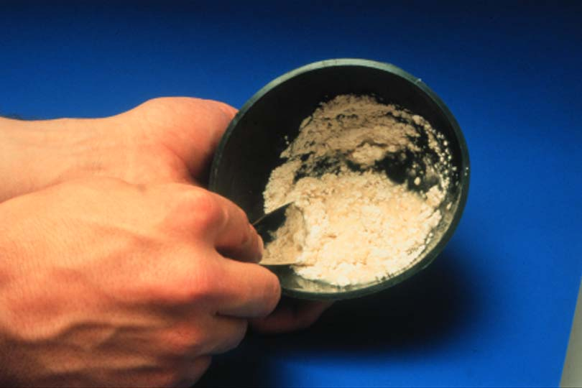
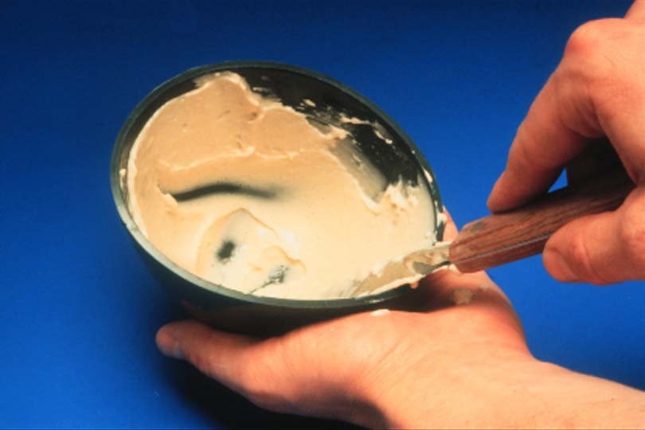
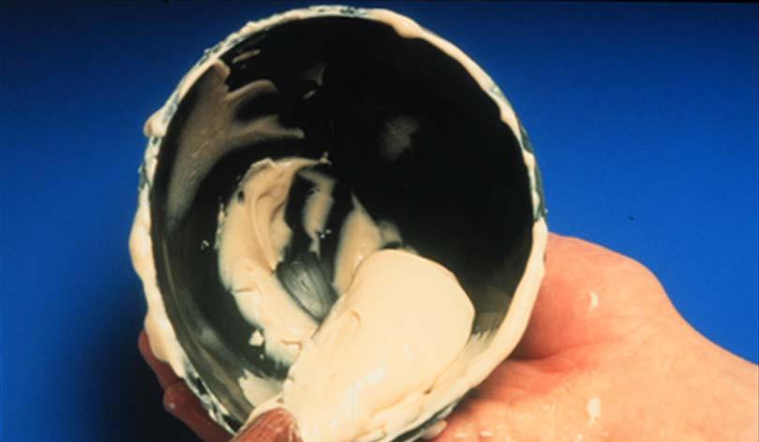
Stir rapidly against the side of the bowl with a short, stiff
spatula. This should be accomplished in less than 1 minute.

Slide 53
Place the patient in an upright position, with the arch to be impressed nearly parallel to the floor.
Ask the patient to rinse his or her mouth with cool water to eliminate excess saliva while the impression material is being mixed and the tray is being loaded.

Slide 54
After loading the tray, remove the gauze with the topical anesthetic and quickly place (rub) some of the impression material on any critical areas using your finger (areas such as rest preparations and abutment teeth).
Place the anterior portion of the tray first, then seat the posterior of the tray
Notes:
If a maxillary impression is being made, place material in the highest aspect of the palate and over the rugae.

Slide 55
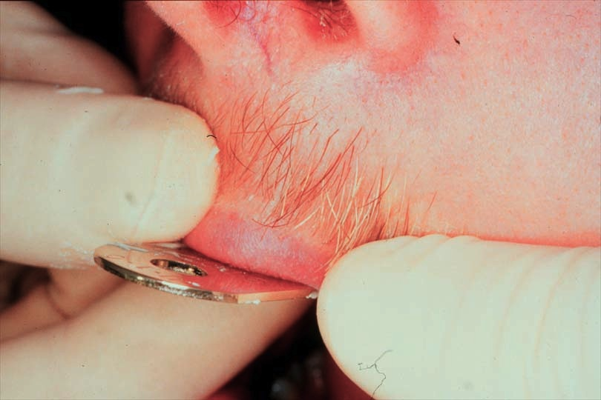
Mold the vestibular area
Pull on the cheeks and lips to activate muscles and frena

Slide 56
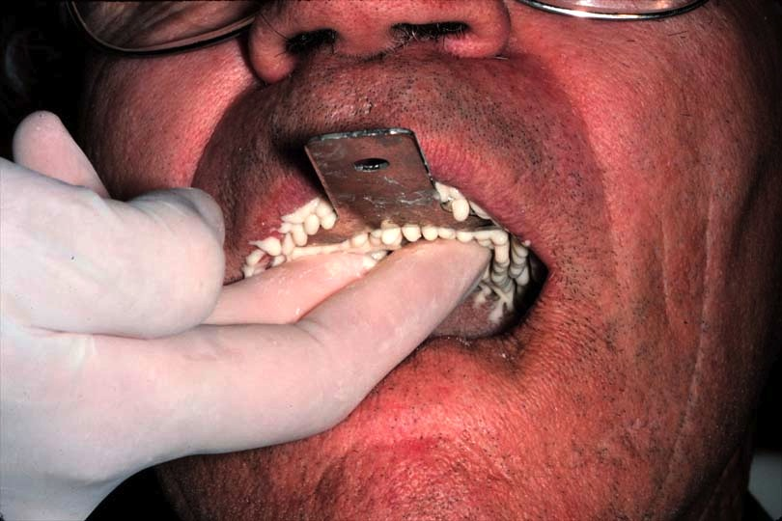
Support the tray during setting - do not leave the patient
Movement causes distortion *
Notes:
Hold the tray immobile for 3 minutes with light finger pressure over the left and right premolar areas. To prevent internal stresses in the finished impression, do not allow the tray to move during gelation.

Slide 57
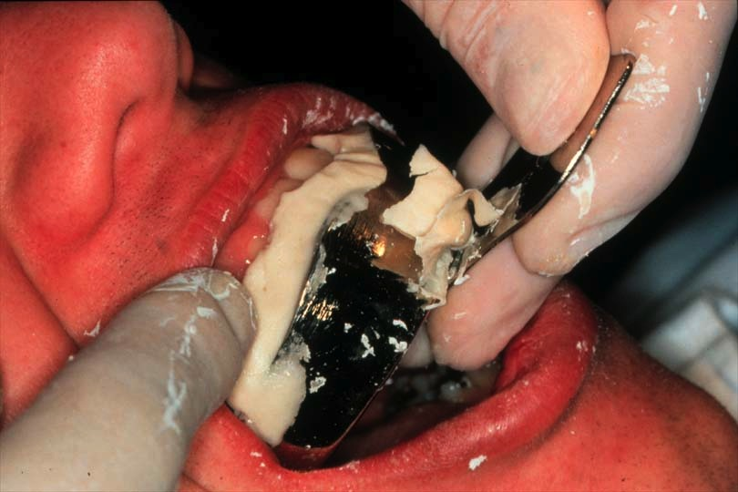
Once seal broken, remove quickly (to avoid permanent deformation)
Evaluate impression
Pour within 15 minutes

Slide 58
Rinse thoroughly with water
Gently shake to remove excess water

Slide 59
Spray with disinfectant to coat all surfaces, and seal in a bag for 15 minutes

Slide 60
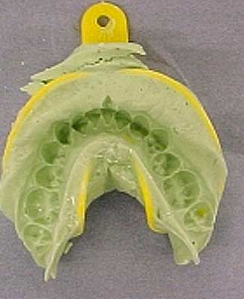
Common Pitfalls and Solutions in Impression Making
Notes:
Pitfall: The impression is removed from the mouth and there are teeth missing. Not all the teeth have been captured in the impression.
Solution: Trying the tray in the mouth and looking to see if the tray is the correct size is the most common error. Fill tray properly with impression material. Failure to get the proper amount of impression material will prevent an accurate impression.

Slide 61
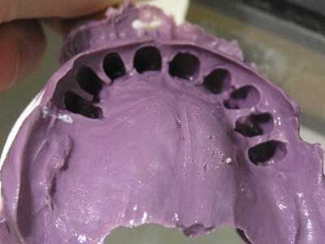
Common Pitfalls and Solutions in Impression Making
Notes:
Pitfall: Removing the impression and all the teeth are present, but the gingival tissue and bone has not been captured. Borders are not captured in the impression (missing half of the gingival tissue).
Solution: There has not been enough impression material in the tray, the tray did not get seated properly, or the PVS or alginate, set up too much before the tray was seated in the mouth.

Slide 62
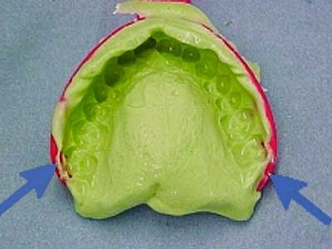
Common Pitfalls and Solutions in Impression Making
Notes:
Pitfall: Runs and pulls at the gum line of the impression.
Solution: Not enough impression material in tray, or not seated properly (the tray should be seated parallel to the long axis of the teeth). Look at the back of the throat to know when to stop seating (when you see material oozing to throat, stop and wipe). Allow the material to set to completion, and do not remove the impression until the timer goes off.

Slide 63
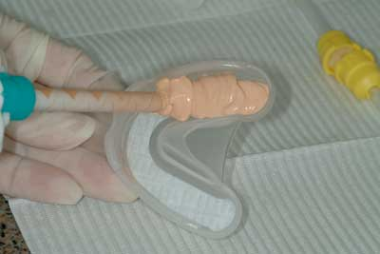
Common Pitfalls and Solutions in Impression Making
Notes:
Pitfall: Air bubbles in impression after removing the tray.
Solution: Not enough impression material in tray, and keep tip of the material gun in the tray while loading material.

Slide 64
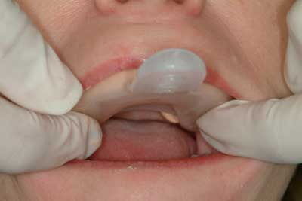
Common Pitfalls and Solutions in Impression Making
Notes:
Pitfall: Unbalanced or crooked impressions.
Solution: Hold over bicuspids to keep even pressure and steady (do not hold the handle of tray while it is setting up). Don’t have patient bite down on tray because this prevents even pressure on the tray.

Slide 65
Common Pitfalls and Solutions in Impression Making
Pitfall: Removing tray improperly.
Solution: Don’t use handle, and break suction over premolar area and pull tray down.
Reference: Impression taking: common pitfalls and solutions. Oct 28, 2011 By Hollie Bryant, DA II

Slide 66
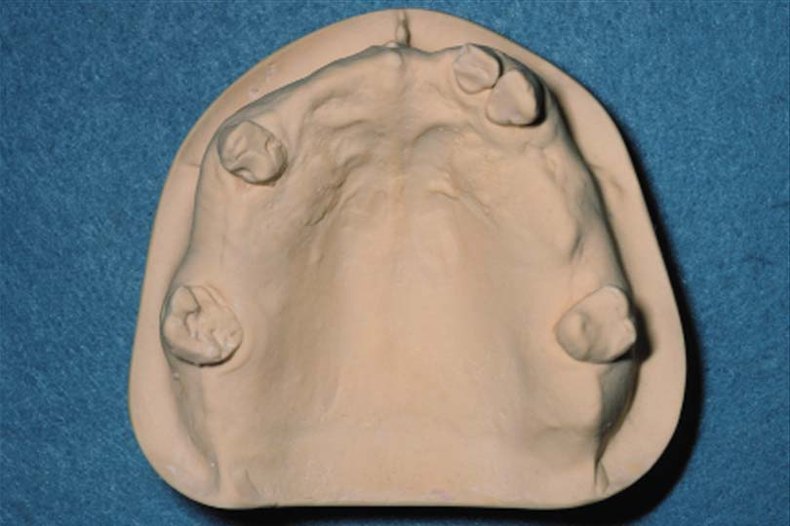
Pouring a Model
A more abrasive resistant Type IV stone should be used to form removable partial denture casts.
Casts should be a minimum of 16-18 mm in thinnest part
Separate the alginate impression from the stone cast after 30 minutes *

Slide 67
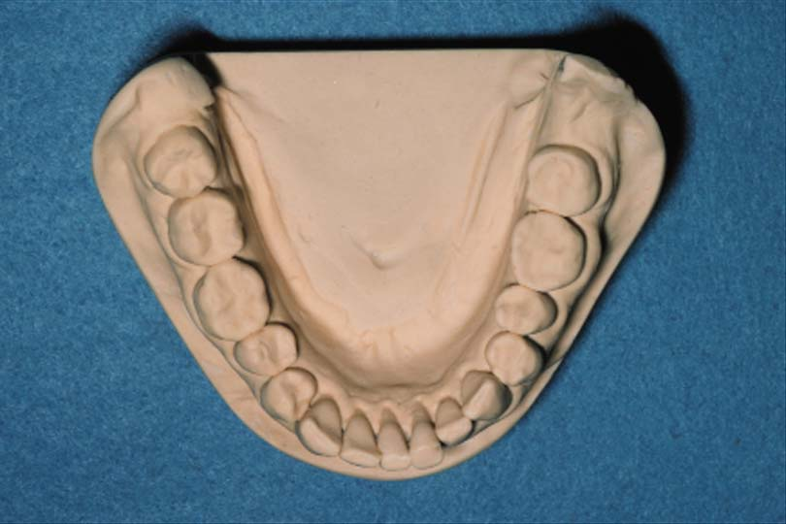
Trimming Casts
Trim the base on the model trimmer parallel to the residual ridges
Leave the vestibular reflection intact for making a custom tray

Slide 68
Trimming Casts
All anatomical surfaces should be included with minimum voids

Slide 69
Possible Causes of an Inaccurate and/or a Weak Cast of a Dental Arch
1. Distortion of the hydrocolloid impression (a) by use of an impression tray that is not rigid; (b) by partial dislodgment from the tray; (c) by shrinkage caused by dehydration; (d) by expansion caused by imbibition

Slide 70
Possible Causes of an Inaccurate and/or a Weak Cast of a Dental Arch
2. A ratio of water to powder that is too high. Although this may not cause volumetric changes in the size of the cast, it will result in a weak cast.
3. Improper mixing. This also results in a weak cast or one with a chalky surface.
4. Trapping of air, either in the mix or in pouring, because of insufficient vibration.

Slide 71
Possible Causes of an Inaccurate and/or a Weak Cast of a Dental Arch
5. Soft or chalky cast surface that results from the retarding action of the hydrocolloid or the absorption of necessary water for crystallization by the
dehydrating hydrocolloid.
6. Premature separation of the cast from the impression.
7. Failure to separate the cast from the impression for an extended period.

Slide 72
Individual Impression Trays for Making Alginate Secondary Impression

Slide 73
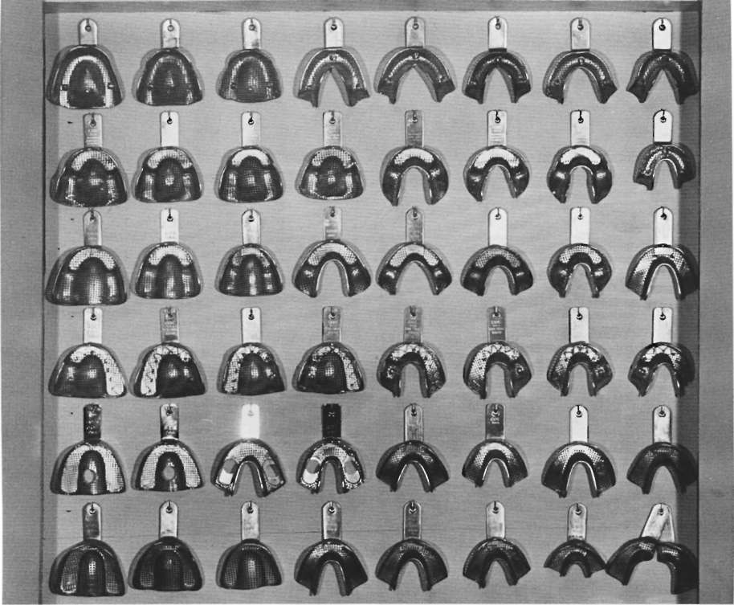
Notes:
Most stock or disposable removable partial denture trays are of either the rim lock or perforated varieties. Both are made in a limited selection of sizes and shapes. There are a wide selection of trays that can be used for partially edentulous patients, including trays for both bilateral and unilateral edentulous areas

Slide 74
Adapt one layer of baseplate wax over the tissue surfaces and teeth of the cast to serve as a spacer for impression material
The wax spacer should be trimmed 2 to 3 mm short of the outline drawn
The posterior palatal seal region is not covered by wax but will be included in finished tray *
Adapt an additional layer of baseplate wax over the teeth if the impression is to be made in irreversible hydrocolloid. This step is not necessary if the choice of impression material is a rubber-base or silicone type of material.
A window is created in wax spacer over incisal edges acting as anterior stop *
Notes:
*Intimate contact of the tray and tissue in this region may serve as an aid in correctly orienting
the tray when making the impression

Slide 75
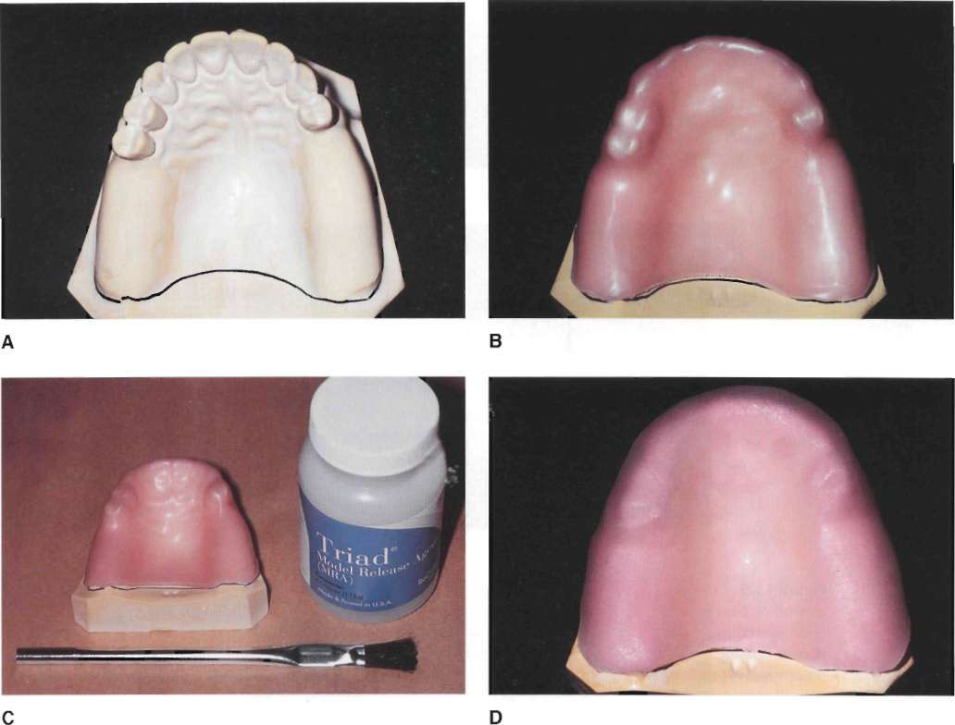
Notes:
Model Release Agent is painted on the stone surfaces of cast that will be contacted by the resin. The VtC resin tray
material is removed from the light-proof wrap and shaped to the desired outline in a uniform manner.

Slide 76
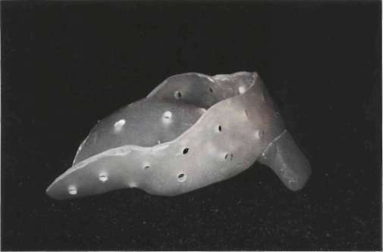
Holes are drilled through tray, spaced approximately 5 mm apart.* These holes will
serve to lock impression material in tray. In addition, excess impression material is forced out of holes when impression is made, thereby minimally displacing soft oral tissues. *
Notes:
*with the exception of the alveolar groove areas on maxillary tray and buccal shelf area in mandibular tray because crest of maxillary ridge and mandibual buccal shelf are primary stress bearing areas.

Slide 77
The technique for making an individual mandibular resin tray follows the same procedures. The wax spacer does not cover the buccal shelf regions, because these areas provide the primary support for the mandibular removable partial denture and serve as posterior stops in
orienting the tray in the patient's mouth.*
Notes:
* Anterior or posterior stops in individual tray function to orient the tray in the patient’s mouth (for correct seating of the tray)

Slide 78
Final impressions for maxillary tooth-supported removable partial dentures often may be made in carefully selected and recontoured rigid stock impression
trays.

Slide 79
An individual acrylic resin tray is preferred in those situations in the mandibular arch when the floor of the mouth closely approximates the lingual gingiva of remaining anterior teeth.
Recording the floor of the mouth at the elevation it assumes is important in selecting the type of major connector to be used

Slide 80
Impression Materials for the Partially Edentulous Arch
Materials that could be permanently deformed by removal from teeth or tissue undercuts should not be used, these include *:
    Thermoplastic impression
    materials,
    Rigid impression materials,
    Rubber base materials that
    are highly cross-linked when large or multiple undercuts exist
Notes:
*However, all these material can be used only for recording distal extension in Kennedy Class I and II

Slide 81
Impression Materials for the Partially Edentulous Arch
The final anatomic (one-stage) impression usually will be made with irreversible hydrocolloid, mercaptan rubber, or silicone impression materials.
Use irreversible hydrocolloid (alginate) for one-piece final impression

Slide 82
References
McCracken's Removable Partial Prosthodontics, Impression Materials and Procedures for Removable Partial Dentures

Slide 83
What Happens if One-stage Anatomic Impression Tech. is Made for Distal Extension RPD?
A distal extension RPD fabricated from a one stage impression which only records the anatomic form of basal seat tissue, places more of the masticatory load on the abutment teeth and that part of the bone that underlies the distal end of the extension base. *
Notes:
This results in a traumatic load to the bone underlying the distal end of the base and loosening of the abutment tooth.
A denture base processed to the functional form is generally less irregular and has greater area coverage than
does a denture base processed to the anatomic or resting form. Moreover, and of far greater significance, a denture base made to anatomic form exhibits less stability under rotating and/or torquing forces than does a denture base processed to functional form and thus fails to maintain its occlusal relation with the opposing teeth.
Also, some tissueward movement can be minimized by providing the best possible support of denture base.

Slide 84
What Types of Impression Techniques Should be Made for Distal Extension RPD?
1. Functional impression tech.
2. Selective pressure "dynamic" impression technique *
Notes:
No single impression material can record both the anatomic form of teeth and tissue in dental arch, and at the same time, the functional form (preferable selective pressure) of residual ridge. Therefore, secondary or corrected impression method must be used (altered cast tech.)
Selective pressure tech. has the advantage of directing the force to the portions of ridge that are most capable of withstanding force and at the same time relieving the tissue of the residual ridge that cannot withstand functional
loading and remain healthy.

Slide 85
How could you make selective pressure "dynamic" impression technique?
By fabricating a specially designed individual tray, you could control the flow of impression material by:
    Amount of wax relief
    Venting
Notes:
Obtaining support from the primary support areas is achieved by the manner in which the flow of the impression material is controlled during the impression-making procedure. Restricting the flow of the material in the primary stress-bearing areas (by minimizing the amount of relief over the area when the custom tray was made) causes greater pressure to be exerted on the tissue in this area (compared with other areas of unrestricted flow where a greater amount of relief or venting of the impression tray was provided).

Slide 86
Impression Tech. for Distal Extension Bases (Mandibular)
Since the goal is to maximize soft tissue support and also use teeth to their supportive advantage, a secondary impression (selective pressure) made in custom trays attached to the framework is a means to coordinate both (Altered cast tech) *
Notes:
A removable partial denture fabricated from a one-stage impression, which only records the anatomic
form of basal seat tissue, places more of the masticatory load on the abutment teeth and that part of the
bone that underlies the distal end of the extension base.

Slide 87
Altered Cast Technique

Slide 88
Altered Cast Technique
Corrected Cast
Modified Cast

Slide 89
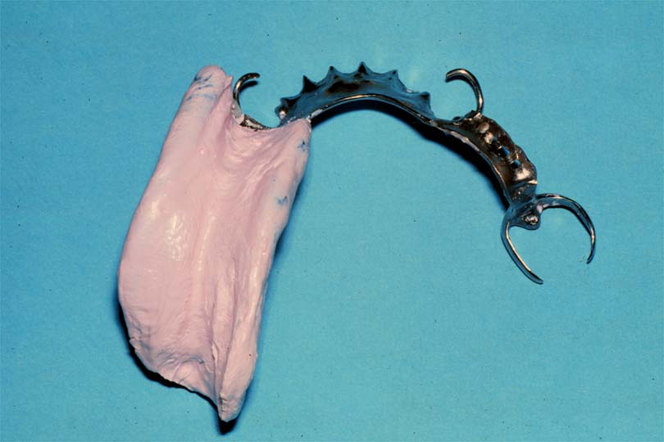
Altered Cast Impressions
Impression of residual ridge
Custom impression tray attached to the framework

Slide 90
Purpose
Provide maximum support for distal extens.RPD
More accurate relationship between abutments & ridge
Equalize stress between ridge & abutments
Minimize tissueward movement of distal extension base
Maintain occlusal contact between both natural & artificial dentition
Correct peripheral adaptation
Notes:
No philosophical difference in the requirement of support and coverage by bases of distal extension RPDs and complete dentures, either maxillary or mandibular, because the objective of maximum support is the same

Slide 91
When Needed?
Class I & II - relationship most needed
Extensive Class III & IV cases
Tooth mobility + compressible mucosa
Less necessary in maxilla

Slide 92
Procedure

Slide 93
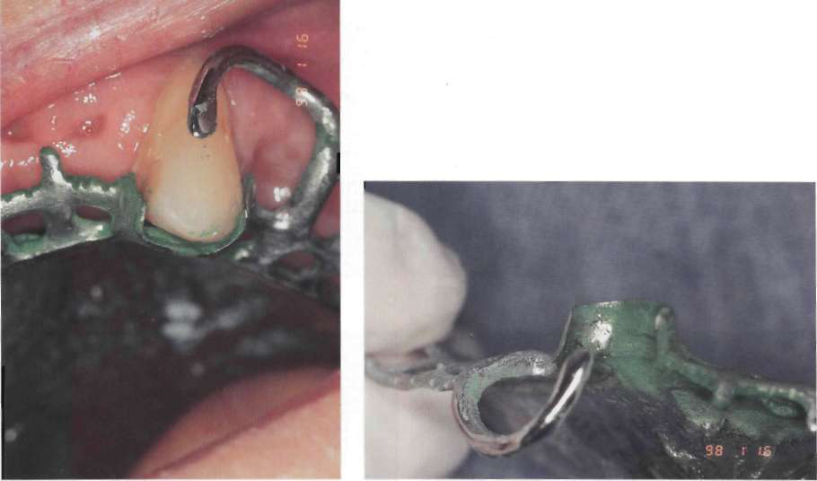
1. Well Fitting Framework
Notes:
Use of a disclosing media to identify interferences to completely seating the removable partial denture framework

Slide 94
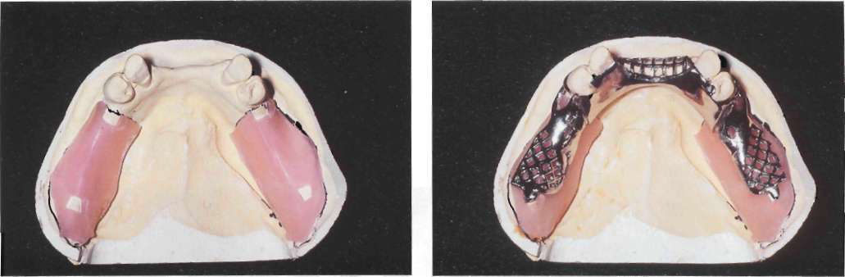
2. Place relief over ridge
  1 mm wax relief
  Heat and fully seat the framework

Slide 95
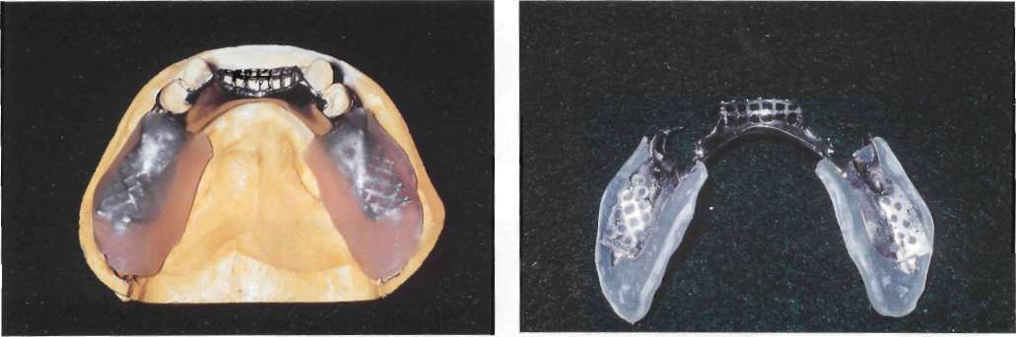
  3. Separator (Tinfoil substitute (Alcote) or model release agent) +Acrylic tray adaptation
Notes:
All regions of cast that will be contacted by autopolymerizing acrylic resin or VLC resin are painted with tinfoil substitute (Alcote) or model release agent (MRA). A sheet of VLC resin material is adapted to cast and over the framework with finger pressure. Excess material over borders of cast is removed with sharp knife while material is still soft.
Holes will be placed in trays corresponding to crest of residual ridge and retromolar pads to allow escape of excess impression material when impression is made. Holes should not be placed in trays in buccal shelf areas

Slide 96
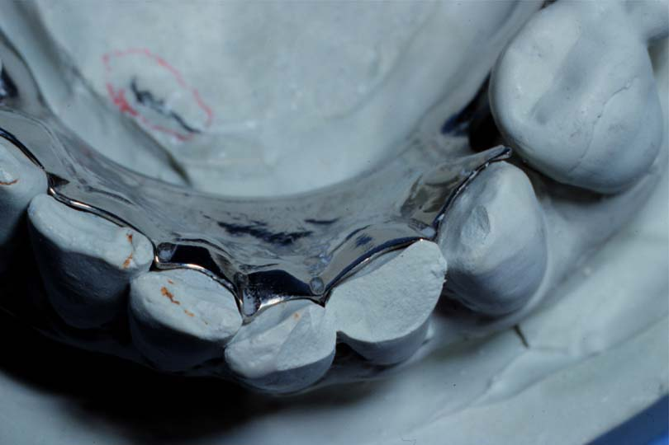
4. Check Seating
If not seated, remove, repeat
  Rests fully seated
  Tissue stop contacts cast
  Metal adjacent abutment contacts cast
  No resistance as framework seated

Slide 97
5. Check Peripheries
2-3 mm short of vestibule
No displacement when:
  Pull on cheeks, lips
  Patient activates tongue

Slide 98
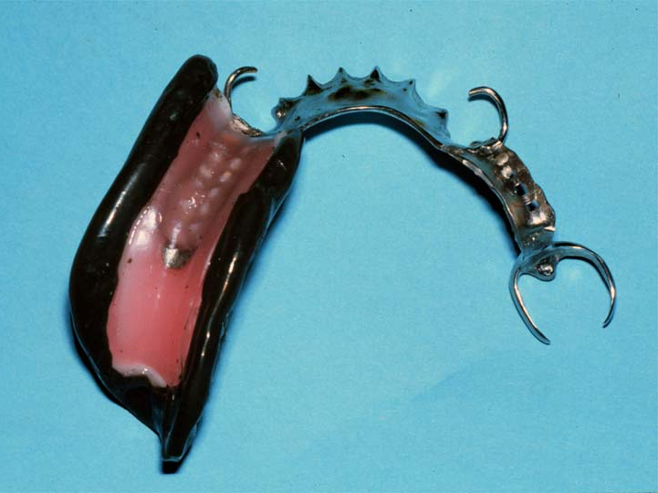
6. Border Mold
Simulate final denture border

Slide 99
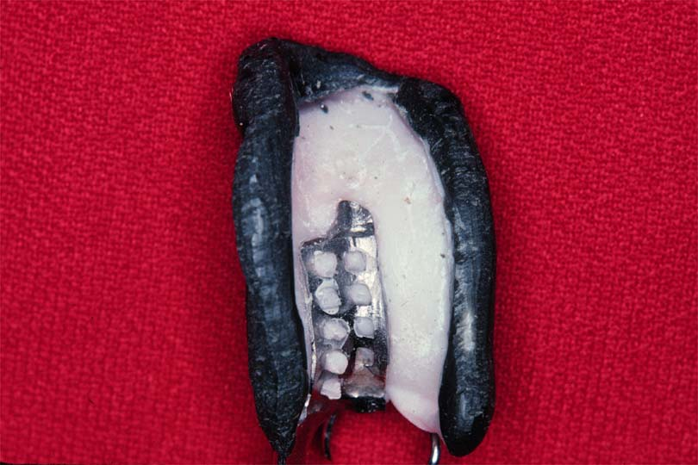
7. Make Altered Cast Impression
Ensure tray is well retained by framework
Remove wax spacer
Coat tray with adhesive If you want to make impression with addition silicone

Slide 100
Altered Cast Impression Material
  Polyvinyl siloxane (Light or medium body)
OR
Metallic oxide paste impression material
Carefully load tray
No material under rests, guiding planes, max.
major connector, etc.
Seat with pressure over Rests

Slide 101
No Pressure Over Gridwork
Fulcruming or tissue compression
Spring back and lack of tissue contact

Slide 102
8. Remove & Inspect Impression
Absence of voids
Minimal burnthrough
Covers supporting tissues
Fully seated, etc.

Slide 103
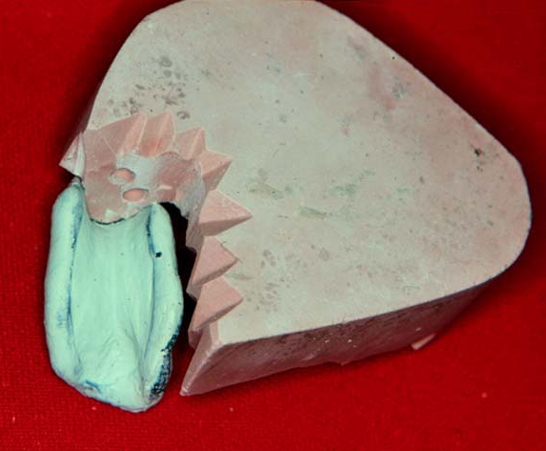
9. Send to Laboratory
Lab Steps
  Section residual ridge from cast
  Ensure no contact between impression & cast
  Place retentive grooves in cast
  Sticky wax in place

Slide 104
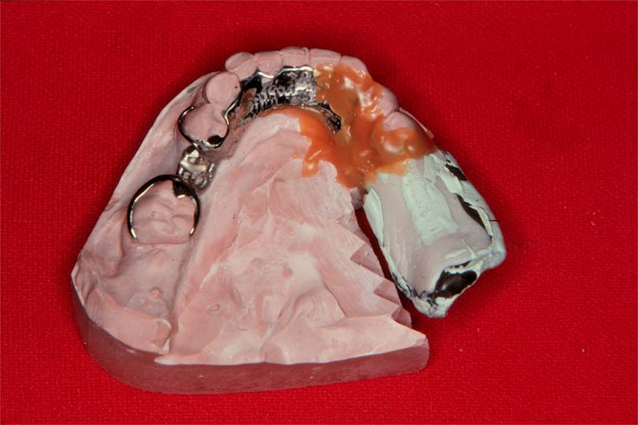
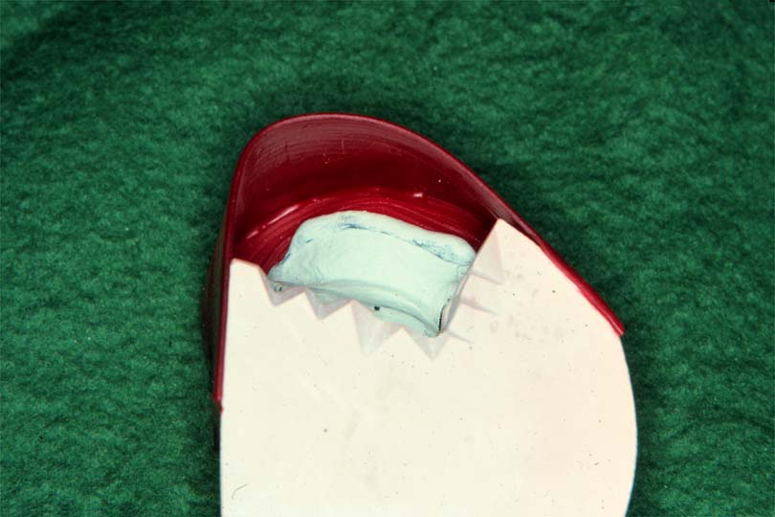
Lab Steps
  Box impression
  Ensure water tight seal
  Seal retainer, major & minor connector borders
  Pour new ridge areas in
  different color stone

Slide 105
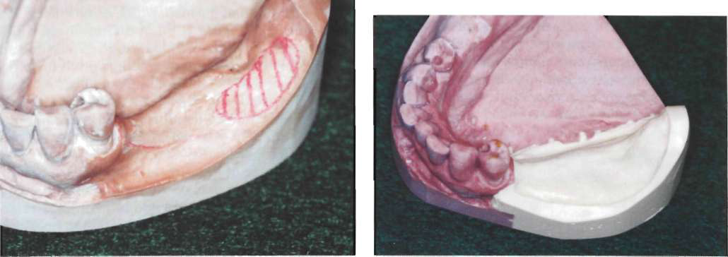
  Pour new ridge areas in different color stone

Slide 106
Problems with the Altered Cast Technique
If tray is added carelessly, it can alter passive relationship
Excess impression material under framework
If inadequately sealed, stone over teeth, can’t articulate model

Slide 107
Why is the altered cast method most commonly used for mandibular distal extension RPD not for maxillary?
Notes:
Because a common clinical finding in the mandibular distal extension cases is a greater variation in tissue mobility and tissue distortion or displaceability, which necessitates some selective tissue placement to obtain the desired support from this tissue. This variability in tissue mobility is probably related to the pattern of mandibular residual ridge resorption.

Slide 108
Why is the altered cast method seldom used in the maxillary arch?
Notes:
Because of the nature of the masticatory mucosa and the amount of firm palatal tissue present to provide soft tissue support. This tissue seldom requires placement to provide the required support. If excessive tissue mobility is present, it is often best managed by surgical resection as this is a primary supporting area.

Slide 109
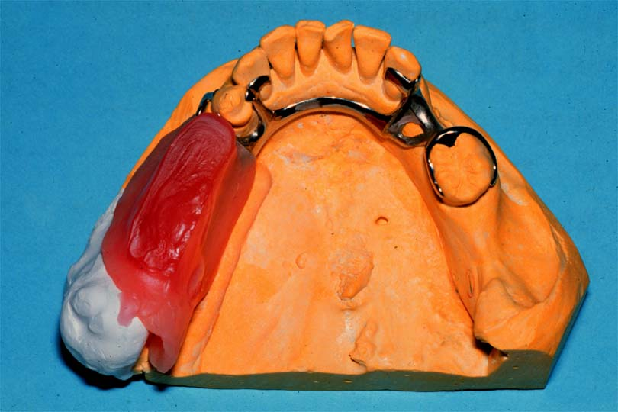
Record Base for Wax Setup
Place Denture Base
  Hard baseplate wax
    Easier to remove during processing
    Can melt or distort
  Acrylic resin
    Harder to remove
    More rigid and stable for jaw relation

Slide 110
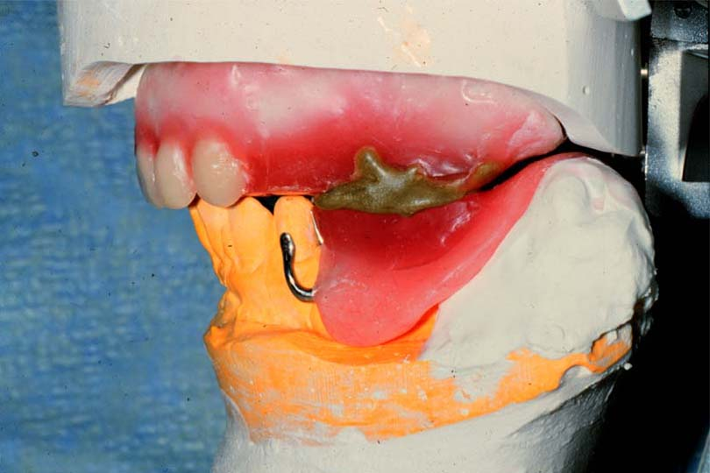
Jaw Relation Records
Mount Casts on Articulators
  Centric Record
    Maxilla to mandible position
  Protrusive Record
    Program articulator for excursions

Slide 111
References
McCracken’s Removable Prosthodontics, 11th Edition 2005 by McGivney GP, Carr AB. Chapter 16
Dalhousie continual education

Slide 112
Support for the Distal Extension Denture Base

Slide 113
Factors Influencing Support of the Distal Extension Base
1. Contour and quality of the residual ridge
2. Extent of residual ridge coverage by the denture base
3. Type and accuracy of the impression registration
4. Accuracy of the fit of the denture base
5. Design of RPD framework
6. Total occlusal load applied

Slide 114
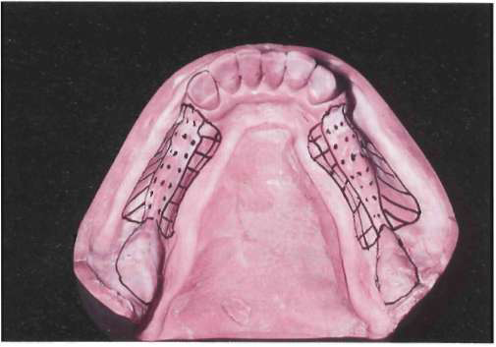
Contour and Quality of the Residual Ridge (Mandibular)
Notes:
Dotted portion outlines crest of residual ridge, which should be recorded in its anatomic form in impression procedures. Similarly, retromolar pads should not be displaced by impression. Buccal shelf regions (diagonal lines) serve as primary support and therefore additional pressures may be placed on these regions for vertical support of denture base. Lingual slopes of residual ridge (cross-hatched) may furnish some vertical support to restoration; however, these regions principally resist horizontal rotational tendencies of denture base and should be recorded by impression in undisplaced form.

Slide 115
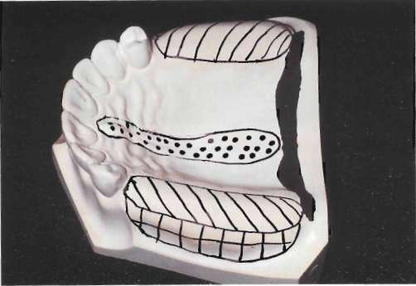
Contour and Quality of the Residual Ridge (Maxillary)
Notes:
Crest of maxillary residual ridge (diagonal lines) is primary supporting region for maxillary distal extension denture base. Buccal and palatal slopes may furnish limited vertical support to denture base. It seems logical that their primary role is to counteract horizontal rotational tendencies of denture base. Dotted portion outlines incisive papilla and median palatal raphe. Relief must be provided for these regions, especially if tissues covering palatal raphe are less displaceable than those covering crest of residual ridge.

Slide 116
Contour and Quality of the Residual Ridge
The immediate crest of the bone of the maxillary
residual ridge may consist primarily of cancellous
bone. Unlike in the mandible, oral tissue that overlies
the maxillary residual alveolar bone is usually of a
firm, dense nature (similar to the mucosa of the hard
palate) or can be surgically prepared to support a
denture base.

Slide 117
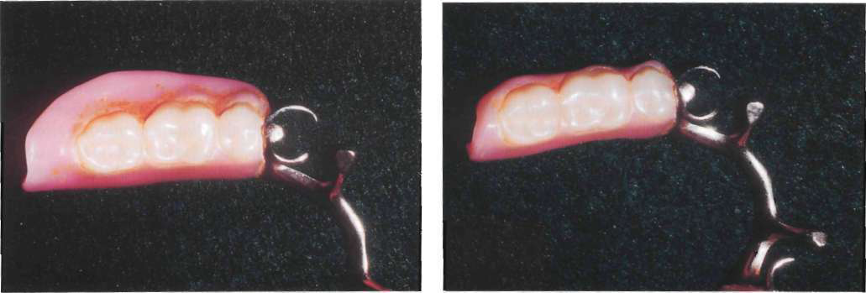
Extent of Residual Ridge Coverage by the Denture Base
Notes:
The broader the residual ridge coverage, the greater the distribution of the load, which results in less load per unit area. A denture base should cover as much of the residual ridge as possible and be extended the maximum amount within the physiological tolerance of the limiting border structures or tissue.

Slide 118
Design of RPD Framework
Mesial Rest Concept
  Provides axis of rotation that directs applied forces in more vertical direction so more of residual ridge receives vertically directed occlusal forces to support denture base
  Will tend to tip terminal abutment tooth mesially & thus be reinforced by other adjacent teeth

Slide 119
Total Occlusal Load Applied
The number of artificial teeth, the width of their occlusal surfaces, and their occlusal efficiency influence the total occlusal load applied to RPD
Kaires concluded "the reduction of the size of the occlusal table reduces the vertical and horizontal forces that act on RPD & lessens the stress on the abutment teeth & supporting tissue

Slide 120
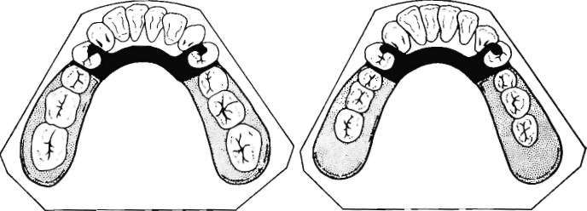
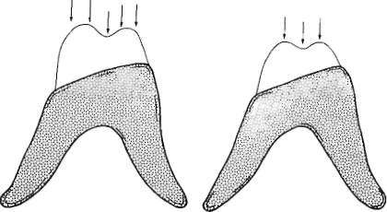
Total Occlusal Load Applied
Notes:
Total occlusal load applied may be reduced by using comparatively smaller posterior teeth represented by right-hand illustration. Less muscular force will be required to penetrate food bolus with reduced occlusal table, thereby reducing forces to supporting oral structures.

Slide 121
Type and Accuracy of the Impression Registration
Comparison of anatomic and functional ridge forms. Original mandibular
cast showing left residual ridge area recorded in its anatomic form. Buccal shelf region is outlined. Right: same cast after left residual ridge area has been repoured to its functional form as recorded by secondary impression. Functional form is less irreqular *
Notes:
A denture base processed to the functional form is generally less irregular and has greater area coverage than
does a denture base processed to the anatomic or resting form. Moreover, and of far greater significance, a denture base made to anatomic form exhibits less stability under rotating and/or torquing forces than does a denture base processed to functional form and thus fails to maintain its occlusal relation with the opposing teeth.

Slide 122
References
McCracken’s Removable Prosthodontics, 11th Edition 2005 by McGivney GP, Carr AB. Chapter 16

