Slide 1
Direct Retainers
Rola M. Shadid, BDS, MSc

Slide 2
The direction of forces can be toward, across, or away from the tissue.
In general, the forces acting to move prostheses toward and across the supporting teeth and/or tissue are the greatest in intensity. This is
because they are most often forces of occlusion.

Slide 3
TERMINOLOGY
Support
Stability
the quality of a prosthesis to be firm, stable, or constant and to resist displacement by functional, horizontal, or rotational stresses.

Slide 4
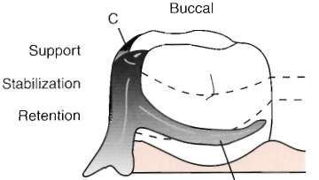
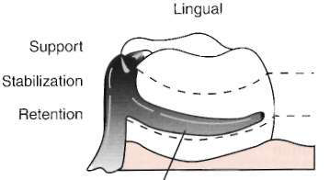
TERMINOLOGY
Reciprocation
resistance to retentive forces, resistance to orthodontic movement of teeth using reciprocal arms or elements placed against guiding planes. *
Notes:
During placement and removal of the partial denture the retentive arm flexes over the height of contour and generates energy. At this point, the rigid reciprocal arm should contact the guiding plane and prevent orthodontic movement from taking place

Slide 5
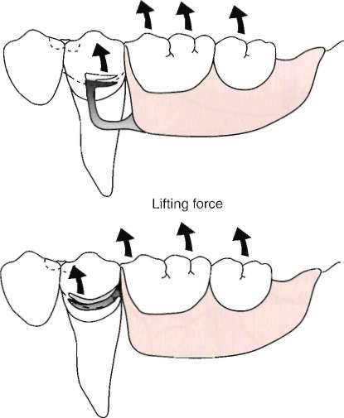

Slide 6
TERMINOLOGY
Retention is that quality inherent in the denture that resists the vertical forces of dislodgment (e. g., the force of gravity, the adhesiveness of foods, or the forces associate with the opening of the jaws).
An abutment is a tooth, a portion of a tooth, or a
portion of an implant that serves to support and/or retain a prosthesis.

Slide 7
TERMINOLOGY
Direct retainer
Any unit of RPD that engages an abutment tooth to resist displacement of the prosthesis away from basal seat tissue.
Greatly influenced by the stability and support of the prosthesis provided by major and minor connectors, rests, and tissue bases.

Slide 8
TERMINOLOGY
Primary retention for RPD is accomplished mechanically by placing retaining elements (direct retainers) on the abutment teeth.
Secondary retention is provided by the intimate relationship of the minor connector contact with the guiding planes; denture bases, and major connectors (maxillary) with the underlying tissue.

Slide 9
TERMINOLOGY
Clasp retention is based on the resistance to deformation of the metal. For a clasp to be retentive, it must be placed in an undercut area of the tooth where it is forced to deform upon application of a vertical dislodging force

Slide 10
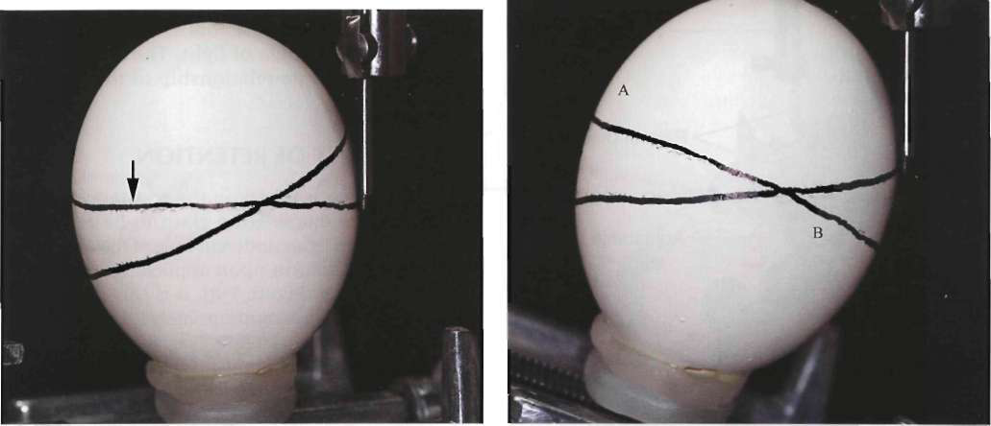
TERMINOLOGY
The term height of contour is defined as a line encircling a tooth, designating its greatest circumference at a selected position determined by a dental surveyor.

Slide 11
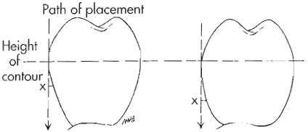
TERMINOLOGY
The term undercut, when used in reference to an abutment tooth, is that portion of a tooth that lies between the height of contour and the gingiva;
when it is used in reference to other oral structures, undercut means the contour or cross section of a residual ridge or dental arch that would prevent the placement of a denture.

Slide 12
TERMINOLOGY
The angle of cervical convergence is an angle viewed between a vertical rod contacting an abutment tooth and the axial surface of the abutment cervical to the height of contour.

Slide 13
Components of Clasp Assembly
Minor connectors from which clasp components originate.
Principal rest designed to direct stress along the long axis of the tooth.
Retentive arm engaging a tooth undercut. For most clasps, the retentive region is only at its terminus.
Non-retentive arm (or other component) on the opposite side of the tooth for stabilization and reciprocation against horizontal movement of the prosthesis (rigidity of this clasp arm is essential to its purpose).

Slide 14
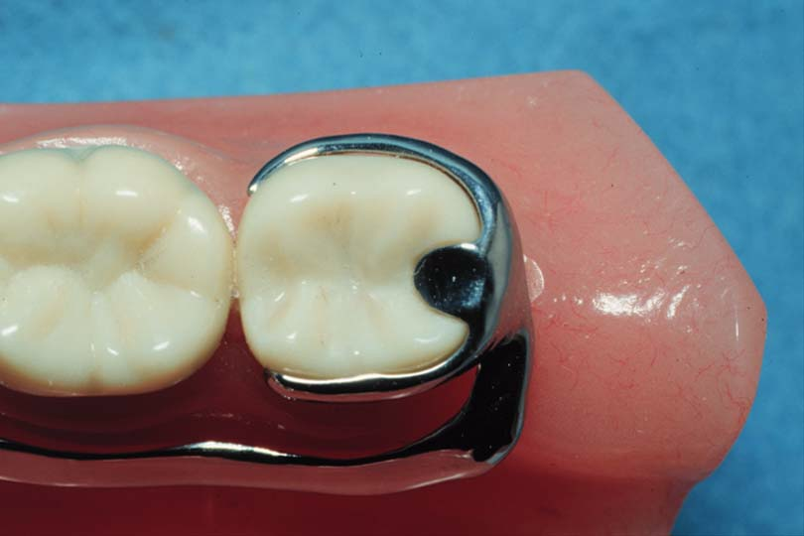
Requirements of Direct Retainers
1. Support
  rests

Slide 15
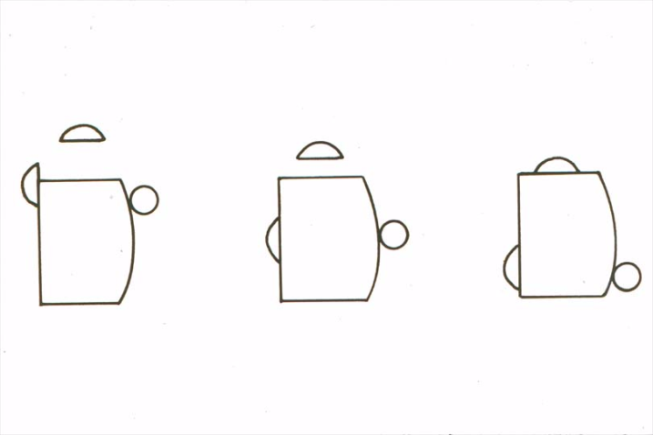
Requirements of Direct Retainers
2. Reciprocation
  bracing arms, minor connectors

Slide 16
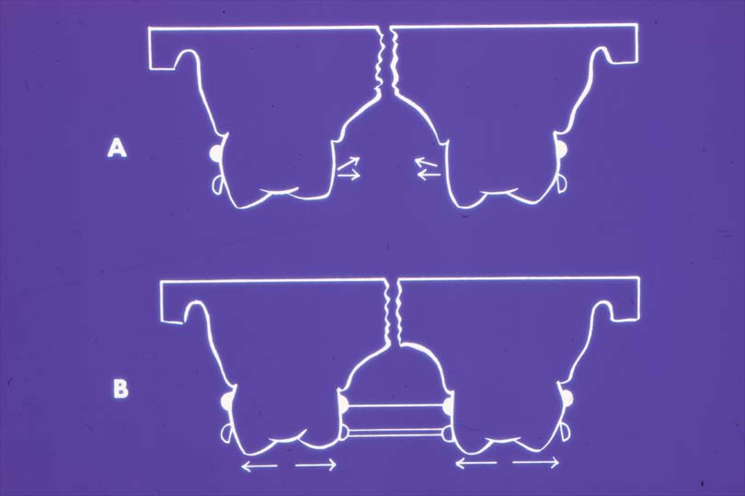
Requirements of Direct Retainers
3. Stability
  resist horizontal movement
  rest, minor connector, bracing arm

Slide 17
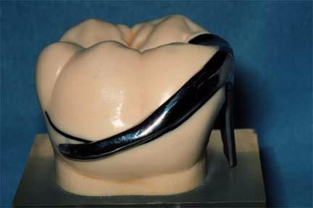
Requirements of Direct Retainers
4. Retention
  retentive arm

Slide 18
Types of clasp assembly
1. Circumferential (suprabulge clasp) is used to designate a clasp arm that originates above the height of contour and approaches the tooth undercut from an occlusal direction.

Slide 19
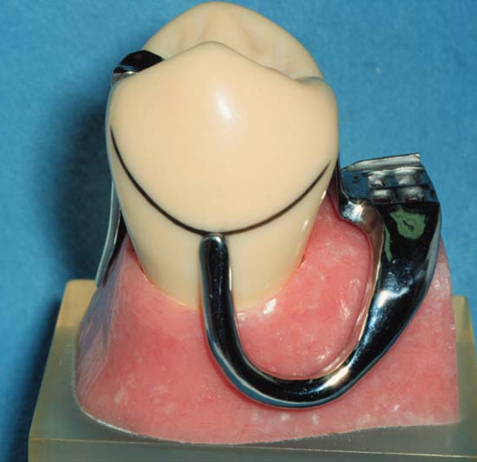
2. Bar clasp (Roach clasp, infrabulge) is a type of extracoronal retainer that originates from the denture base or framework, traverses soft tissue, & approaches the tooth undercut area from a gingival direction. *
Notes:
The bar clasp arm has been classified by the shape of the retentive terminal. Thus it has been identified as a T, modified T, I, S, or Y.

Slide 20
Amount of Retention
1. The size of the angle of cervical convergence (depth of undercut) and how far the clasp terminal is placed into the angle of cervical convergence.
2. The flexibility of the clasp arm:
Clasp length
Clasp relative diameter
Clasp cross-sectional form or shape (whether it is round, half round, or some other form)
The material used in making the clasp

Slide 21
Size of and Distance Into the Angle of Cervical Convergence *
A
B
Notes:
Angle of cervical convergence on two teeth presenting dissimilar contours. Greater angle of cervical convergence on tooth A necessitates placement of clasp terminus, X, nearer the height of contour than when lesser angle exists,as in B. It is apparent that uniform clasp retention depends on depth (amount) of tooth undercut rather than on distance below the height of contour at which clasp terminus is placed.

Slide 22
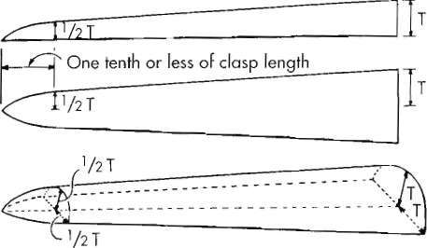
Length of Clasp Arm
The longer the clasp arm the more flexible it will be, all other factors being equal.
The length of cast clasp arm is measured from the point at which a uniform taper begins
The retentive circumferential clasp arm should be tapered uniformly from its point of origin through the full length of the clasp arm

Slide 23
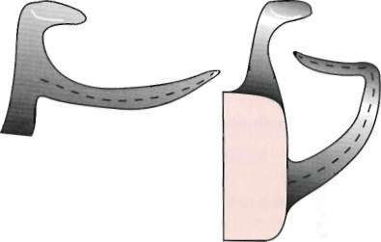
Length of Clasp Arm
Although a bar clasp arm will usually be longer than a circumferential clasp arm, its (bar) flexibility will be less because its half-round form lies in several planes, which prevents its flexibility from being proportionate
to its total length.

Slide 24
Diameter of Clasp Arm
  Clasp Flexibility
  Diameter
    inversely proportional
    use uniform taper *
Notes:
If its taper is absolutely uniform, the average diameter will be at a point midway between its origin and its terminal end.

Slide 25

Cross-sectional Form of the Clasp Arm
The only universally flexible form is the round form
Flexibility is limited to only 2 directions in the case of the half-round form.
Cast retentive clasp arms are more acceptable in tooth-supported partial dentures in which they are called on to flex only during placement and removal of the prosthesis

Slide 26
Cross-sectional Form of the Clasp Arm
A retentive clasp arm on an abutment adjacent to a distal extension base not only must flex during placement and removal but also must be capable of flexing during functional movement of the distal extension base.
A round clasp is the only circumferential clasp form that may be safely used to engage a tooth undercut on the side of an abutment tooth away from the distal extension base, * to avoid transmission of tipping stresses to the abutment tooth
Notes:
The location of the undercut is perhaps the single most important factor in selecting a clasp for use with distal extension partial dentures.

Slide 27
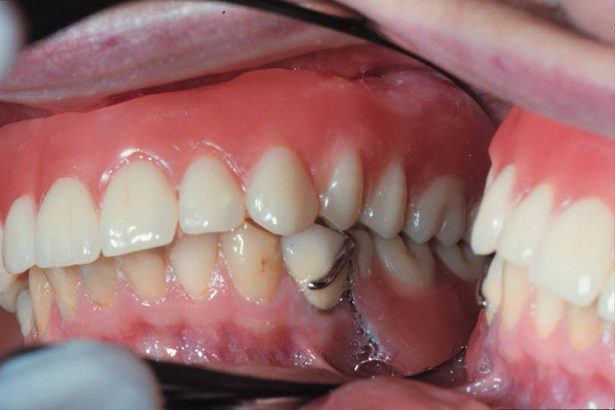
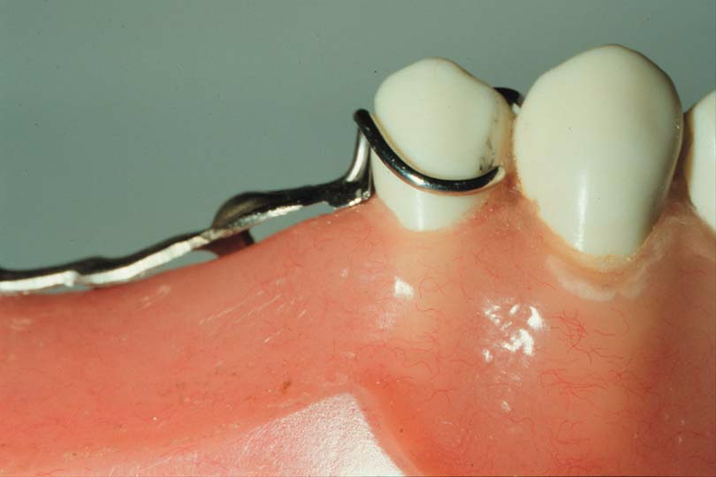
Material Used for the Clasp Arm
Clasp Flexibility
  Material
    Cast is less flexible
    Wrought wire
      greater tensile strength
      flexibility without fatigue

Slide 28
Material Used for the Clasp Arm
Greater rigidity with less bulk is possible through use of chromium-cobalt alloys*
Cast is less flexible8
Wrought wire
      greater tensile strength
      flexibility without fatigue
Notes:
A disadvantage of a cast gold partial denture is that its bulk must be increased to obtain the needed rigidity at the expense of added weight and increased cost.

Slide 29
BASIC PRINCIPLES OF CLASP DESIGN
principle of encirclement
Encircle > 180 °
Notes:
Purposes of Encirclement:
it ensures the stability of the tooth position because of the restraint from encirclement
it ensures stability of the clasp assembly because of the controlled position of the clasp in three dimensions

Slide 30
BASIC PRINCIPLES OF CLASP DESIGN
2. The occlusal rest must be designed to prevent the movement of the clasp arms toward the cervical.

Slide 31
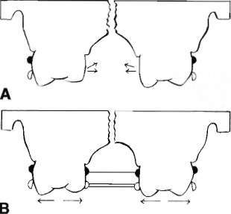
BASIC PRINCIPLES OF CLASP DESIGN
3. Each retentive terminal should be opposed by a
reciprocal component capable of resisting any transient pressures exerted by the retentive arm during placement and removal. *
Notes:
Stabilizing and reciprocal components must be rigidly connected bilaterally (cross-arch) to realize reciprocation of the retentive elements

Slide 32
BASIC PRINCIPLES OF CLASP DESIGN
4. Clasp retainers on abutment teeth adjacent to distal
extension bases should be designed so that
they will avoid direct transmission of tipping and
rotational forces to the abutment. In effect, they
must act as stress-breakers either by their design
or by their construction. This is accomplished
through proper location of the retentive terminal
relative to the rest or by use of a more flexible
clasp arm in relation to the anticipated rotation of
the denture under functional forces.

Slide 33
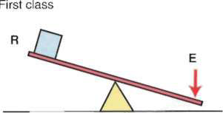
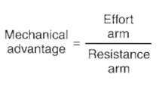
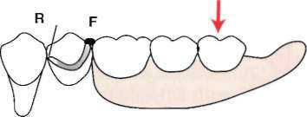
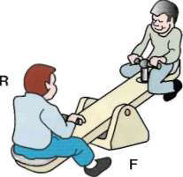

Slide 34
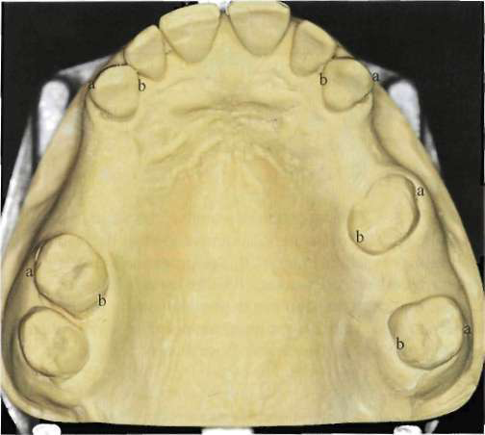
BASIC PRINCIPLES OF CLASP DESIGN
5. Unless guiding planes will positively control the path of removal and stabilize abutments against rotational movements, retentive clasps should be bilaterally opposed, i. e., buccal retention on one side of the arch should be opposed by buccal retention on the other, or lingual on one side opposed by lingual on the other.

Slide 35
BASIC PRINCIPLES OF CLASP DESIGN
6. The path of escapement for each retentive clasp
terminal must be other than parallel to the path
of removal for the prosthesis to require clasp engagement with the resistance to deformation (that is retention)

Slide 36
BASIC PRINCIPLES OF CLASP DESIGN
7. The amount of retention should always be the minimum necessary to resist reasonable dislodging forces.

Slide 37
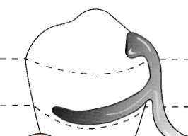
BASIC PRINCIPLES OF CLASP DESIGN
8. Reciprocal elements of the clasp assembly should be located at the junction of the gingival and middle thirds of the crowns of abutment teeth.

Slide 38
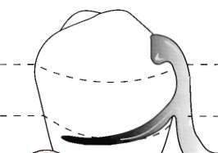
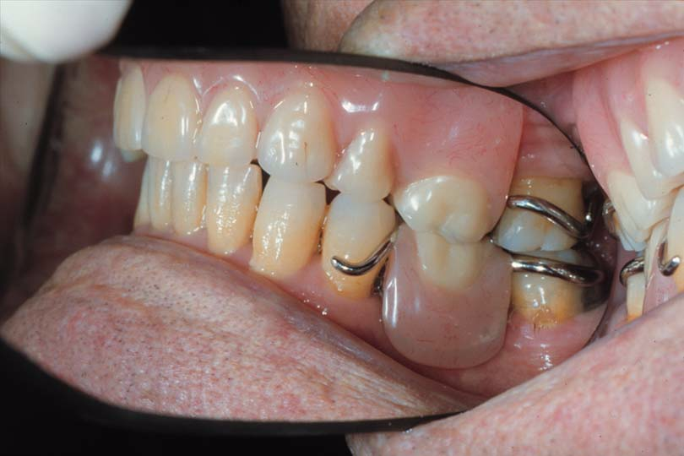
BASIC PRINCIPLES OF CLASP DESIGN
Placement of Retentive Arm *
Middle to Lower 1/3 of Tooth
  Tipping forces
  Esthetics
  Occlusal interferences
Notes:
The terminal end of the retentive arm is optimally placed in the gingival third of the crown

Slide 39
BASIC PRINCIPLES OF CLASP DESIGN
9. Passivity : at rest, a direct retainer should not exert force against a tooth

Slide 40
Stabilizing/ Reciprocal Arm Functions
1. to resist tooth movements in response to the retainer arm deforming as it engages a tooth height of contour.

Slide 41
Stabilizing/ Reciprocal Arm Functions
2. To stabilize the denture against horizontal
movement. Stabilization is possible only through the use of rigid clasp arms, rigid minor connectors, and a rigid major connector. Horizontal forces applied on one side of the dental arch are resisted by the stabilizing components on the opposite side providing cross-arch stability

Slide 42
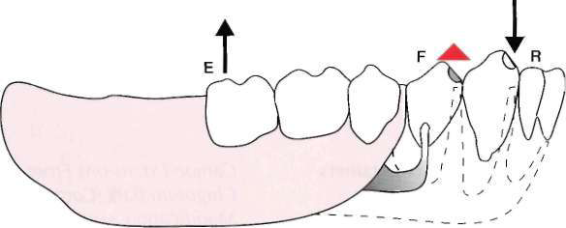
Stabilizing/ Reciprocal Arm Functions
3. The reciprocal clasp arm also may act to a minor degree as an indirect retainer.

Slide 43
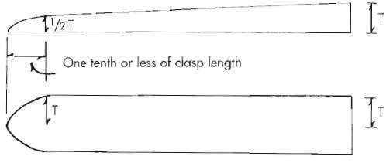
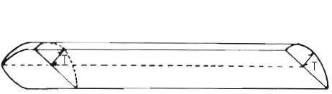
Stabilizing/ Reciprocal Arm Properties
Should be rigid.
Its average diameter must be greater than the average diameter of the opposing retentive arm
A cast retentive arm is tapered in two dimensions, whereas a reciprocal arm should be tapered in one dimension only

Slide 44
Direct Retainer Selection
Principal
Pick a retainer to suit the existing teeth rather than prepare the tooth to fit a particular direct retainer design

Slide 45
Is there any difference betw. tooth-borne & tooth- tissue borne RPDs in terms of movement?

Slide 47
Types of Direct Retainers
Clasps Designed to Accommodate Functional
Movement
Clasps not Designed to Accommodate Functional Movement

Slide 48
Direct Retainer Selection
Class I & II (Tooth & Tissue-Borne)
  Stress releasing direct retainers *
Class III & IV (Tooth-Borne)
  Non-stress releasing direct retainers
Notes:
Compensate for difference in movement of teeth and mucosa

Slide 49
Stress Releasing Retainers
Consider when:
  Distal extension (Cl I & II)
  Abutment periodontally involved
  Displaceable mucosal support
  Extensive edentulous space

Slide 50
  Clasps Designed Without Movement
  Accommodation (Non-Stress Releasing Direct Retainers)
(Tooth-Borne) Class III, class IV

Slide 51
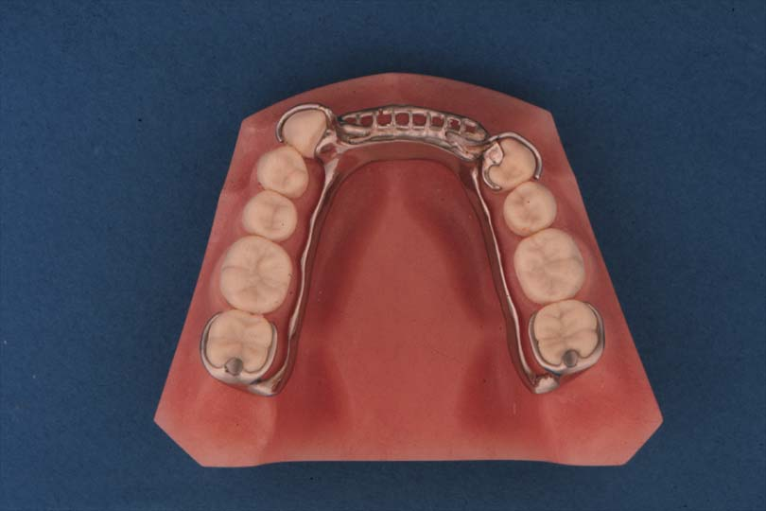
Rest Placement: Tooth-Borne RPD’s
Adjacent to Edentulous Space
  Most effective placement of support
  Ease of preparation
  Reduces minor connectors
  Very rare exceptions

Slide 52
Retainer Selection: Tooth-Borne RPD’s
Minimal rotation
  Cast Circumferential
  Ring Clasp
  Embrasure Clasp (Double Akers)
  Reverse Action (‘C’) Clasp

Slide 53
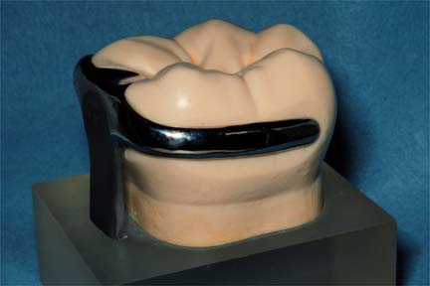
Cast Circumferential (Akers)
Buccal
Clasp of choice
Retentive & bracing arms originate from rest
Lingual

Slide 54
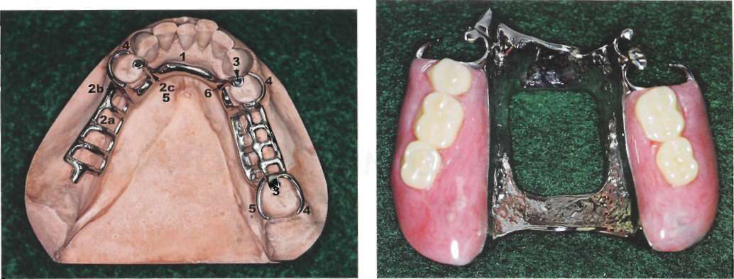

Slide 55
Advantages of Cast Circumferential
Simple to construct
Hygienic *
Excellent stabilization & bracing
Notes:
Less potential for food accumulation below the clasp compared to bar clasps

Slide 56
Disadvantages of Cast Circumferential
Less esthetic than bar clasps *
Increase the width of the occlusal surface of some teeth #
More difficult to adjust than wrought wire ¶
Notes:
*More tooth surface is covered than with a bar clasp arm because of its occlusal origin.
In the mandibular arch, more metal may be displayed than with the bar clasp arm.
#particularly the buccal surface of mandibular teeth and the lingual surfaces of maxillary teeth.
¶ As with all cast clasps, its half-round form prevents adjustment to increase or decrease retention. Adjustments in the retention afforded by a cast clasp arm should be made by moving a clasp terminal cervically into the angle of cervical convergence or occlusally into a lesser area of undercut
Therefore, true adjustment is impossible with most cast clasps.

Slide 57
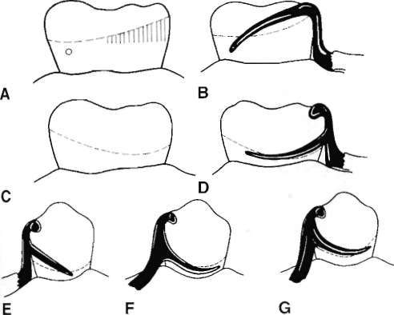
Improper designs of circumferential clasp
Notes:
straight arm configuration provides poor approach to retentive area and is less resistant to
dislodging force

Slide 58
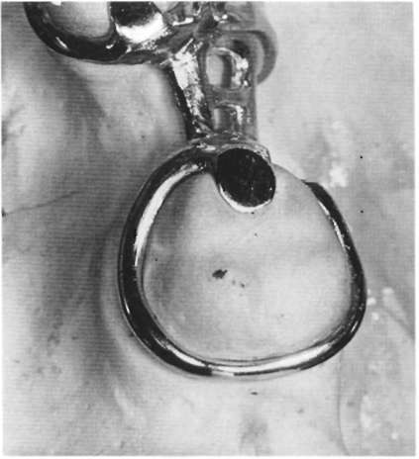
Ring Clasp
Tilted abutments
Usually mesially and lingually tilted mandibular molars(with m-L undercut) or mesially and buccally tilted maxillary molars (with m-b undercut)
Undercut on same side as the rest (adjacent to edentulous span)

Slide 59
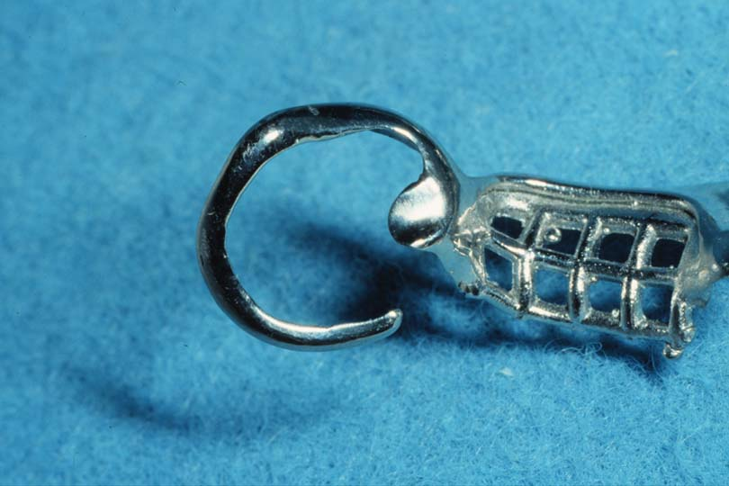
Ring Clasp
Supporting strut and auxiliary rest *
  resists flexure
Excellent bracing
Notes:
The ring-type clasp should always be used with a supporting strut on the nonretentive side, with or without an auxiliary occlusal rest on the opposite marginal ridge

Slide 60
Ring Clasp
Poor hygiene
Very difficult to adjust
Contraindicated with excessive tissue undercuts (support strut)

Slide 61
Ring Clasp
Use a cast circumferential clasp with lingual retention and buccal bracing, in preference to a ring clasp whenever possible, unless a severe tilt of the tooth will not permit, and cannot be approached with a bar clasp arm because of lingual inclination of the tooth.

Slide 62
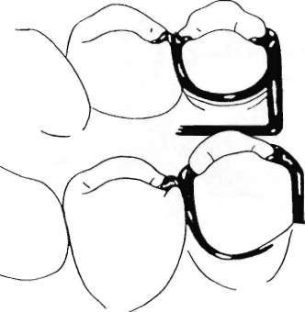
Ring Clasp
A ring-type clasp may be used in reverse on an abutment located anterior to a tooth-bounded edentulous space
The only justification for its use is when a distobuccal or distolingual undercut cannot be approached directly from the occlusal rest area and/or tissue undercuts prevent its approach from a gingival direction with a bar clasp arm.

Slide 63
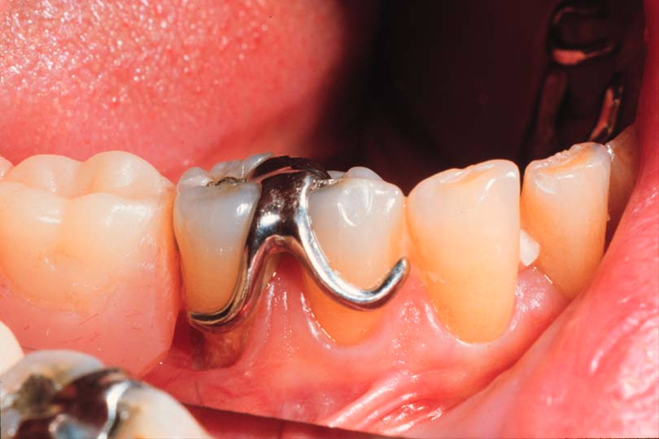
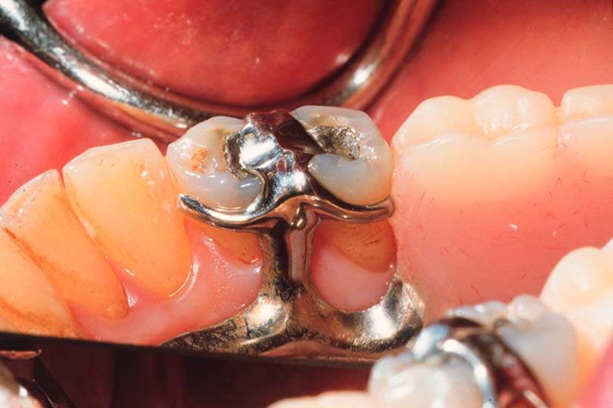
Embrasure Clasp
Buccal
Two rests, two retentive arms, two bracing arms
Requires extensive preparation
Rests must be positive to prevent wedging
Hygiene
Lingual

Slide 64
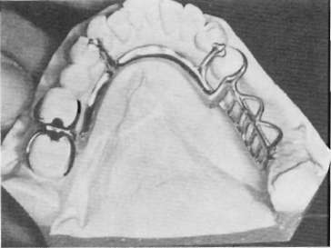
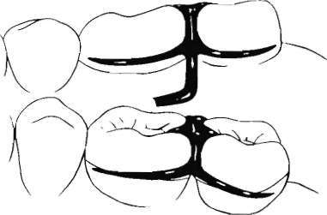
Embrasure Clasp
Unmodified Class II or Class III partial denture, there are no edentulous spaces on the opposite side of the arch to aid in clasping
Abutment protection with inlays or crowns is recommended.

Slide 65
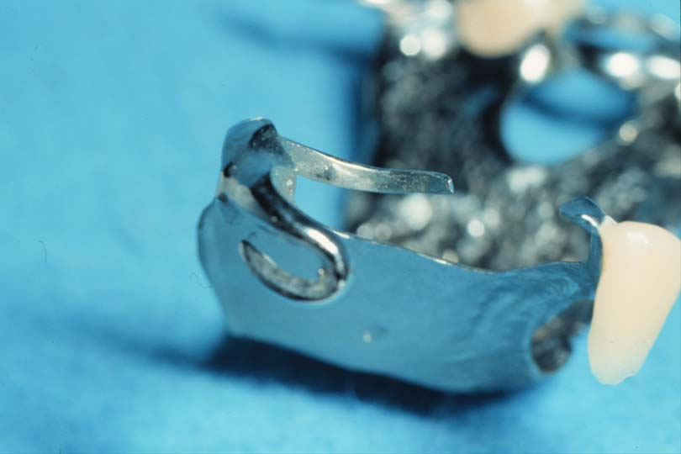
Reverse Action Clasp ("C"Clasp, Hairpin)
Undercut adjacent to edentulous space *
Almost impossible to adjust
Poor esthetics esp. on anterior abutment, poor hygiene
Clearance from opposing occlusion
Limited flexibility (esp. short crowns)
Notes:
You could use a ring clasp or a bar clasp instead.

Slide 66
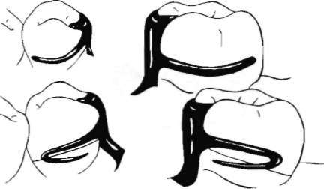
Reverse Action Clasp ("C"Clasp, Hairpin)

Slide 67
Tooth-Borne Direct Retainers
Cast circumferential clasps
Exceptions
  Use stress-releasing clasps when:
  Esthetics *
    use bar or wrought wire
  Poor prognosis for posterior abutment
    allows conversion to distal extension
  Abutments are mobile, the tooth borne segment is extensive, the use of the stress-breaking clasps should be considered
Notes:
Since wrought-wire clasps can be placed into greater undercuts (0.02") than cast clasps (0.01") they can be placed lower on teeth, allowing better esthetics in some cases. Infrabulge clasps are also less visible.

Slide 68
Disadvantages of cast circuferential clasp
1. Create a "pump-handle" action on the abutment teeth in distal extension cases if the guiding plane on the distal surface is too long, with insufficient relief.
2. Some clasps can be ineffective on teeth tilted buccally or lingually
3. Some varieties cover more tooth surface than is desirable
4. Poor esthetics in the anterior region

Slide 70
Tooth-Tissue Borne Direct Retainers
Denture base moves toward tissue in function
Rotation around rests
Use stress-releasing direct retainers

Slide 71
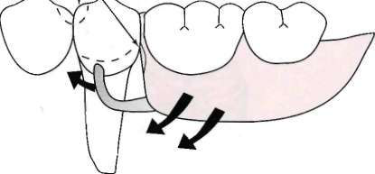
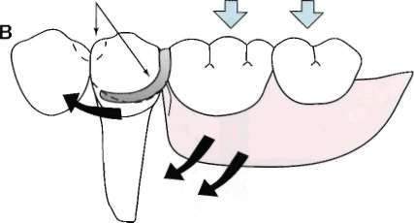
Stress-Releasing Direct Retainers
2 strategies are adopted to either
1. change the fulcrum location and subsequently the "resistance arm" engaging effect (mesial rest concept)
2. use of flexible arm (wrought-wire retentive arm).

Slide 72
Stress-Releasing Direct Retainers
Mesial Rest Concept
  Rotation: retentive tip, proximal plate
  Move mostly down (and forward)
  Into more undercut (release of tooth)

Slide 73
Non-Stress-Releasing Direct Retainers
Distal Rest
  Rotation: retentive tip, proximal plate
  Move mostly forward (tip rotates up)
  Toward height of contour (activate or bind)

Slide 74
Distal Rest Concept
Long Guiding Planes
  Binding, torque
  Not advisable
Short Guiding Planes
  proximal plate moves into space, escape of rest
  Acceptable, if mesial rest not possible

Slide 75
Tooth-Tissue -Borne RPD's
Use mesial rest to reduce torque
  Exceptions:
    Large mesial restoration
    Heavy mesial occlusion
    Insufficient room for rest or minor connector (rotations)
    Modification spaces

Slide 76
Mesial Rest Concept Clasps
RPI and RPA clasps

Slide 77
Retainer Selection: Tooth-Tissue Borne RPD’s
Stress-releasing Clasps
  RPI Clasp *
  RPA Clasp
  Combination Clasp

Slide 78
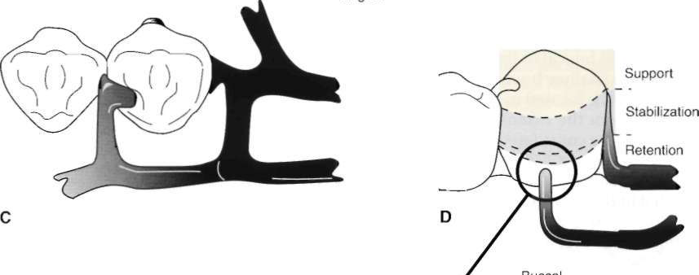
RPI Clasp
"R" Rest (always mesial)
"P" Proximal Plate (distal)
"I" I - Bar (buccal) *
Notes:
I - bar most common
S - bar used to avoid large soft tissue undercut
"Y", "T", "L", and "U" less useful

Slide 79
RPI Clasp
Retentive arm mid-buccal * except canines (mesio-buccal)
No more than 2 mm of its tip contacting abutment
I-bar should be located in gingival third of buccal or labial surface of abutment in 0. 01-inch undercut
Horizontal portion of approach arm must be located at least 4 mm from gingival margin
Notes:
Distobuccal undercut not useful (less than 180°)

Slide 80
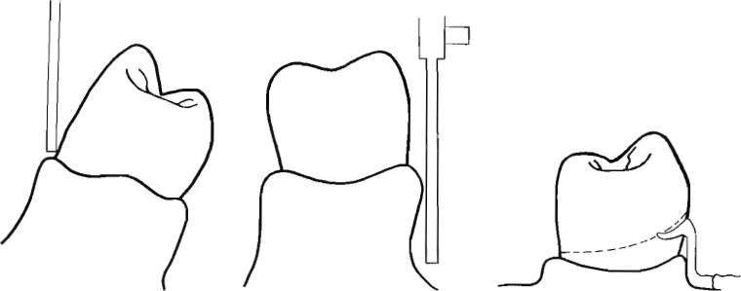
Contraindications for a Bar-Type
Clasp
Deep cervical undercut
Excessive buccal or lingual tilt of abutment tooth
Shallow buccal vestibule *
High frenal attachments
Notes:
Requires 4 mm from free gingival margin - 3 mm for clearance, 1mm for thickness of arm

Slide 81
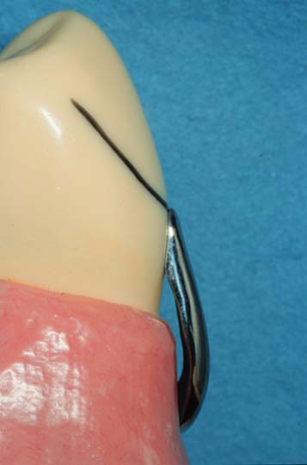
Contraindications for a Bar-Type
Clasp
Large soft tissue undercut
  food impaction
Disto-buccal undercut
  ≤ 180° encirclement

Slide 82
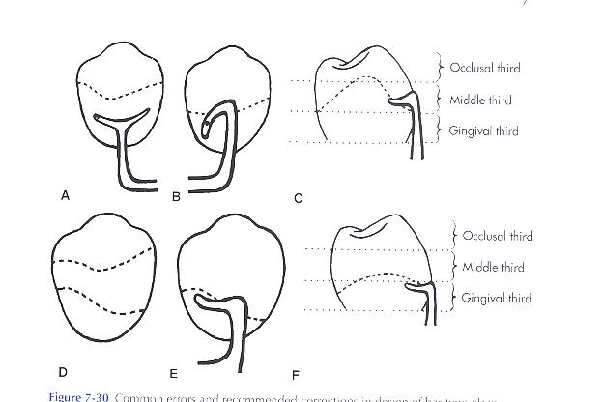
Common errors and recommended corrections in design of bar-type clasp

Slide 83
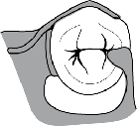
RPA Clasp
"R" Rest (always mesial)
"P" Proximal Plate (distal)
"A" Aker's retentive arm (always wrought wire)

Slide 84
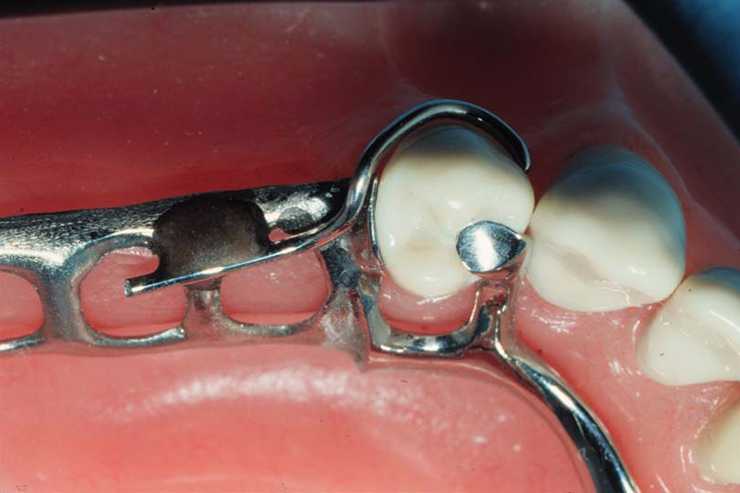
RPA Clasp
Similar to RPI except except suprabulge wrought wire clasp is used instead of I-bar
Used where infrabulge approach not possible *
Notes:
It is used when you can’t use bar clasp in vestibule and desirable undercut is located in gingival third of tooth away from extension base area (mesiobuccal)

Slide 85
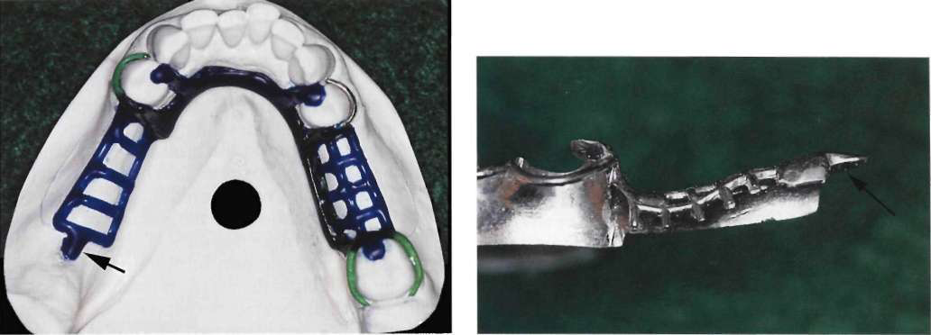
RPA Clasp

Slide 86
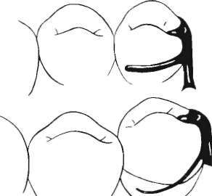
Combination Clasp
Wrought-wire retentive clasp arm & cast reciprocal clasp arm
Bracing and retentive arms originate from distal rest
Guiding plane must not run entire occluso-gingival height

Slide 87
Combination Clasp
Advantages
-flexibility,
-adjustability,
-appearance
-minimum of tooth covered
-less fatigue failure

Slide 88
Indications of Combination Clasp
The most common use of the combination clasp is on an abutment tooth adjacent to a distal extension base where only a mesial undercut exists on the abutment or where a large tissue undercut contraindicates a bar-type retainer
It is used when maximum flexibility is desirable, such as on an abutment tooth adjacent to a distal extension base or on a weak abutment when a bar-type direct retainer is contraindicated.

Slide 89
Indications of Combination Clasp
It may be used for its adjustability when precise retentive requirements are unpredictable and later adjustment to increase or decrease retention may be necessary.
Esthetic advantage over cast clasps. Wrought in structure, it may be used in smaller diameters than a cast clasp, with less danger of fracture.
recommended for anterior abutment of posterior modification space in Class II partially edentulous arch, where only a mesiobuccal undercut exists, to minimize the effects of first-class lever system

Slide 90
Disadvantages of Combination Clasps
Involves extra steps in fabrication, particularly when high-fusing chromium alloys are used;
May be distorted by careless handling on the part of the patient;
Because it is bent by hand, it may be less accurately adapted to the tooth and therefore provide less stabilization in the suprabulge portion,
May distort with function and not engage the tooth.

Slide 91
References
WMcCracken’s Removable Prosthodontics, 11th Edition 2005 by McGivney GP, Carr AB. Chapter 7
Dalhousie continual education

