Slide 1
Denture Bases & Replacement Denture Teeth
Rola M. Shadid, BDS, MSc

Slide 2
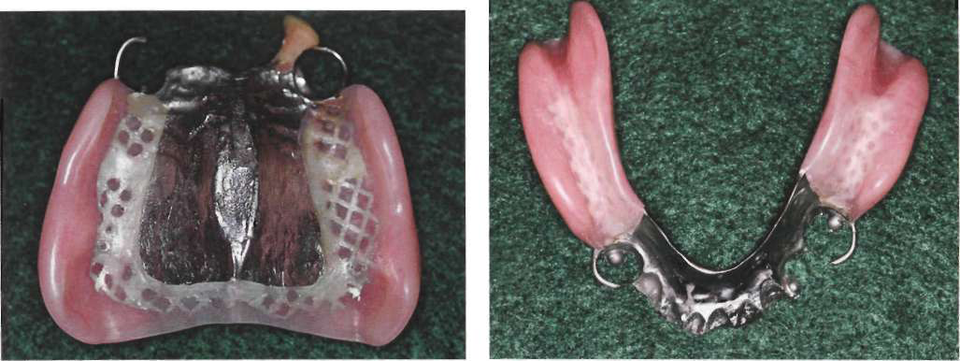
The denture base supports the artificial teeth and consequently receives the functional forces from occlusion & transfers functional forces to supporting oral structures

Slide 3
Functions of Denture Bases
1. Contribute to support of distal extension partial denture,i.e, transmission of stresses to oral tissues (primary purpose)
The snowshoe principle *
2. Support and retention of denture teeth
Notes:
In a distal extension partial denture, the denture bases other than those in tooth-supported modifications must contribute to the support of the denture. Such support is critical to the goal of minimizing functional movement and improving prosthesis stability.
The snowshoe principle, which suggests that broad coverage furnishes the best support with the least load per unit area, is the principle of choice for providing maximum support

Slide 4
Functions of Denture Bases
Improve esthetics
Stimulation of underlying tissue of the residual ridge
Prevent vertical and horizontal migration of remaining natural teeth
Eliminate undesirable food traps (oral cleanliness)
Retention from the denture bases may contribute significantly to the overall retention of the partial denture

Slide 5
Retention of Denture Bases
Retention of denture bases is result of following forces:
1) adhesion 2) cohesion 3) atmospheric pressure* 4) physiological molding of tissue around polished surfaces of denture 5) effect of gravity on mandibular denture
Notes:
* which is dependent on a border seal and results in a partial vacuum beneath the denture base when a dislodging force is applied; however, it is questionable whether atmospheric pressure plays as important a role in retention of removable partial dentures because a border seal cannot be obtained as readily as it can be with complete dentures.

Slide 6
Methods of Attaching Denture Bases
Acrylic resin bases are attached to the partial denture framework by means of a minor connector (gridwork) designed
so that a space exists between the framework and the underlying tissue of the residual ridge.
Relief of at least a 20-gauge thickness over the basal seat areas of the master cast is used to create a raised platform on the investment cast on which the pattern for the retentive frame is formed .

Slide 7
Methods of Attaching Denture Bases
Gridworks can be an open lattice work or
mesh type

Slide 8
Methods of Attaching Denture Bases
Sufficient thickness of resin (1.5 mm) to allow for relieving if this becomes necessary during the denture adjustment period or during relining procedures.*
Notes:
Thickness is also necessary to prevent weakness and subsequent fracture of the acrylic resin base material surrounding the metal framework.

Slide 9
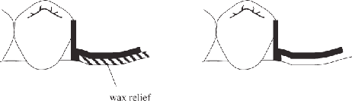

Methods of Attaching Denture Bases

Slide 10
Ideal Denture Base Material
1. Accuracy of adaptation to the tissue, with minimal volume change
2. Dense, nonirritating surface capable of receiving and maintaining a good finish
3. Thermal conductivity
4. Low specific gravity; lightweight in the mouth

Slide 11
Ideal Denture Base Material
5. Sufficient strength; resistance to fracture or
distortion
6. Easily kept clean
7. Esthetic acceptability
8. Potential for future relining
9. Low initial cost

Slide 12
Materials of Denture Bases
Acrylic Resin Bases
Metal bases

Slide 13
Acrylic Resin Bases
The most common types used
Should be routinely used in distal extension cases to allow for relining of the base to maintain mucosal support

Slide 14
Acrylic Resin Bases
Advantages:
a. ability to reline the base as the supporting tissues change
b. esthetically superior to metal bases
c. ease of repair
Disadvantages:
a. dimensional stability less than metal bases - warpage
b. lower strength than metal - long spans
c. porous - hygiene
d. low thermal conductivity

Slide 15
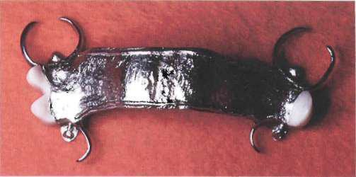
Metal Bases
Indicated for stable ridges that will change little over a long period
Cannot be relined, so they are GENERALLY not used for distal extension RPDs, or in areas where teeth have been removed within 12 months *
Notes:
(resorption will still be occurring at an increased rate and relining will be usually be required).

Slide 16
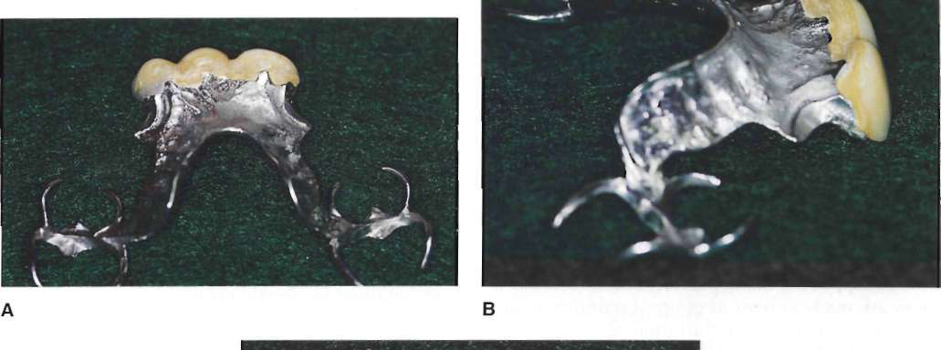
Metal Bases
Can be used for distal extension RPD with the ridge that has supported a previous partial denture without having become narrowed or flat,or without consisting primarily of easily displaceable tissue *
Notes:
The possibility that tissue will remain healthier beneath a metal base than it will beneath an acrylic resin base may justify wider use of metal bases for distal extension
partial dentures.

Slide 17


Metal Bases
Where single tooth replacements are placed, there is often insufficient room to fabricate a retentive gridwork. A full metal base is often used in these instances & denture tooth is attached to framework with acrylic resin via beading or retentive posts on metal surface.

Slide 18
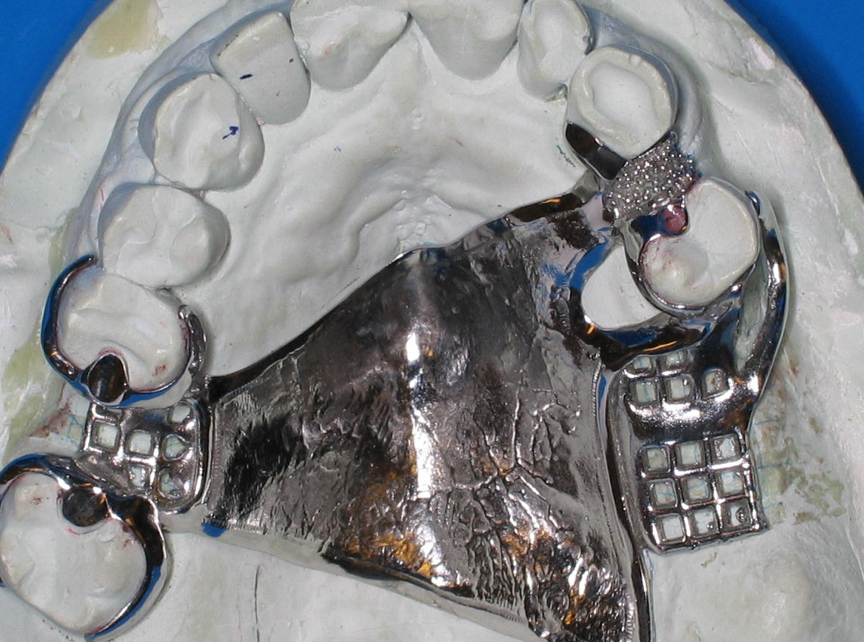
Beaded Metal Base

Slide 19
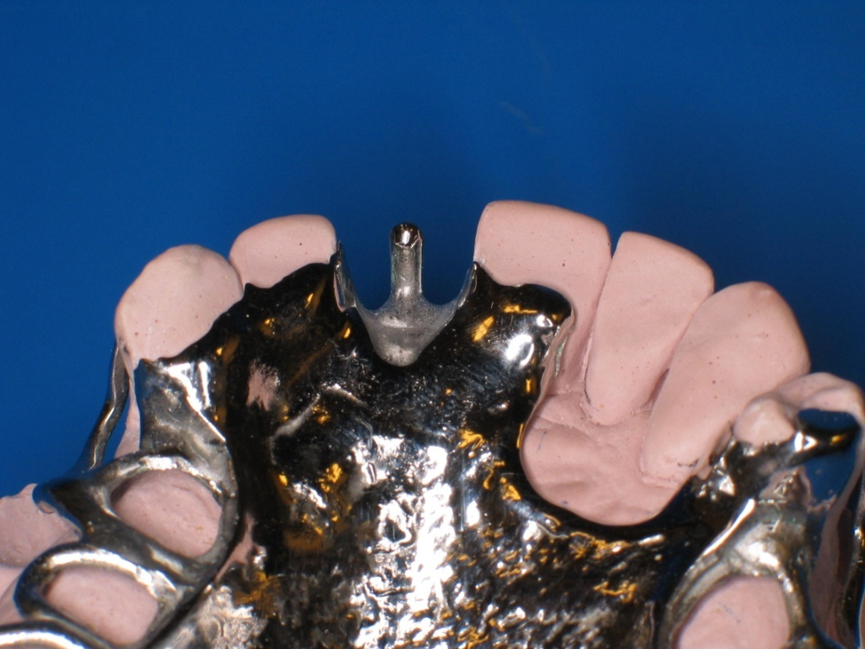
Retentive Posts

Slide 20
Advantages of Metal Bases
1. Thermal Conductivity *
2. Stimulation to the underlying tissue is so beneficial that it prevents some alveolar atrophy that would otherwise occur under a resin base
Notes:
Thermal conductivity is thought to maintain tissue health by ensuring patients do not swallow substances that are too hot. Some patients feel that improved thermal perception lessens the feeling of the denture as a foreign object.

Slide 21
Advantages of Metal Bases
3. Accuracy & permanence of form *
4. Hygiene - Metal surfaces are less porous than resin surfaces.
5. Weight and Bulk - metal bases can be cast thinner than resin bases while maintaining adequate strength. Thus, metal bases have minimal weight & bulk.
Notes:
Metal alloys cast accurately and maintain their accuracy. The accuracy in casting can eliminate the need for a posterior palatal seal. In contrast, acrylic resins distort due to release of internal strains after processing. This causes them to distort away from palate in the posterior region, thereby affecting retention. In addition, acrylic resins can imbibe or lose moisture depending on their storage conditions, leading to distortion and/or warpage if they are improperly stored. Abrasion from tooth brushing can adversely affect retention of acrylic resin bases in extreme cases.

Slide 22
Metal Bases Preferable
Sometimes, both weight & thickness may be used to advantage in denture bases to increase retention (mandibular arch), & for this reason a cast gold base may be preferable.
In areas where the tongue and cheek need maximum room, thinness of metal bases may be desirable.

Slide 23
Resin Bases Preferable
Extreme loss of residual alveolar bone may make it necessary to add fullness to denture base to restore normal facial contours
& to fill out buccal vestibule to prevent food accumulation. In such situations an acrylic resin base may be preferable to the thinner metal base.

Slide 24
Resin Bases Preferable
In the maxillary arch, an acrylic resin base may be preferable to thinner metal base to provide fullness in buccal flanges (esthetic) or to fill a maxillary buccal vestibule (retention and cleanliness) *
Notes:
but in areas where the tongue and cheek need maximum room, thinness of metal bases may be desirable.

Slide 25
Flange Extension
1.Denture bases for tooth-tissue supported partial dentures should be extended to provide the greatest available surface area for support and retention, without overextension or impingement on movable border tissues.
2.Tooth supported partial dentures need not necessarily be extended maximally, since most of the support for these dentures comes from the teeth.

Slide 26
Flange Extension
3. Maxillary distal extension denture bases should terminate in the hamular notches
4. Mandibular distal extension denture bases should terminate on the pear-shaped retromolar pads

Slide 27
Methods of Attaching Artificial Teeth
Artificial teeth may be attached to denture bases by the several means:
with acrylic resin (the most common method)
with cement
processed directly to metal, cast with the framework
chemical *
Notes:
Recent developments in resin bonding have provided a means of direct chemical bonding of acrylic resin to metal frameworks.

Slide 28
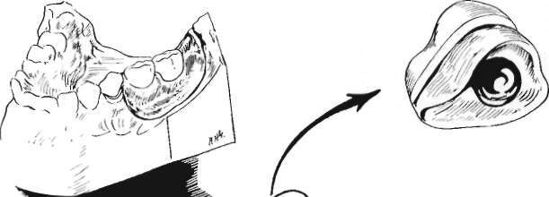
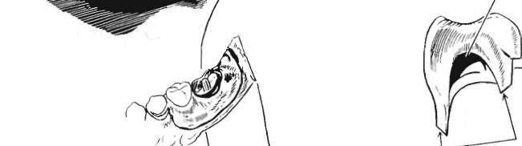
Porcelain or Acrylic Resin Artificial Teeth Attached with Acrylic Resin
Porcelain teeth are mechanically retained.
Posteriors retained by acrylic resin in their diatoric holes
Anteriors retained by acrylic resin surrounding their lingually placed retention pins
Resin teeth are retained by a chemical union with acrylic denture base *
Notes:
Attachment of the acrylic resin teeth to the metal base may be accomplished by nailhead retention, retention loops, or diagonal spurs placed at random.

Slide 29
Porcelain or Resin Tube Teeth
Cemented Directly to Metal Bases
Some disadvantages of this type are difficulties in obtaining satisfactory occlusion, the lack of adequate contours for functional tongue & cheek contact, & the unesthetic display of metal at gingival margins

Slide 30
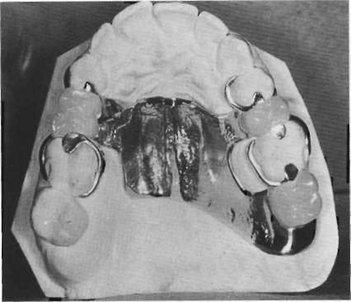
Resin Teeth Processed Directly to Metal Bases
Resin teeth are waxed to fit space and opposing occlusion, then processed or light cured to retention previously provided on metal framework *
Notes:
Unusually long, short, wide, or narrow teeth may be created when necessary to fill spaces not easily filled by the limited selection of commercially available teeth.

Slide 31
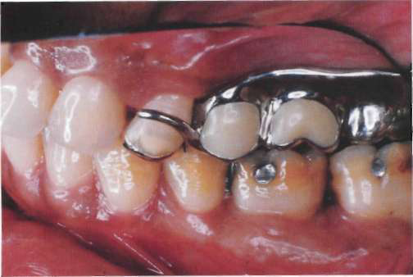
Metal Teeth
Occasionally a second molar tooth may be replaced as part of the partial denture casting
This is usually done when space is too limited for the attachment of an artificial tooth and yet the addition of a second molar is desirable to prevent extrusion of an opposing second molar

Slide 32
Need for Relining
First manifestation of change in the supporting ridge and the need for relining is a loss of occlusion between the distal extension denture base and the opposing dentition, and a return to heavy occlusal contact between remaining natural teeth. Usually this is an indication that relining is needed *

Slide 33
Need for Relining
This change is proved by having the patient close on strips of 28-gauge green casting wax, or any similar wax, and tapping in centric relation only *
Notes:
Indentations in a wax strip of known thickness are quantitative, whereas marks made with articulating ribbon are only qualitative. Indentations in the wax may be interpreted as being light, medium, or heavy, whereas it is difficult if not impossible to interpret a mark made with articulating ribbon as light or heavy. In fact, the heaviest occlusal contact may perforate paper-articulating ribbon and make a lesser mark than areas of lighter contact. In making occlusal adjustments, articulating ribbon should be used only to indicate where to relieve after the need for relief has been established by using wax strips of known thickness.

Slide 34
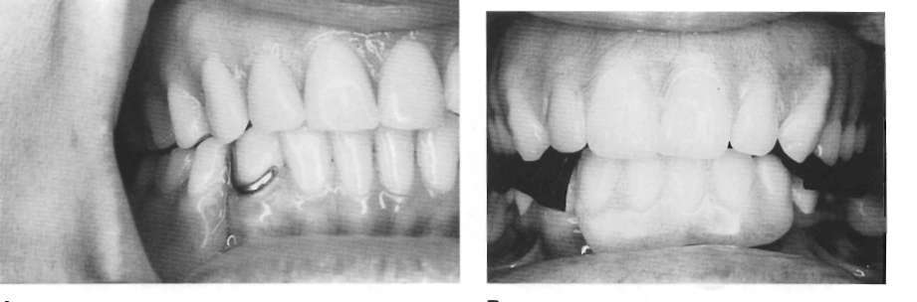
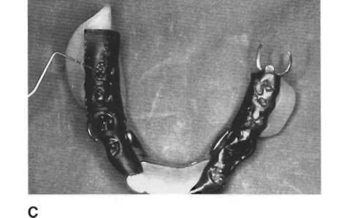

Slide 35
Need for Relining
Second manifestation of change in the supporting ridge and the need for relining is evidence of rotation about the fulcrum line with the indirect retainers lifting from their seats as the distal extension base is pressed against the ridge tissue

Slide 36
Need for Relining
If occlusal contact has been lost and rotation about the fulcrum line is evident, relining is indicated.
If occlusal contact has been lost without any evidence of denture rotation and if stability of the denture base is otherwise satisfactory, reestablishing the occlusion is the remedy rather than relining.

Slide 37
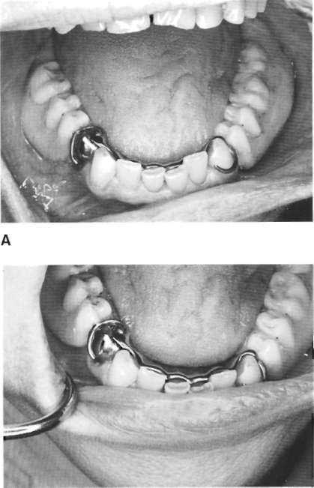

Slide 38
Acrylic resin teeth may be reestablished to compensate for wear or settling by reprocessing new acrylic resin or using light-activated acrylic resin when this becomes necessary. *
Reestablishment of occlusion may also be accomplished by placing cast gold or other suitable cast alloy restorations on existing resin teeth.
Notes:
Although this may be done on porcelain teeth as well, it is difficult to cut preparations in porcelain teeth unless air abrasive methods are used. Therefore, if later additions to occlusal surfaces are anticipated, acrylic resin teeth should be used, thereby facilitating the addition of new resin or cast gold surfaces.

Slide 39
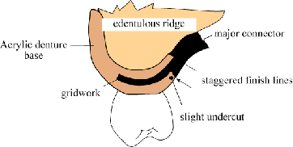
Acrylic Resin Finish Lines
Denture bases should have internal and external finish lines which do not coincide (offsetting improves the strength at metal/denture base junction) *
Notes:
Any junction of acrylic resin with metal should be at an undercut finishing line or should be associated
with some retentive undercut. Because only a mechanical attachment exists between metal and
acrylic resin, every attempt should be made to prevent separation and seepage, which results in
discoloration and uncleanliness. Denture odors are frequently caused by accretions at the junction of
the acrylic resin with metal when only a mechanical union exists. Separation occurring between the
acrylic resin and metal can eventually lead to some loosening of the acrylic resin base.

Slide 40
Acrylic Resin Finish Lines
Internal finish lines should
be placed furthest from abutment teeth.
The external metal finish line should be located approximately 2 mm lingual to the lingual surface of the replacement denture teeth.

Slide 41
References
McCracken’s Removable Prosthodontics, 11th Edition 2005 by McGivney GP, Carr AB. Chapter 9

